Slide 1

Spectral Structure of Operators in Hilbert Space
Lecture 6

Slide 2
The story so far…
We began with complex numbers.
saw that complex amplitudes carry magnitude and phase, and that geometry in complex space requires conjugation.
introduced inner products to define length and angle.
defined the adjoint as the operator determined by inner product symmetry.
saw that unitary operators preserve that geometry.
Normalized vectors in ℂ² live on a 3-sphere.

Slide 3
Eigenvalues and Eigenvectors
Augustin-Louis Cauchy (1820s) studied what he called characteristic values of matrices.
David Hilbert, in developing what we now call Hilbert spaces, popularized the German terms Eigenwert and Eigenvektor.
Eigen is a German adjective meaning “own” or “intrinsic.” (“wert” and “vector” are value and vector)
For example:
Jeder Mensch hat seine eigene Geschichte. (Everyone has their own story.)
An eigenvalue and eigenvector are therefore the intrinsic value and intrinsic direction of an operator.
They are not imposed by coordinates.
They belong to the transformation itself.
For many operators in Hilbert space, especially Hermitian and unitary operators, this intrinsic data completely determines the operator.
*In many linear algebra courses, eigenvalues and eigenvectors are presented as computational tools for diagonalizing matrices and solving systems of equations. Here, we will treat them as revealing the intrinsic structure of operators in Hilbert space.

Slide 4
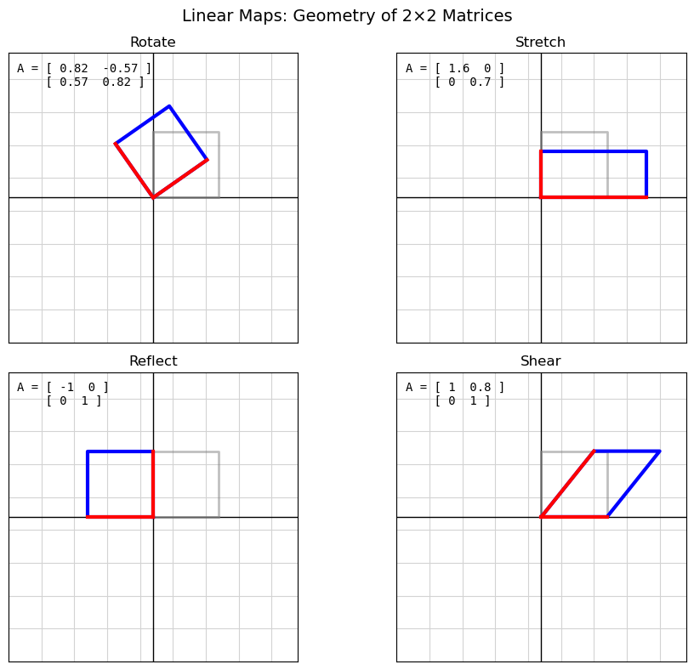
Recall… Matrices as Linear Maps
Multiplication as composition of maps.
A linear map can Rotate, Stretch, Reflect, Shear
It will turn out that quantum computing depends on linear maps. Non-linear transformations break quantum computing.

Slide 5
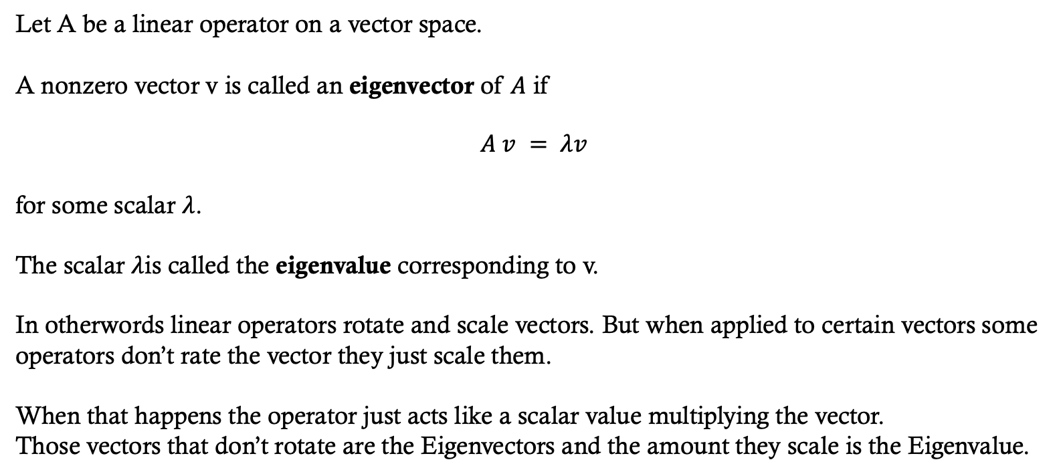

Eigenvalues and Eigenvectors in $ℝ^{n}$
Let A be a linear operator on a vector space.
A nonzero vector v is called an eigenvector of $A$ if
$$A v = λv$$
for some scalar $λ$.
The scalar $λ$is called the eigenvalue corresponding to v.
In otherwords linear operators rotate and scale vectors. But when applied to certain vectors some operators don’t rate the vector they just scale them.
When that happens the operator just acts like a scalar value multiplying the vector.
Those vectors that don’t rotate are the Eigenvectors and the amount they scale is the Eigenvalue.
*In many linear algebra courses, eigenvalues and eigenvectors are presented as computational tools for diagonalizing matrices and solving systems of equations. Here, we will treat them as revealing the intrinsic structure of operators in Hilbert space.

Slide 6
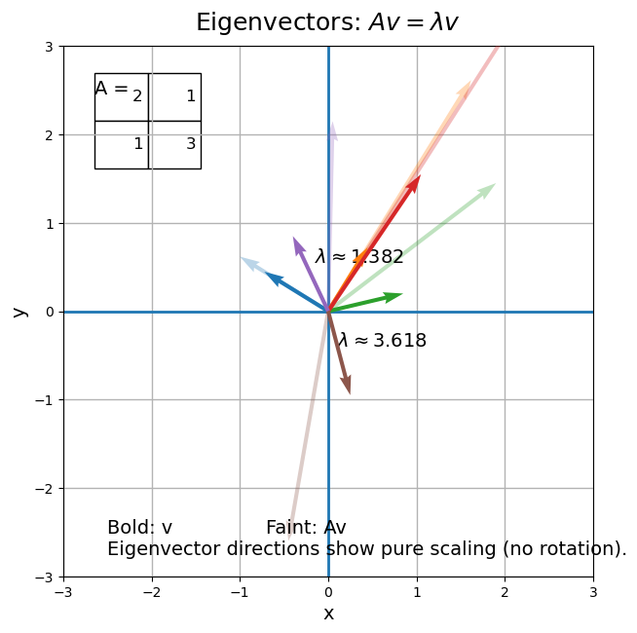

Eigenvalues and Eigenvectors in $ℝ^{n}$
In other words linear operators rotate and scale vectors. But when applied to certain vectors some operators don’t rate the vector they just scale them.
When that happens the operator just acts like a scalar value multiplying the vector.
Those vectors that don’t rotate are the Eigenvectors and the amount they scale is the Eigenvalue.
Notice how the blue and orange vectors only scale they don’t rotate.
*In many linear algebra courses, eigenvalues and eigenvectors are presented as computational tools for diagonalizing matrices and solving systems of equations. Here, we will treat them as revealing the intrinsic structure of operators in Hilbert space.

Slide 7
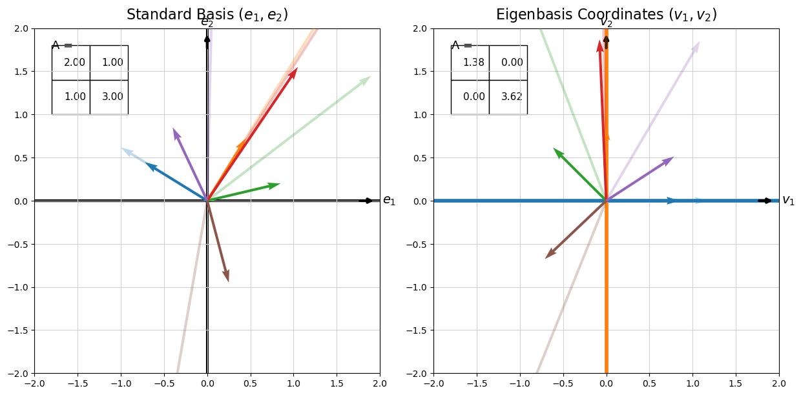
Eigenvalues and Eigenvectors in $ℝ^{n}$
Eigenbasis: Instead of using the standard axes$e_{1}=\left(1,0\right),e_{2}=\left(0,1\right)$ (left panel) we choose axes aligned with the eigenvectors of A; in this coordinate system the matrix becomes diagonal $Λ=\text{diag}\left(1.38,3.62\right),$ so the operator no longer mixes directions and acts independently on each coordinate.
*In many linear algebra courses, eigenvalues and eigenvectors are presented as computational tools for diagonalizing matrices and solving systems of equations. Here, we will treat them as revealing the intrinsic structure of operators in Hilbert space.

Slide 8
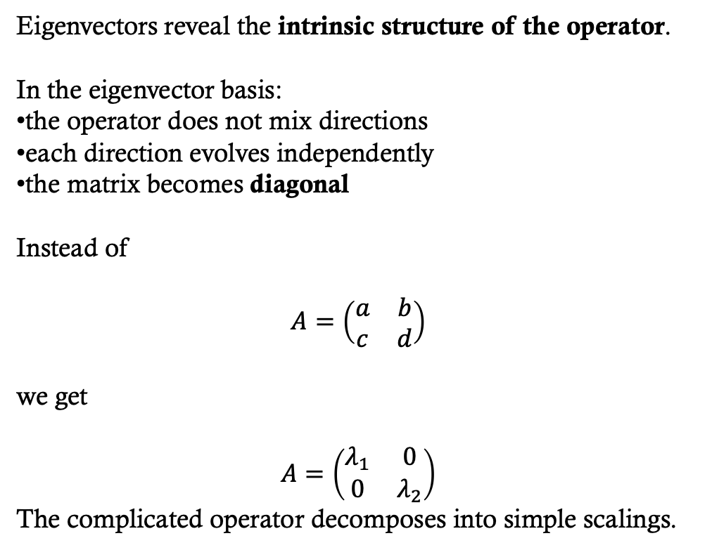
Why we care about vectors that scale and don’t rotate when an operator is applied?
Eigenvectors reveal the intrinsic structure of the operator.
In the eigenvector basis:
the operator does not mix directions
each direction evolves independently
the matrix becomes diagonal
Instead of
$$A=\left(\begin{matrix}a & b \\ c & d\end{matrix}\right)$$
we get
$$A=\left(\begin{matrix}λ_{1} & 0 \\ 0 & λ_{2}\end{matrix}\right)$$
The complicated operator decomposes into simple scalings.
Quantum Computing: Quantum states are often written in the eigenbasis of an operator because in that basis the operator does not mix directions, allowing each component of the state to evolve independently.

Slide 9
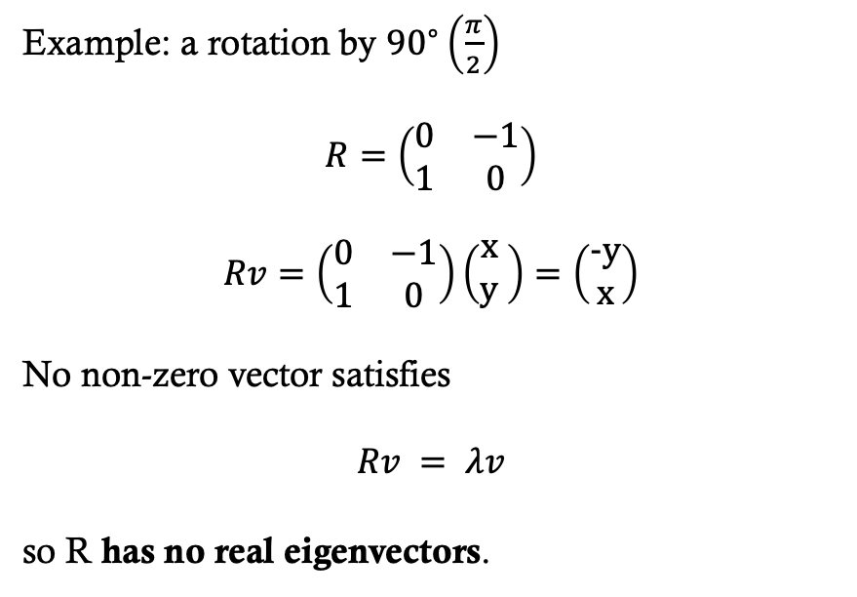

Not all operators have such vectors in $ℝ^{n}$
Example: a rotation by ${90}^{∘}\left(\frac{π}{2}\right)$
$$R=\left(\begin{matrix}0 & −1 \\ 1 & 0\end{matrix}\right)$$
No non-zero vector satisfies
$$Rv = λv$$
so R has no real eigenvectors.

Slide 10
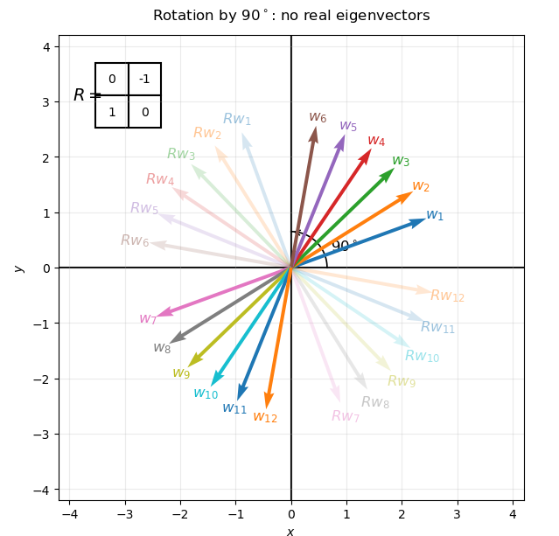
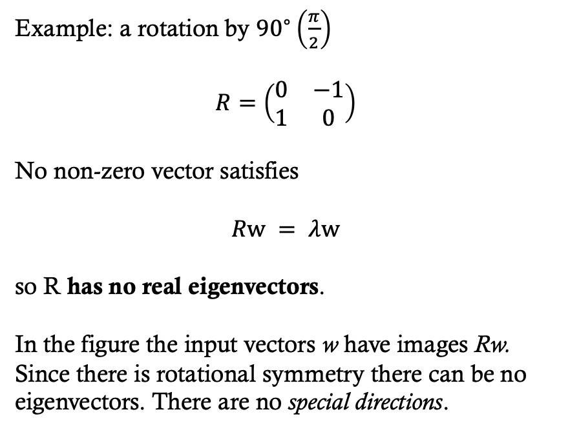
Not all operators have such vectors in $ℝ^{n}$
Example: a rotation by ${90}^{∘}\left(\frac{π}{2}\right)$
$$R=\left(\begin{matrix}0 & −1 \\ 1 & 0\end{matrix}\right)$$
No non-zero vector satisfies
$$Rw = λw$$
so R has no real eigenvectors.
In the figure the input vectors w have images Rw. Since there is rotational symmetry there can be no eigenvectors. There are no special directions.

Slide 11
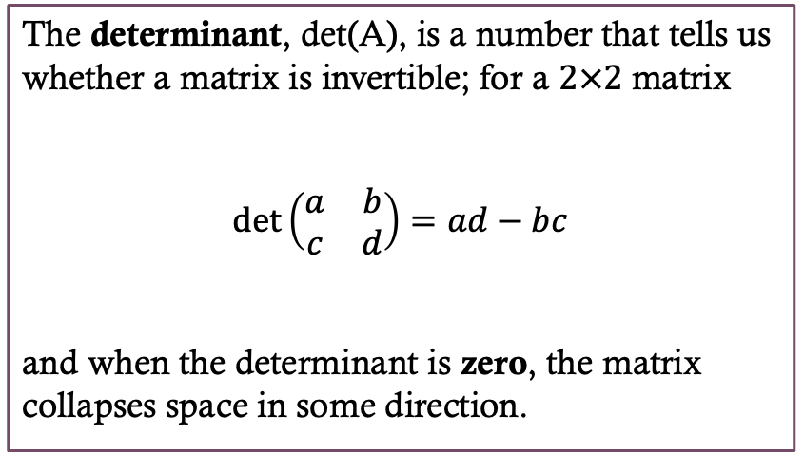
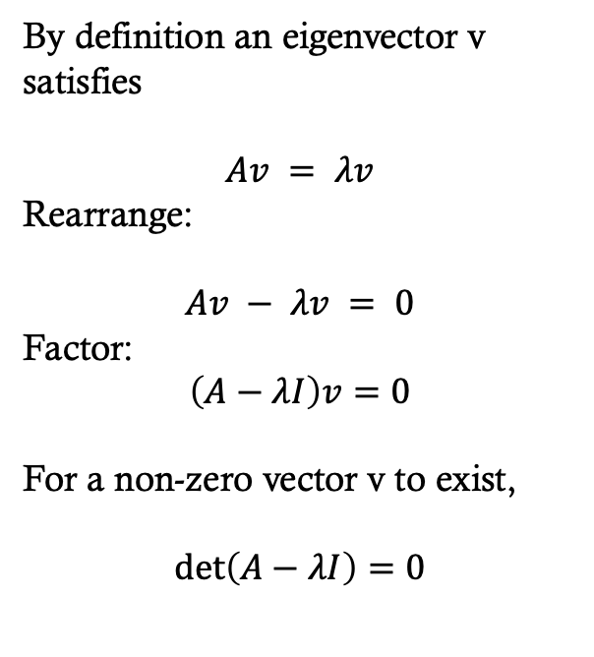
How to calculate eigenvalues and eigenvectors
The determinant, det(A), is a number that tells us whether a matrix is invertible; for a $2×2$matrix
$$\det\left(\begin{matrix}a & b \\ c & d\end{matrix}\right)=ad−bc$$
and when the determinant is zero, the matrix collapses space in some direction.
By definition an eigenvector v satisfies
$$Av = λv$$
Rearrange:
$$Av − λv = 0$$
Factor:
$$\left(A−λI\right)v=0$$
For a non-zero vector v to exist,
$$\det\left(A−λI\right)=0$$

Slide 12
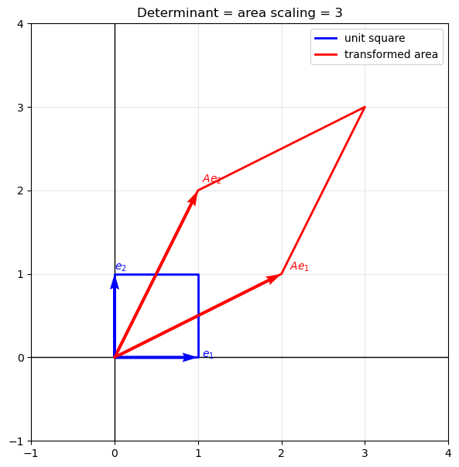
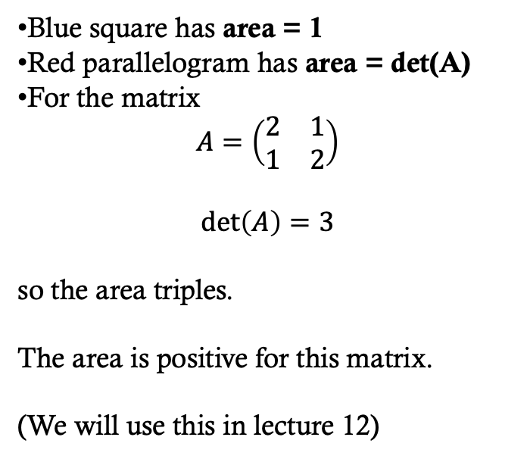
How to calculate eigenvalues and eigenvectors
Transforms the unit square into a parallelogram
det = 0 → area = 0 (collapse)
|det| < 1 → area shrinks
|det| > 1 → area expands
det < 0 → orientation flips (meaning the order of vertexes flips)
Blue square has area = 1
Red parallelogram has area = det(A)
For the matrix
$$A=\left(\begin{matrix}2 & 1 \\ 1 & 2\end{matrix}\right)$$
$$\det\left(A\right)=3$$
so the area triples.
The area is positive for this matrix.
(We will use this in lecture 12)

Slide 13
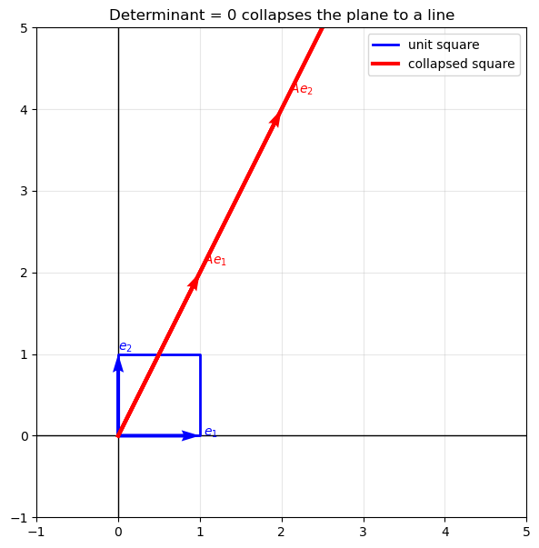
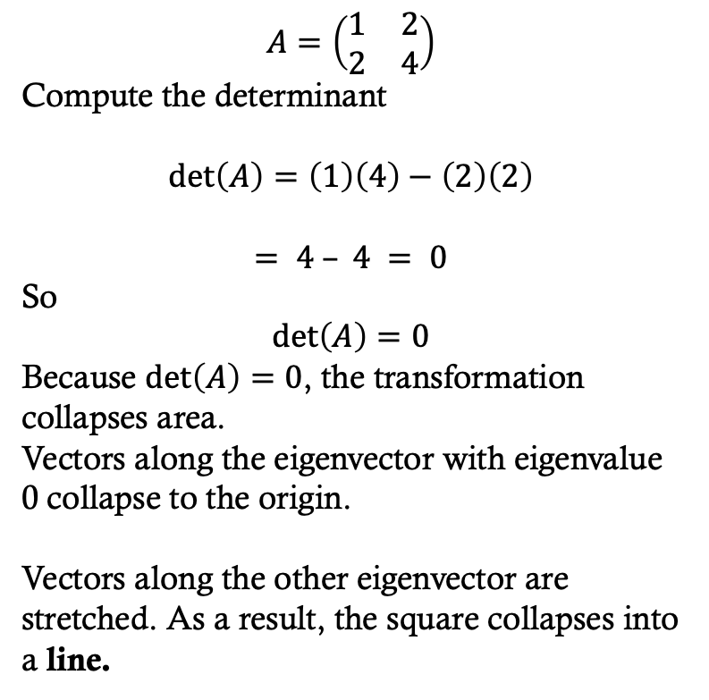
How to calculate eigenvalues and eigenvectors
$$A=\left(\begin{matrix}1 & 2 \\ 2 & 4\end{matrix}\right)$$
Compute the determinant
$$\det\left(A\right)=\left(1\right)\left(4\right)−\left(2\right)\left(2\right)$$
$$= 4 – 4 = 0$$
So
$$\det\left(A\right)=0$$
Because $\det\left(A\right)=0$, the transformation collapses area.
Vectors along the eigenvector with eigenvalue 0 collapse to the origin.
Vectors along the other eigenvector are stretched. As a result, the square collapses into a line.

Slide 14
How to calculate eigenvalues and eigenvectors
This figure is similar to when I showed how operators transform shapes.
Sometimes we illustrate a transformation by applying it to a few example vectors, such as when we showed rotations. But an operator actually acts on all vectors in the space.
Because of this, it is often helpful to think about how the entire space of points is transformed.
In this case we look at what happens to the unit square. Every vector inside that square is transformed by the operator A. Because the determinant of A is zero, the transformation collapses the square into a line.
The reason the line implies A is not invertible is that there isn’t a unique mapping from points on a line to a square!
So the operator A cannot be undone by feeding in points from the line to the inverse of $A,\left(A^{−1}\right) the output wouldn’t be unique.$

Slide 15
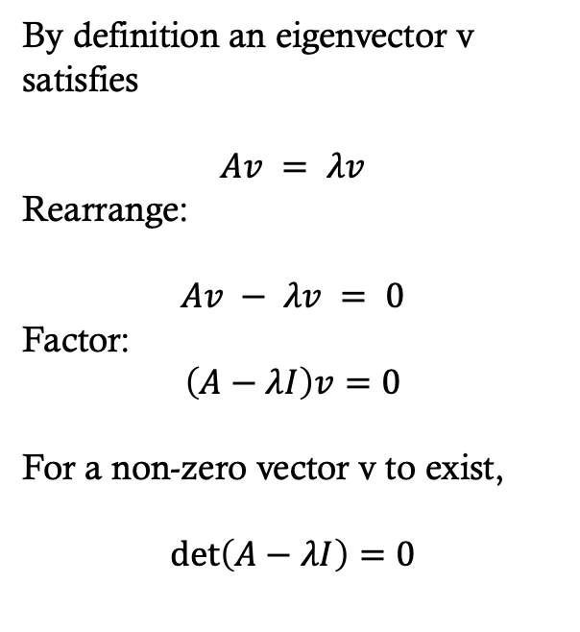
How to calculate eigenvalues and eigenvectors
By definition an eigenvector v satisfies
$$Av = λv$$
Rearrange:
$$Av − λv = 0$$
Factor:
$$\left(A−λI\right)v=0$$
For a non-zero vector v to exist,
$$\det\left(A−λI\right)=0$$

Slide 16
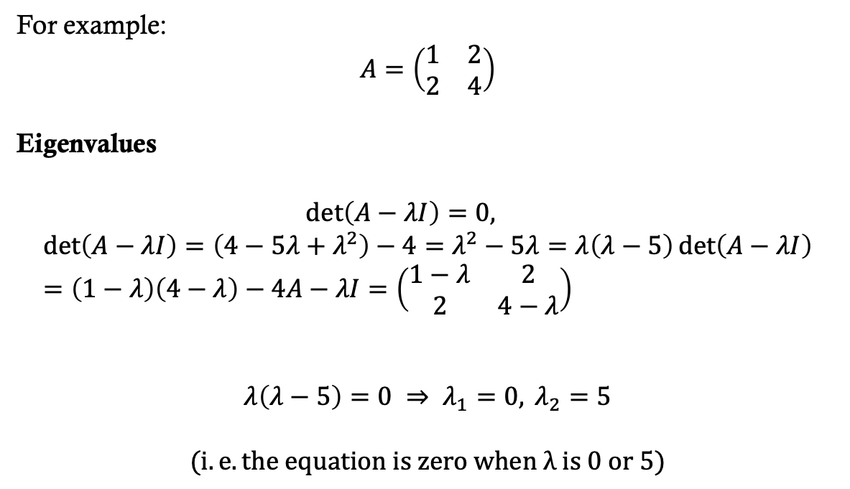
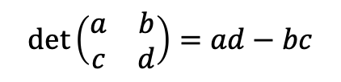
How to calculate eigenvalues and eigenvectors
$$\det\left(\begin{matrix}a & b \\ c & d\end{matrix}\right)=ad−bc$$
For example:
$$A=\left(\begin{matrix}1 & 2 \\ 2 & 4\end{matrix}\right)$$
Eigenvalues
$$\det\left(A−λI\right)=0,$$
$$\det\left(A−λI\right)=\left(4−5λ+λ^{2}\right)−4=λ^{2}−5λ=λ\left(λ−5\right)\det\left(A−λI\right)=\left(1−λ\right)\left(4−λ\right)−4A−λI=\left(\begin{matrix}1−λ & 2 \\ 2 & 4−λ\end{matrix}\right)$$
$$λ\left(λ−5\right)=0 ⇒ λ_{1}=0, λ_{2}=5$$
$$(i.e. the equation is zero when λ is 0 or 5)$$
By definition an eigenvector v satisfies
$$Av = λv$$
Rearrange:
$$Av − λv = 0$$
Factor:
$$\left(A−λI\right)v=0$$
For a non-zero vector v to exist,
$$\det\left(A−λI\right)=0$$

Slide 17
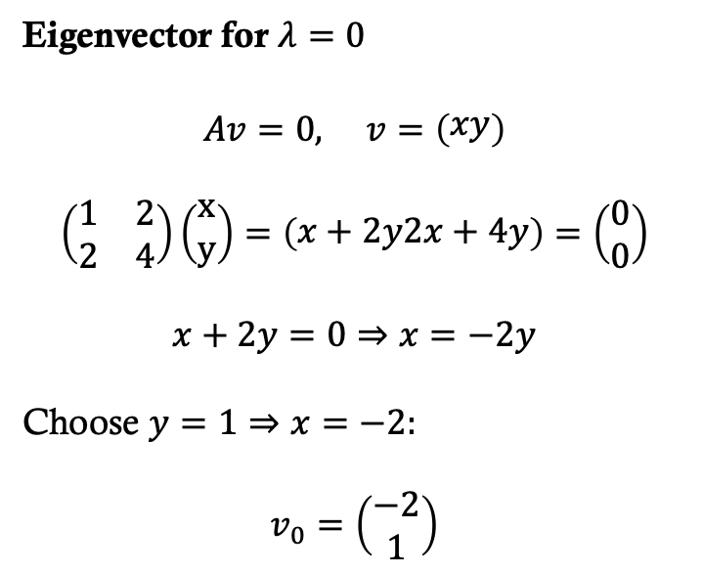
Eigenvalues and vectors in complex space
Eigenvector for $λ=0$
$$Av=0, v=\left(\begin{matrix}xy\end{matrix}\right)$$
$$\left(\begin{matrix}1 & 2 \\ 2 & 4\end{matrix}\right)\left(\begin{matrix}x \\ y\end{matrix}\right)=\left(\begin{matrix}x+2y2x+4y\end{matrix}\right)=\left(\begin{matrix}0 \\ 0\end{matrix}\right)$$
$$x+2y=0⇒x=−2y$$
Choose $y=1⇒x=−2:$
$$v_{0}=\left(\begin{matrix}\begin{aligned}−2 \\ 1\end{aligned}\end{matrix}\right)$$

Slide 18
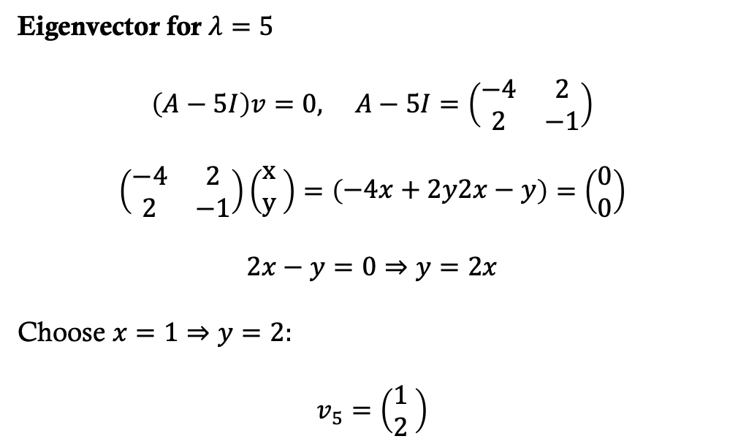
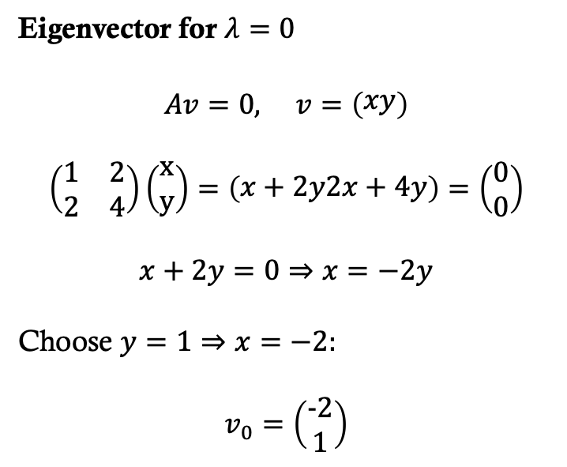
How to calculate Eigenvalues and vectors
Eigenvector for $λ=0$
$$Av=0, v=\left(\begin{matrix}xy\end{matrix}\right)$$
$$\left(\begin{matrix}1 & 2 \\ 2 & 4\end{matrix}\right)\left(\begin{matrix}x \\ y\end{matrix}\right)=\left(\begin{matrix}x+2y2x+4y\end{matrix}\right)=\left(\begin{matrix}0 \\ 0\end{matrix}\right)$$
$$x+2y=0⇒x=−2y$$
Choose $y=1⇒x=−2:$
$$v_{0}=\left(\begin{matrix}−2 \\ 1\end{matrix}\right)$$
Eigenvector for $λ=5$
$$\left(\begin{matrix}−4 & 2 \\ 2 & −1\end{matrix}\right)\left(\begin{matrix}x \\ y\end{matrix}\begin{matrix}\end{matrix}\right)=\left(\begin{matrix}−4x+2y2x−y\end{matrix}\right)=\left(\begin{matrix}0 \\ 0\end{matrix}\right)$$
$$2x−y=0⇒y=2x$$
Choose $x=1⇒y=2:$
$$v_{5}=\left(\begin{matrix}1 \\ 2\end{matrix}\begin{matrix}\end{matrix}\right)$$

Slide 19
In codE
Find eigenvalues:
We can write code to do this laborious work for us in a few lines.
Here is a function that finds the eigenvalues for a 2x2 matrix
import math # for sqrt
def eigenvalues_2x2(A):
  a, b = A[0]
  c, d = A[1]
  tr = a + d
  det = a*d - b*c
  disc = tr*tr - 4*det
  root = math.sqrt(disc)
  λ1 = (tr + root) / 2
  λ2 = (tr - root) / 2
return λ1, λ2

Slide 20

In codE
Solve $\left(A−λI\right)v=0$
A short function to solve the linear equation
Find eigenvalues:
def solve_2x2(A, λ):
a, b = A[0]
c, d = A[1]
m11 = a - λ
m12 = b
m21 = c
m22 = d - λ
if abs(m11) > 1e-12:
x = -m12 / m11
y = 1
else:
x = -m22 / m21
y = 1
return (x, y)
import math # for sqrt
def eigenvalues_2x2(A):
  a, b = A[0]
  c, d = A[1]
  tr = a + d
  det = a*d - b*c
  disc = tr*tr - 4*det
  root = math.sqrt(disc)
  λ1 = (tr + root) / 2
  λ2 = (tr - root) / 2
return λ1, λ2

Slide 21
In codE
Solve $\left(A−λI\right)v=0$
Simplify the vector
Find eigenvalues:
def gcd(a, b):
while b != 0:
a, b = b, a % b
return abs(a)
def lcd(a, b):
return abs(a*b)//gcd(a, b)
def solve_2x2(A, λ):
a, b = A[0]
c, d = A[1]
m11 = a - λ
m12 = b
m21 = c
m22 = d - λ
if abs(m11) > 1e-12:
x = -m12 / m11
y = 1
else:
x = -m22 / m21
y = 1
return (x, y)
import math # for sqrt
def eigenvalues_2x2(A):
  a, b = A[0]
  c, d = A[1]
  tr = a + d
  det = a*d - b*c
  disc = tr*tr - 4*det
  root = math.sqrt(disc)
  λ1 = (tr + root) / 2
  λ2 = (tr - root) / 2
return λ1, λ2
When we solve for eigen vectors it is nice (but not necessary) to show them in their simplest form. So we define the gcd (greatest common divisor function)

Slide 22

In codE
Solve $\left(A−λI\right)v=0$
Simplify the vector
Find eigenvalues:
def gcd(a, b):
while b != 0:
a, b = b, a % b
return abs(a)
def lcd(a, b):
return abs(a*b)//gcd(a, b)
def solve_2x2(A, λ):
a, b = A[0]
c, d = A[1]
m11 = a - λ
m12 = b
m21 = c
m22 = d - λ
if abs(m11) > 1e-12:
x = -m12 / m11
y = 1
else:
x = -m22 / m21
y = 1
return (x, y)
import math # for sqrt
def eigenvalues_2x2(A):
  a, b = A[0]
  c, d = A[1]
  tr = a + d
  det = a*d - b*c
  disc = tr*tr - 4*det
  root = math.sqrt(disc)
  λ1 = (tr + root) / 2
  λ2 = (tr - root) / 2
return λ1, λ2
Find eigenvector from eigenvalue:
Now we can find the eigenvector that corresponds to each eigenvalue
def eigenvector_2x2(A, λ):
x, y = solve_2x2(A, λ)
x, y = int(round(x)), int(round(y))
g = gcd(x, y)
return (x//g, y//g)

Slide 23
In codE
Solve $\left(A−λI\right)v=0$
Simplify the vector
A = [[1, 2], [2, 4]]
λ1, λ2 = eigenvalues_2x2(A)
print("Eigenvalues:", str(λ1)+",", λ2)
v1 = eigenvector_2x2(A, λ1)
v2 = eigenvector_2x2(A, λ2)
print("Eigenvector for λ =", str(λ1)+":", v1)
print("Eigenvector for λ =", str(λ2)+":", v2)
Eigenvalues: 5.0, 0.0
Eigenvector for λ = 5.0: (0.5, 1)
Eigenvector for λ = 0.0: (-2.0, 1)
Find eigenvalues:
def gcd(a, b):
while b != 0:
a, b = b, a % b
return abs(a)
def lcd(a, b):
return abs(a*b)//gcd(a, b)
def solve_2x2(A, λ):
a, b = A[0]
c, d = A[1]
m11 = a - λ
m12 = b
m21 = c
m22 = d - λ
if abs(m11) > 1e-12:
x = -m12 / m11
y = 1
else:
x = -m22 / m21
y = 1
return (x, y)
import math # for sqrt
def eigenvalues_2x2(A):
  a, b = A[0]
  c, d = A[1]
  tr = a + d
  det = a*d - b*c
  disc = tr*tr - 4*det
  root = math.sqrt(disc)
  λ1 = (tr + root) / 2
  λ2 = (tr - root) / 2
return λ1, λ2
Find eigenvector from eigenvalue:
def eigenvector_2x2(A, λ):
x, y = solve_2x2(A, λ)
x, y = int(round(x)), int(round(y))
g = gcd(x, y)
return (x//g, y//g)

Slide 24
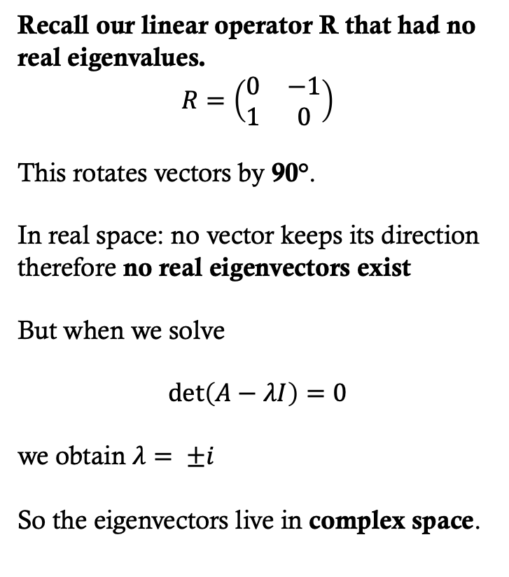

How to calculate Eigenvalues and vectors in $ℂ^{2}$
Recall our linear operator R that had no real eigenvalues.
$$R=\left(\begin{matrix}0 & −1 \\ 1 & 0\end{matrix}\right)$$
This rotates vectors by 90°.
In real space: no vector keeps its direction therefore no real eigenvectors exist
But when we solve
$$\det\left(A−λI\right)=0$$
we obtain $λ= ±i$
So the eigenvectors live in complex space.

Slide 25
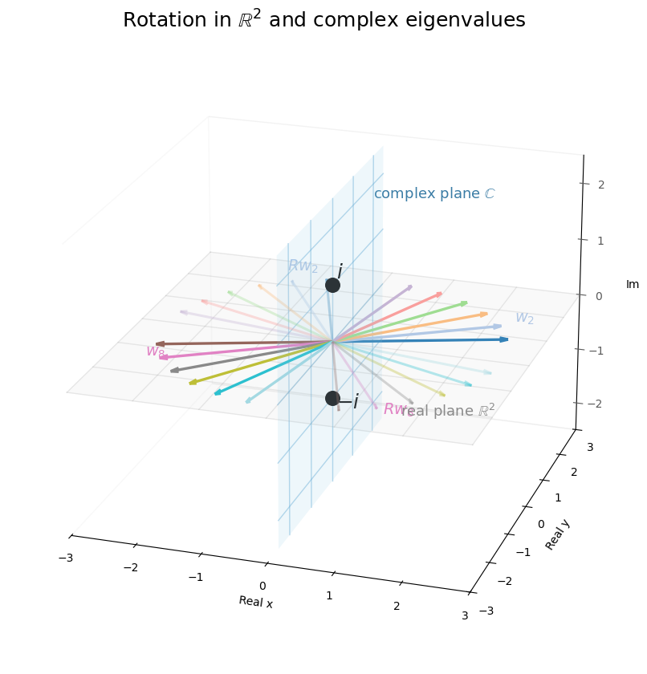
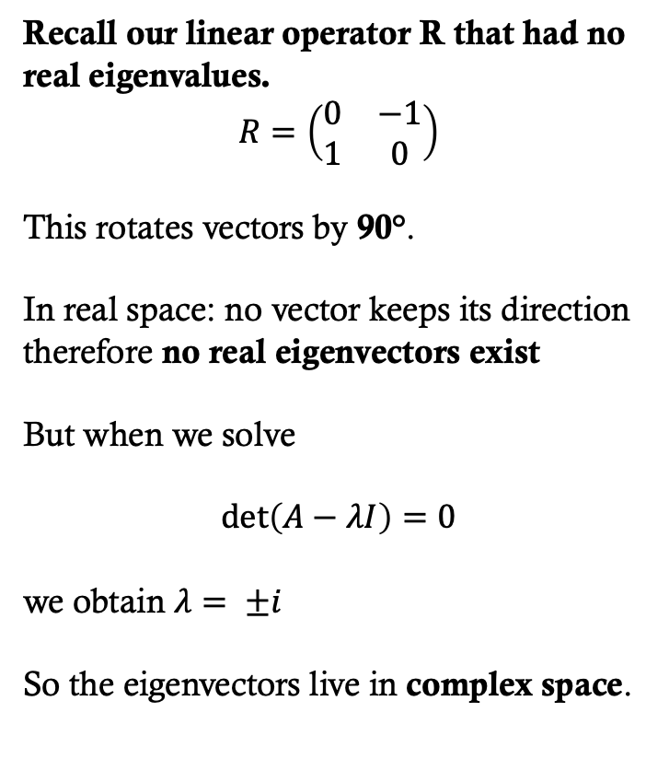

How to calculate Eigenvalues and vectors in $ℂ^{2}$
Recall our linear operator R that had no real eigenvalues.
$$R=\left(\begin{matrix}0 & −1 \\ 1 & 0\end{matrix}\right)$$
This rotates vectors by 90°.
In real space: no vector keeps its direction therefore no real eigenvectors exist
But when we solve
$$\det\left(A−λI\right)=0$$
we obtain $λ= ±i$
So the eigenvectors live in complex space.
The corresponding eigenvectors are in $ℝ^{4}$

Slide 26
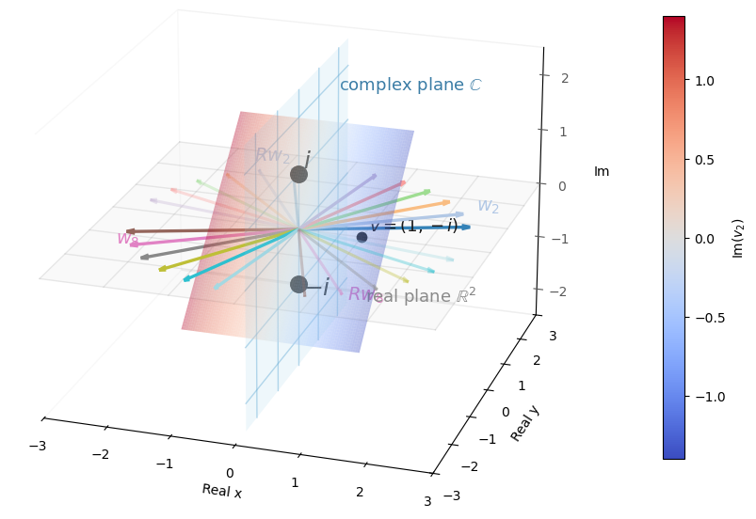
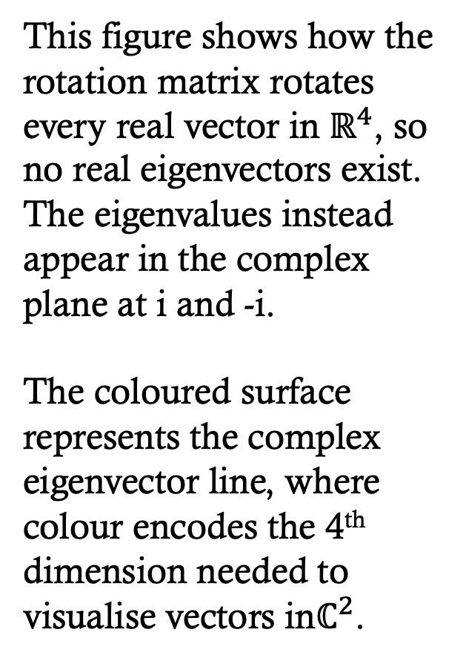
How to calculate Eigenvalues and vectors in $ℂ^{2}$
This figure shows how the rotation matrix rotates every real vector in $ℝ^{4}$, so no real eigenvectors exist. The eigenvalues instead appear in the complex plane at i and -i.
The coloured surface represents the complex eigenvector line, where colour encodes the 4th dimension needed to visualise vectors in$ℂ^{2}$.
Corresponding eigenvectors lie in ℝ⁴, shown as a colour-encoded surface.

Slide 27
In codE
Solve $\left(A−λI\right)v=0$
Simplify the vector
Find eigenvalues:
def gcd(a, b):
while b != 0:
a, b = b, a % b
return abs(a)
def lcd(a, b):
return abs(a*b)//gcd(a, b)
def solve_2x2(A, λ):
a, b = A[0]
c, d = A[1]
m11 = a - λ
m12 = b
m21 = c
m22 = d - λ
if abs(m11) > 1e-12:
x = -m12 / m11
y = 1
else:
x = -m22 / m21
y = 1
return (x, y)
import cmath # for sqrt
def eigenvalues_2x2(A):
  a, b = A[0]
  c, d = A[1]
  tr = a + d
  det = a*d - b*c
  disc = tr*tr - 4*det
  root = cmath.sqrt(disc)
  λ1 = (tr + root) / 2
  λ2 = (tr - root) / 2
return λ1, λ2
Find eigenvector from eigenvalue:
Now we can find the eigenvector that corresponds to each eigenvalue
def eigenvector_2x2(A, λ):
x, y = solve_2x2(A, λ)
x, y = int(round(x)), int(round(y))
g = gcd(x, y)
return (x//g, y//g)

Slide 28
In codE
Solve $\left(A−λI\right)v=0$
math.sqrt(-1) → error
cmath.sqrt(-1) → 1j
No simplification step needed. (j is a common engineering variable for i)
Complex eigenvectors are returned directly
GCD doesn’t make sense anymore.
A = [[0, -1],[1, 0]]
λ1, λ2 = eigenvalues_2x2(A)
print("Eigenvalues:", λ1, ",", λ2)
v1 = eigenvector_2x2(A, λ1)
v2 = eigenvector_2x2(A, λ2)
print("Eigenvector for λ =", λ1, ":", v1)
print("Eigenvector for λ =", λ2, ":", v2)
Eigenvalues: 1j , -1j
Eigenvector for λ = 1j : ((-0+1j), 1)
Eigenvector for λ = -1j : (-1j, 1)
Find eigenvalues:
def solve_2x2(A, λ):
a, b = A[0]
c, d = A[1]
m11 = a - λ
m12 = b
m21 = c
m22 = d - λ
if abs(m11) > 1e-12:
x = -m12 / m11
y = 1
else:
x = -m22 / m21
y = 1
return (x, y)
import cmath # for sqrt
def eigenvalues_2x2(A):
  a, b = A[0]
  c, d = A[1]
  tr = a + d
  det = a*d - b*c
  disc = tr*tr - 4*det
  root = cmath.sqrt(disc)
  λ1 = (tr + root) / 2
  λ2 = (tr - root) / 2
return λ1, λ2
Find eigenvector from eigenvalue:
def eigenvector_2x2(A, λ):
x, y = solve_2x2(A, λ)
return (x, y)
Now we can find the complex eigenvector that corresponds to each complex eigenvalue

Slide 29


Hermitian Operators
We have seen that…
Real matrices can have complex eigenvalues.
Eigenvectors may live in $ℂ^{n}$ rather than $ℝ^{n}$.
The geometry gets harder to visualise.
Hermitian matrices are the complex analogue of symmetric matrices, and this symmetry forces their eigenvalues to be real, which we can visualise again in $ℝ^{2}$and $ℝ^{3}$.
… bringing the parietal lobe back online for 3D processing.

Slide 30
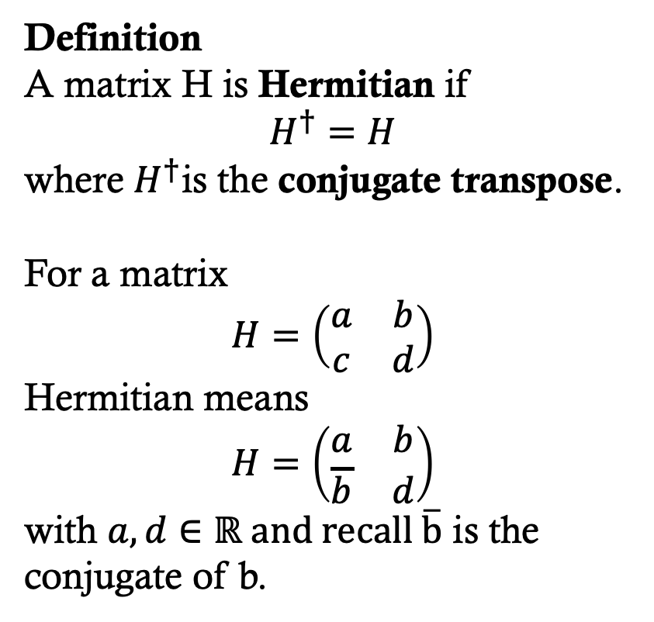
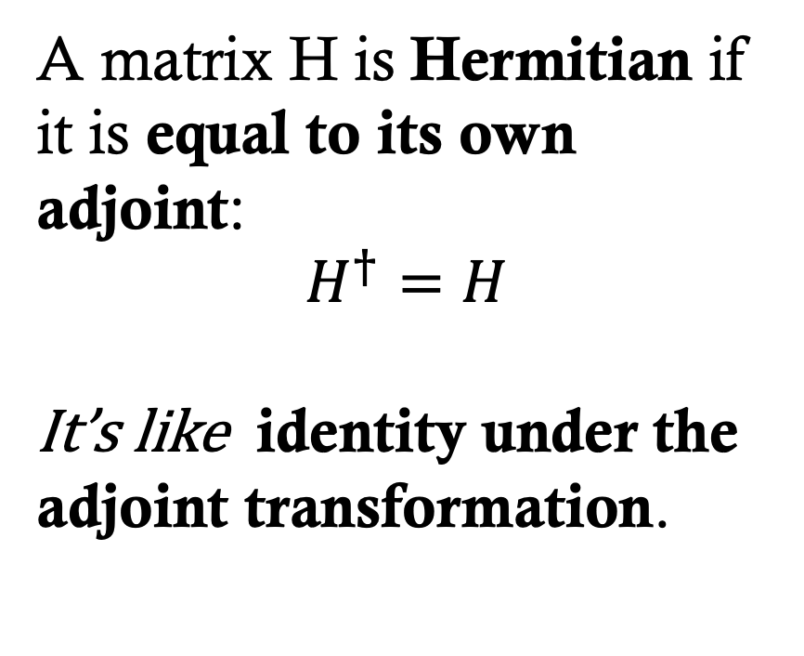
HERMITIAN Operators
Definition
A matrix H is Hermitian if
$$H^{†}=H$$
where $H^{†}$is the conjugate transpose.
For a matrix
$$H=\left(\begin{matrix}a & b \\ c & d\end{matrix}\right)$$
Hermitian means
$$H=\left(\begin{matrix}a & b \\ \overline{b} & d\end{matrix}\right)$$
with $a,d∈ℝ and recall \overline{b}$ is the conjugate of b.
A matrix H is Hermitian if it is equal to its own adjoint:
$$H^{†}=H$$
It’s like identity under the adjoint transformation.
Recall: if $z = a + bi$then its conjugate is $\overline{z}=a−bi;$ ${Adjoint: A}^{†}$= ${\overline{A}}^{,T}$

Slide 31
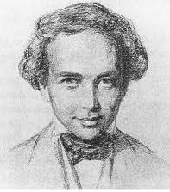
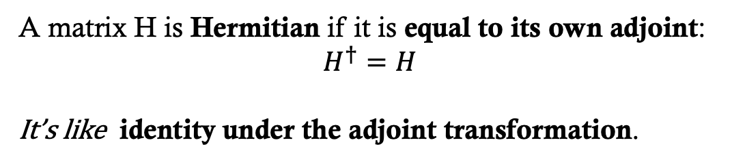
HERMITIAN Operators
A matrix H is Hermitian if it is equal to its own adjoint:
$$H^{†}=H$$
It’s like identity under the adjoint transformation.
Charles Hermite (1822–1901)
Sur la théorie des formes quadratiques (On the theory of quadratic forms), symmetry of complex matrices, 1854
École Polytechnique, Paris
“I turn away with fear and horror from this lamentable plague of functions which have no derivatives.”
in reaction to Karl Weierstrass and the rise of pathological functions in real analysis.

Slide 32
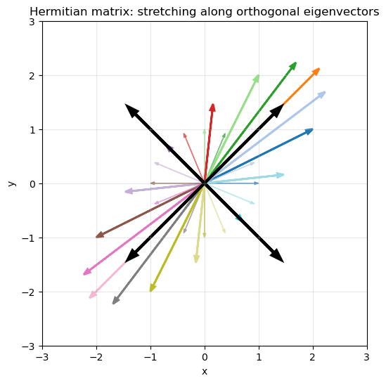
HERMITIAN Operators
Most matrices do not have orthogonal eigenvectors.
Hermitian matrices are special because they always have orthogonal eigenvectors.
The black eigenvectors are orthogonal, so they form an orthonormal basis.

Slide 33
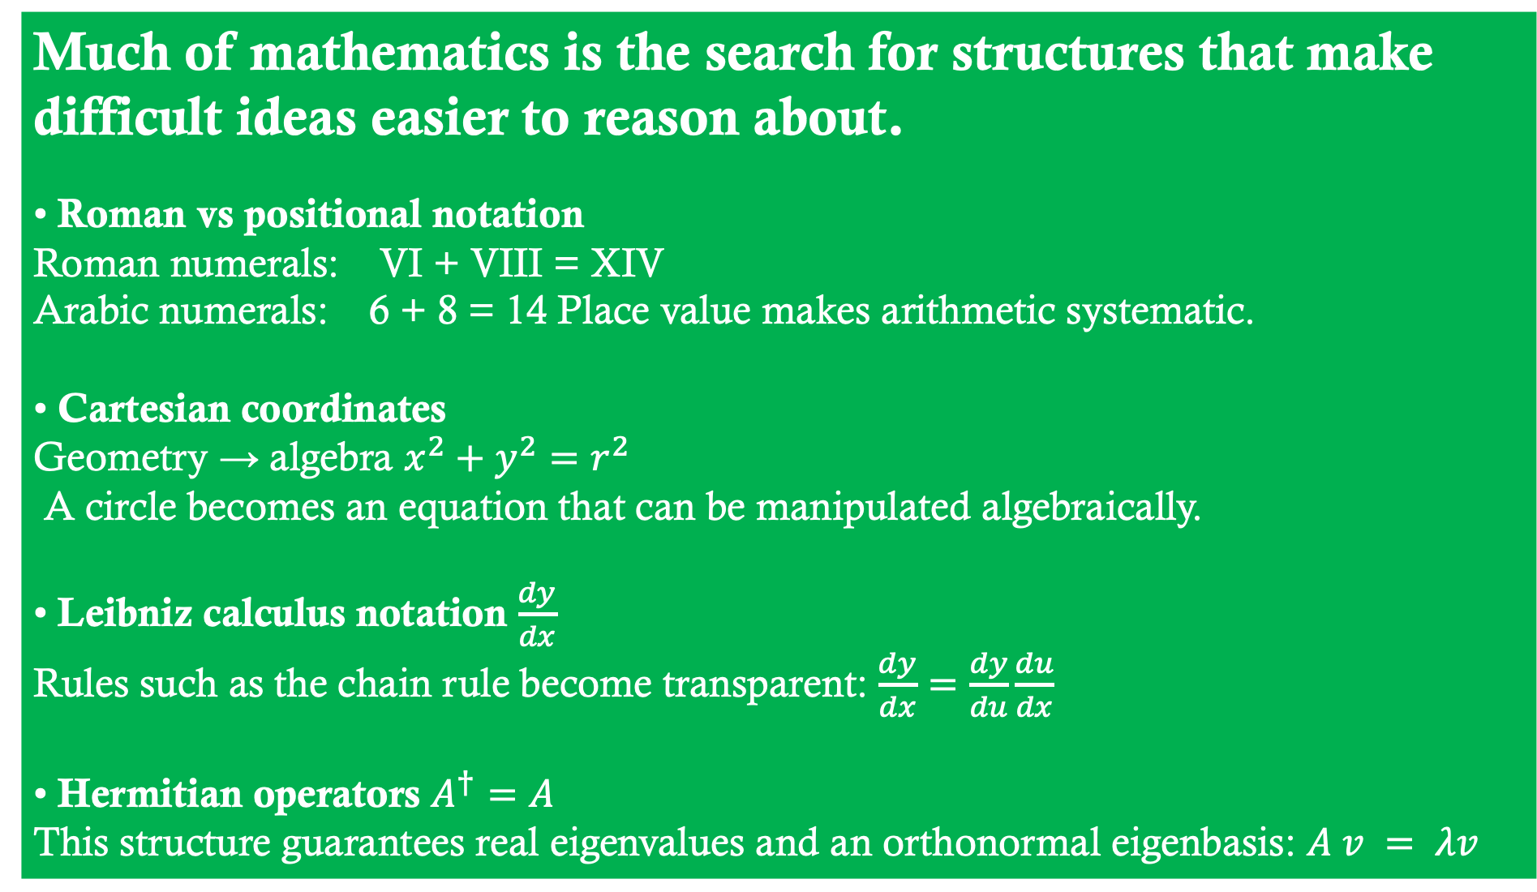
HERMITIAN Operators
Much of mathematics is the search for structures that make difficult ideas easier to reason about.
• Roman vs positional notation
Roman numerals: VI + VIII = XIV
Arabic numerals: 6 + 8 = 14 Place value makes arithmetic systematic.
• Cartesian coordinates
Geometry → algebra $x^{2}+y^{2}=r^{2}$
A circle becomes an equation that can be manipulated algebraically.
• Leibniz calculus notation $\frac{dy}{dx}$
Rules such as the chain rule become transparent: $\frac{dy}{dx}=\frac{dy}{du}\frac{du}{dx}$
• Hermitian operators $A^{†}=A$
This structure guarantees real eigenvalues and an orthonormal eigenbasis: $A v = λv$
Most matrices do not have orthogonal eigenvectors.
Hermitian matrices are special because they always have orthogonal eigenvectors.
The black eigenvectors are orthogonal, so they form an orthonormal basis.

Slide 34

HERMITIAN Operators
Much of mathematics is the search for structures that make difficult ideas easier to reason about.
• Roman vs positional notation
Roman numerals: VI + VIII = XIV
Arabic numerals: 6 + 8 = 14 Place value makes arithmetic systematic.
• Cartesian coordinates
Geometry → algebra $x^{2}+y^{2}=r^{2}$
A circle becomes an equation that can be manipulated algebraically.
• Leibniz calculus notation $\frac{dy}{dx}$
Rules such as the chain rule become transparent: $\frac{dy}{dx}=\frac{dy}{du}\frac{du}{dx}$
• Hermitian operators $A^{†}=A$
This structure guarantees real eigenvalues and an orthonormal eigenbasis: $A v = λv$
Paul Dirac
Principles of Quantum
Mechanics (1930)
University of Cambridge
“The formulation of these laws requires the use of the mathematics of transformations. The important things in the world appear as the invariants … of these transformations.”
The eigenvalues of the Hermitian operators are those invariants.
Most matrices do not have orthogonal eigenvectors.
Hermitian matrices are special because they always have orthogonal eigenvectors.
The black eigenvectors are orthogonal, so they form an orthonormal basis.

Slide 35
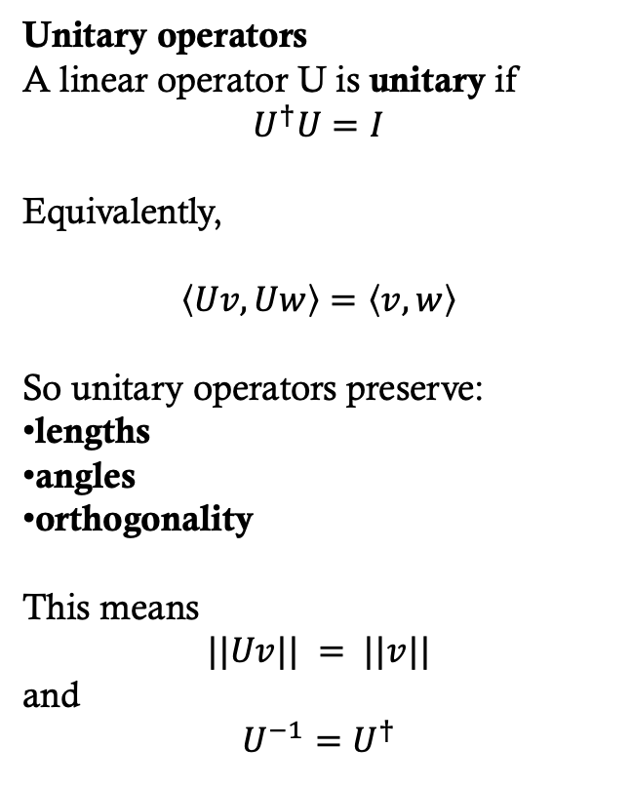
Unitary Operators
Unitary operators
A linear operator U is unitary if
$$U^{†}U=I$$
Equivalently,
$$\left\langle Uv,Uw\right\rangle =\left\langle v,w\right\rangle$$
So unitary operators preserve:
lengths
angles
orthogonality
This means
$$||Uv|| = ||v||$$
and
$$U^{−1}=U^{†}$$
Preview: Quantum gates must be unitary, because quantum evolution must preserve the norm of the state vector.
Operators that have these properties preserve the geometry of Hilbert space.

Slide 36
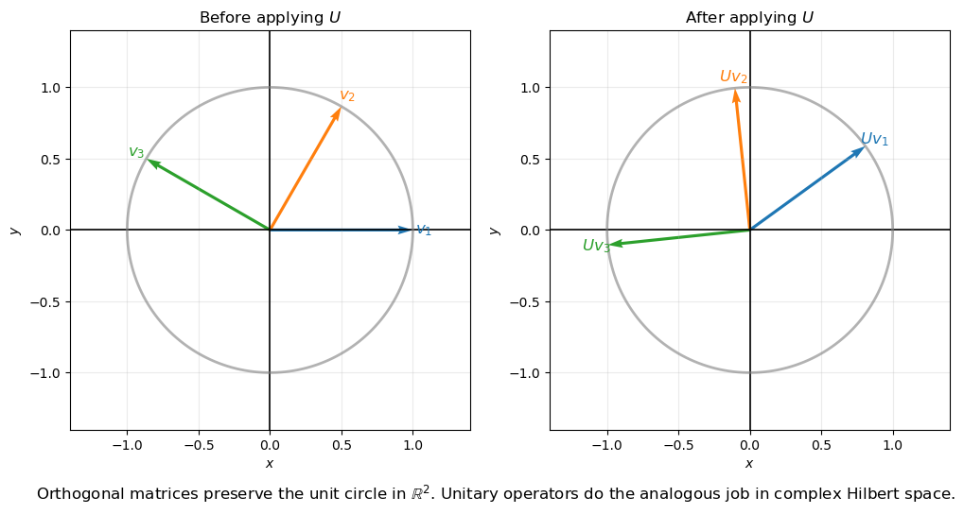
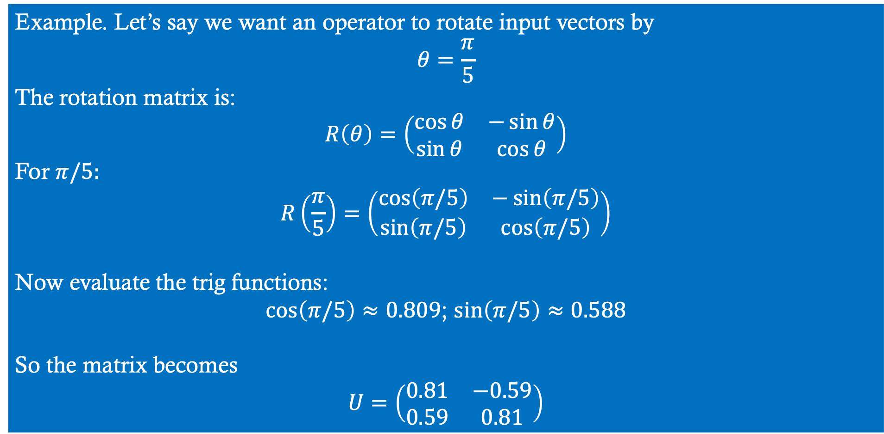
Unitary Operators
Example. Let’s say we want an operator to rotate input vectors by
$$θ=\frac{π}{5}$$
The rotation matrix is:
$$R\left(θ\right)=\left(\begin{matrix}\cos{θ} & −\sin{θ} \\ \sin{θ} & \cos{θ}\end{matrix}\right)$$
For $π/5:$
$$R\left(\frac{π}{5}\right)=\left(\begin{matrix}\cos\left(π/5\right) & −\sin\left(π/5\right) \\ \sin\left(π/5\right) & \cos\left(π/5\right)\end{matrix}\right)$$
Now evaluate the trig functions:
$\cos\left(π/5\right)≈0.809$; $\sin\left(π/5\right)≈0.588$
So the matrix becomes
$$U=\left(\begin{matrix}0.81 & −0.59 \\ 0.59 & 0.81\end{matrix}\right)$$

Slide 37
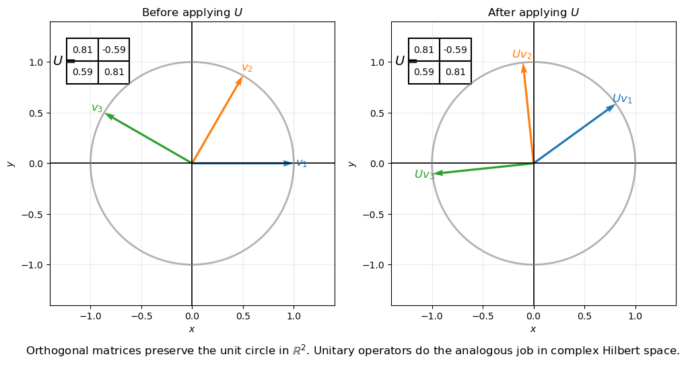
Unitary Operators

Slide 38
Spectral decomposition
The set of eigenvalues of an operator is called its spectrum.
So spectral decomposition means
decomposing the operator into its eigenvalue spectrum.
.

Slide 39
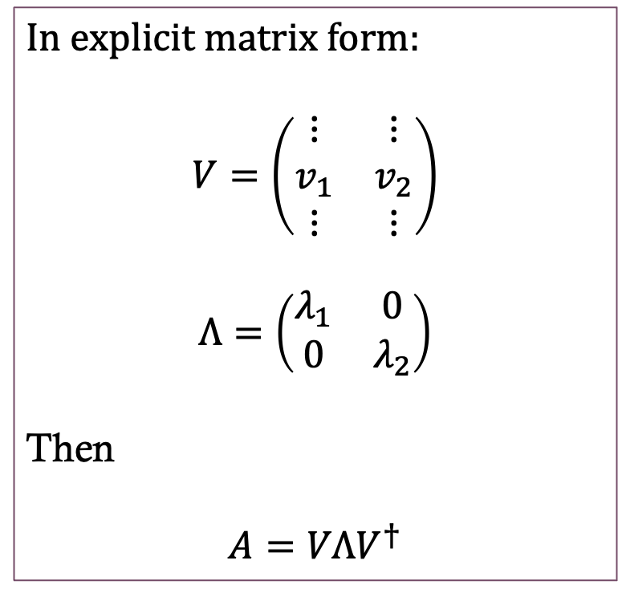
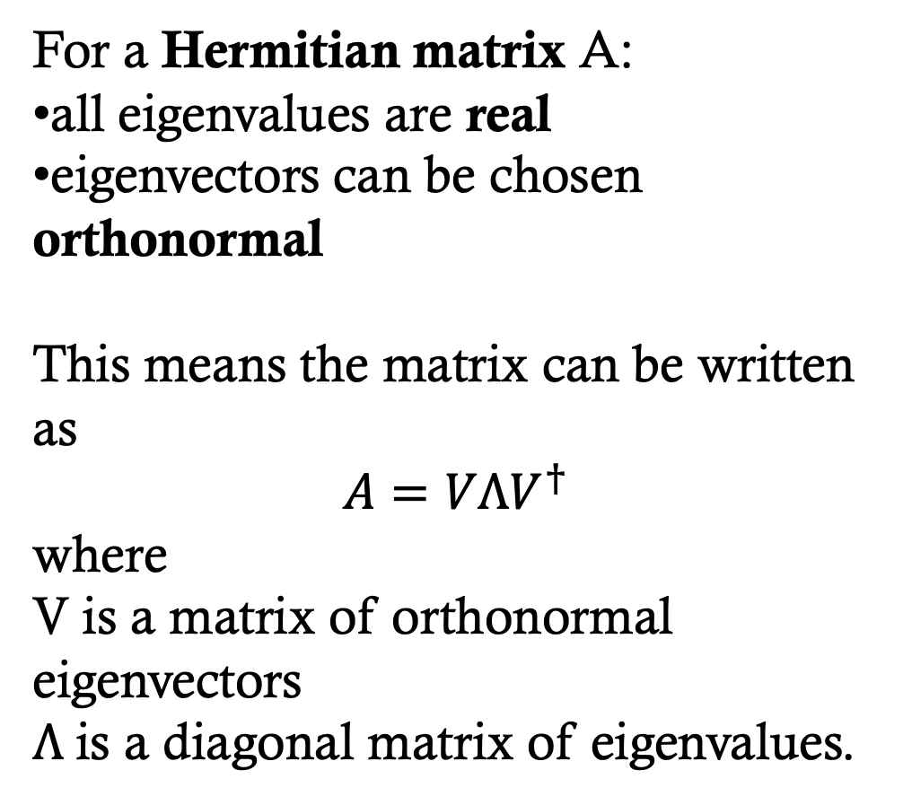
Spectral decomposition
For a Hermitian matrix A:
all eigenvalues are real
eigenvectors can be chosen orthonormal
This means the matrix can be written as
$$A=VΛV^{†}$$
where
V is a matrix of orthonormal eigenvectors
$Λ$is a diagonal matrix of eigenvalues.
In explicit matrix form:
$$V=\left(\begin{matrix}⋮ & ⋮ \\ v_{1} & v_{2} \\ ⋮ & ⋮\end{matrix}\right)$$
$$Λ=\left(\begin{matrix}λ_{1} & 0 \\ 0 & λ_{2}\end{matrix}\right)$$
Then
$$A=VΛV^{†}$$

Slide 40
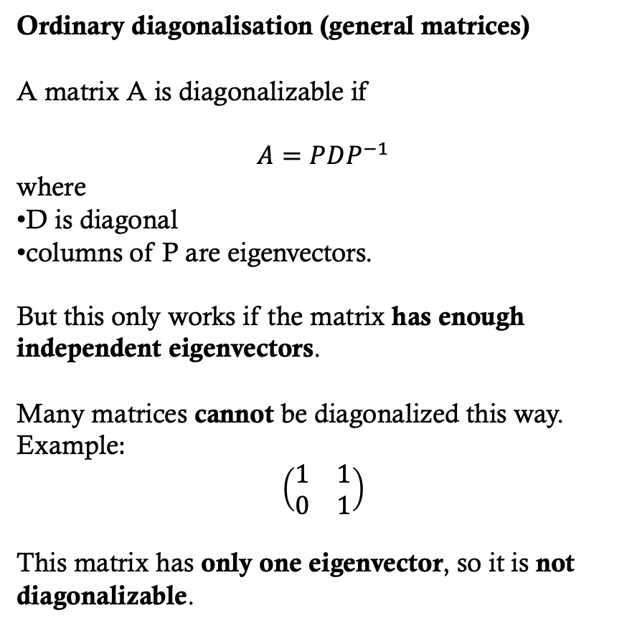
Spectral decomposition
Ordinary diagonalisation (general matrices)
A matrix A is diagonalizable if
$$A=PDP^{−1}$$
where
D is diagonal
columns of P are eigenvectors.
But this only works if the matrix has enough independent eigenvectors.
Many matrices cannot be diagonalized this way.
Example
This matrix has only one eigenvector, so it is not diagonalizable.
Hermitian operators do not have this problem: they always have a full orthonormal set of eigenvectors and therefore can always be diagonalised, which is the basis of the spectral decomposition.
Preview: the eigenvalues will be the outputs of our quantum computations.

Slide 41
Spectral decomposition
# Example: Matrix that can't be diagonalised
#------------------
A = [[1, 1],
[0, 1]]
# Compute eigenvalues
λ1, λ2 = complex_eigenvalues_2x2(A)
print("Eigenvalues:", λ1, ",", λ2)
# Compute eigenvectors
v1 = complex_eigenvector_2x2(A, λ1)
v2 = complex_eigenvector_2x2(A, λ2)
print("Eigenvector for λ =", λ1, ":", v1)
print("Eigenvector for λ =", λ2, ":", v2)
Eigenvalues: (1+0j) , (1+0j)
Traceback (most recent
ZeroDivisionError:
Since the matrix has just
one repeated eigenvalue we
can’t write a matrix with
two eigenvalues on the
diagonal.

Slide 42
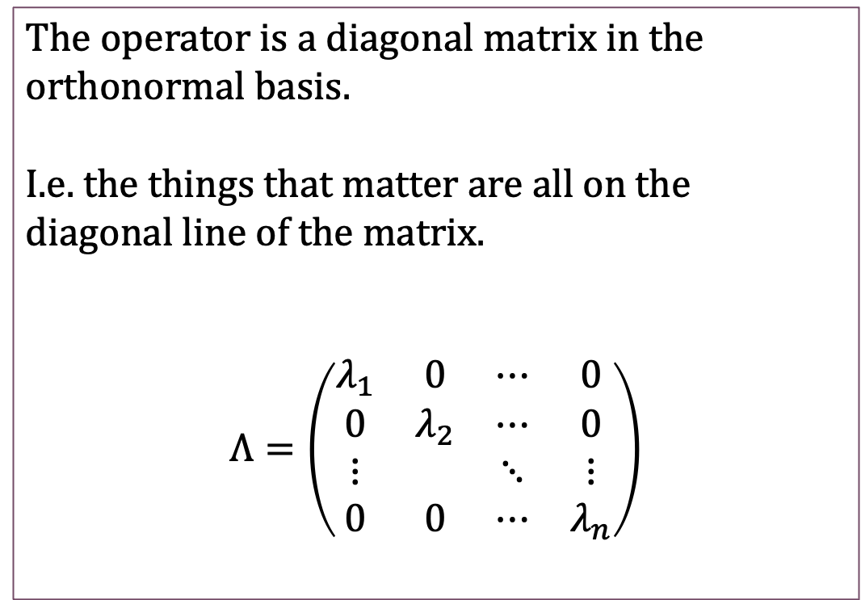
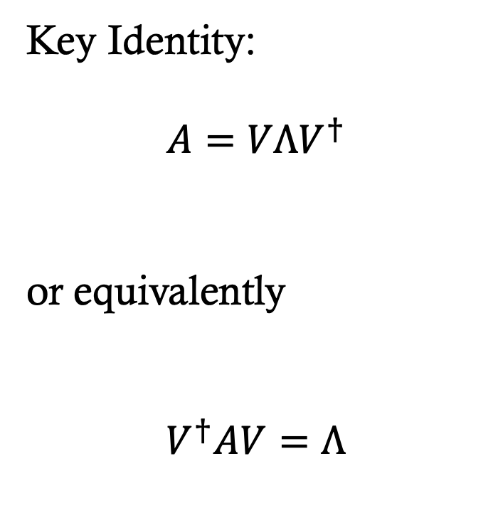
Spectral decomposition
The operator is a diagonal matrix in the orthonormal basis.
I.e. the things that matter are all on the diagonal line of the matrix.
$$Λ=\left(\begin{matrix}λ_{1} & 0 & ⋯ & 0 \\ 0 & λ_{2} & ⋯ & 0 \\ ⋮ & & ⋱ & ⋮ \\ 0 & 0 & ⋯ & λ_{n}\end{matrix}\right)$$
Key Identity:
$$A=VΛV^{†}$$
or equivalently
$$V^{†}AV=Λ$$

Slide 43
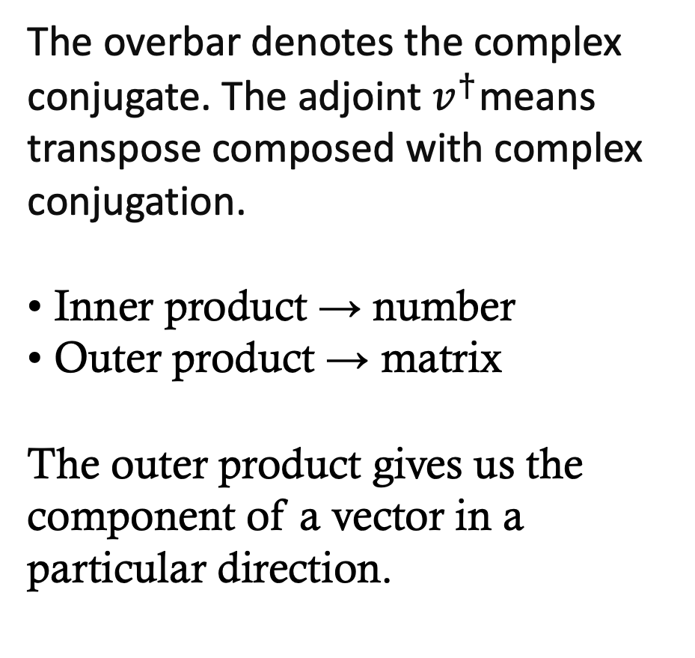
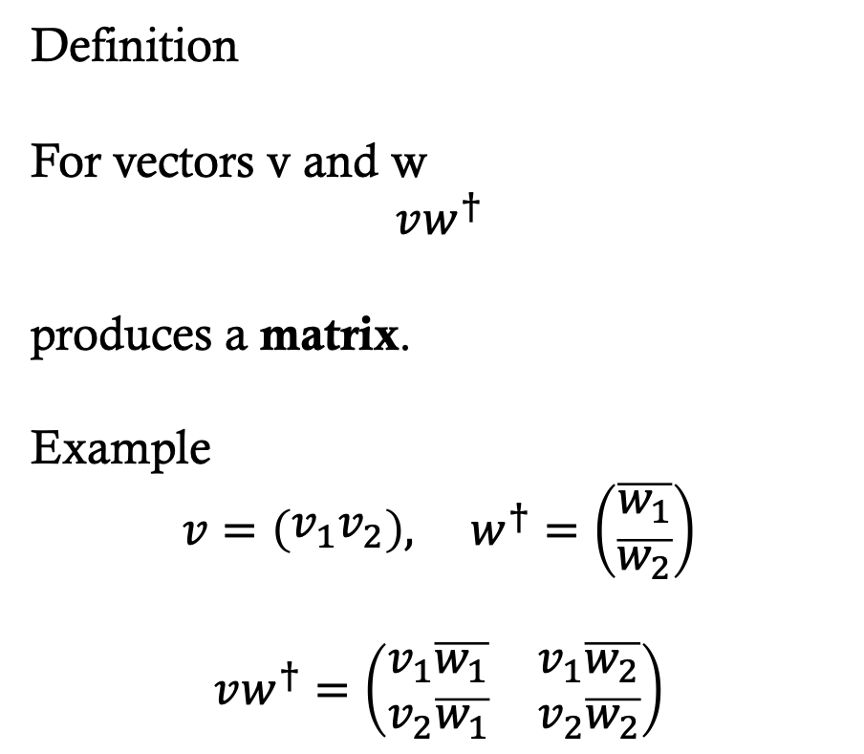
The outer product
Definition
For vectors v and w
$$vw^{†}$$
produces a matrix.
Example
$$v=\left(\begin{matrix}v_{1}v_{2}\end{matrix}\right), w^{†}=\left(\begin{matrix}\overline{w_{1}} \\ \overline{w_{2}}\end{matrix}\right)$$
$$vw^{†}=\left(\begin{matrix}v_{1}\overline{w_{1}} & v_{1}\overline{w_{2}} \\ v_{2}\overline{w_{1}} & v_{2}\overline{w_{2}}\end{matrix}\right)$$
The overbar denotes the complex conjugate. The adjoint $v^{†}$means transpose composed with complex conjugation.
• Inner product → number
• Outer product → matrix
The outer product gives us the component of a vector in a particular direction.

Slide 44
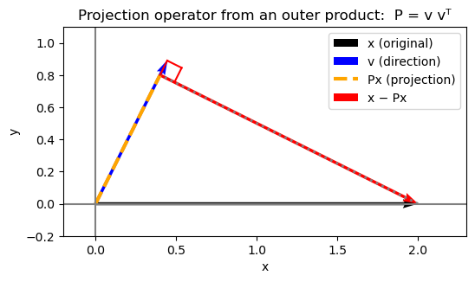
The outer product
We are asking: “How much of vector x points in that direction?”
The projection is the part that points that way.

Slide 45
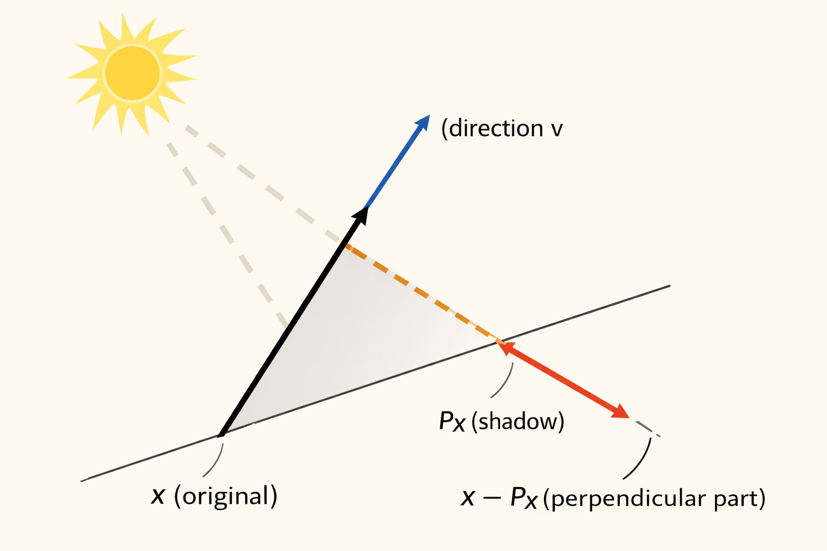
The outer product
The original vector x (black) can be decomposed relative to the direction v (blue). When light shines from the sun, x casts a shadow onto the line defined by v.
This shadow is the projection P x (orange dashed segment ending in the red arrow). The remaining component x - P x (red) is the part of the vector perpendicular to that direction.
The projection operator keeps only the component of a vector that lies along the chosen direction.

Slide 46
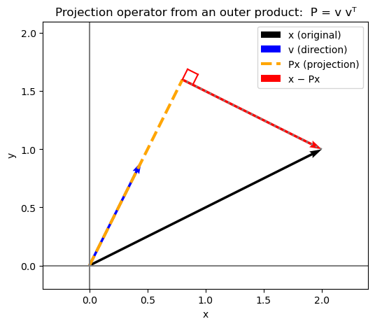
The outer product
We are asking: “How much of vector x points in that direction?”
The projection is the part that points that way.

Slide 47
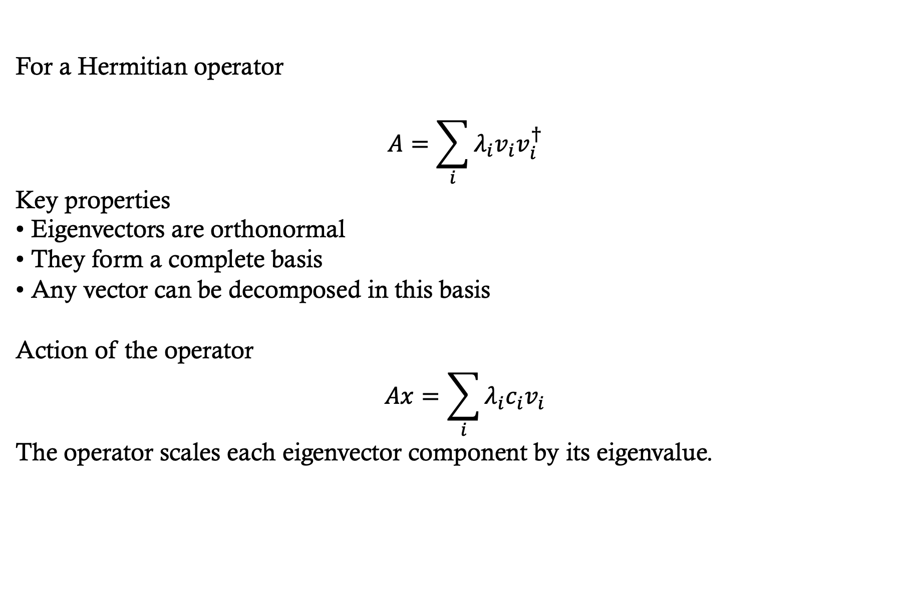
Spectral decomposition
For a Hermitian operator
$$A=\sum_{i}{λ_{i}v_{i}v_{i}^{†}}$$
Key properties
• Eigenvectors are orthonormal
• They form a complete basis
• Any vector can be decomposed in this basis
Action of the operator
$$Ax=\sum_{i}{λ_{i}c_{i}v_{i}}$$
The operator scales each eigenvector component by its eigenvalue.

Slide 48
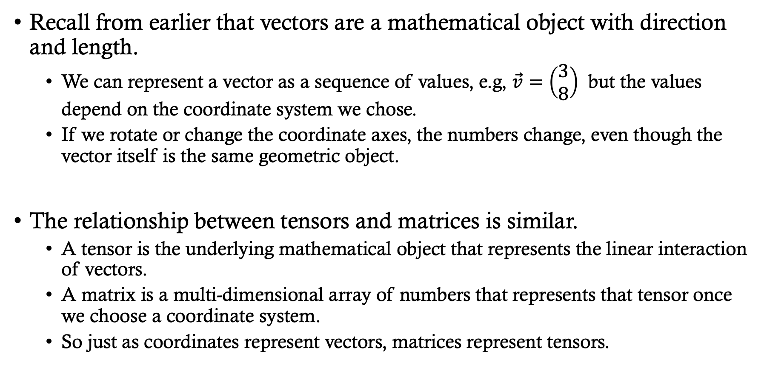
Tensor Products
Recall from earlier that vectors are a mathematical object with direction and length.
  We can represent a vector as a sequence of values, e.g, $\vec{v}=\left(\begin{matrix}3 \\ 8\end{matrix}\right)$ but the values depend on the coordinate system we chose.
  If we rotate or change the coordinate axes, the numbers change, even though the vector itself is the same geometric object.
The relationship between tensors and matrices is similar.
  A tensor is the underlying mathematical object that represents the linear interaction of vectors.
  A matrix is a multi-dimensional array of numbers that represents that tensor once we choose a coordinate system.
  So just as coordinates represent vectors, matrices represent tensors.

Slide 49
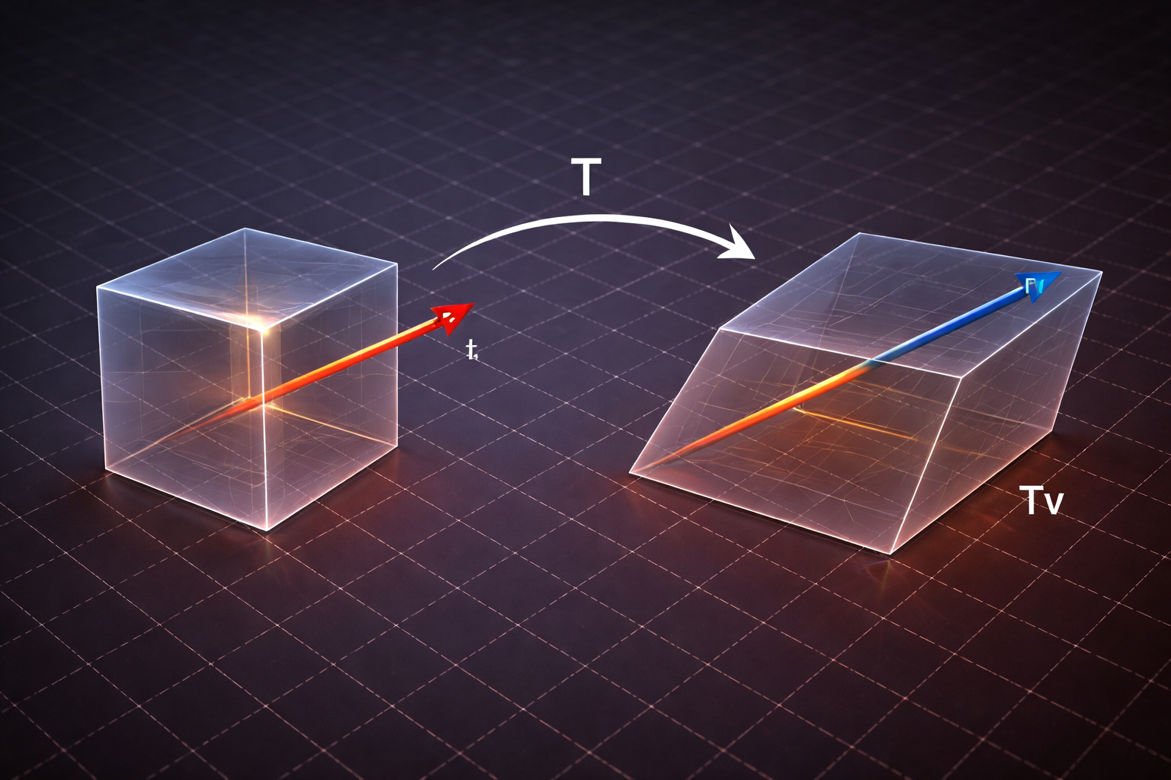
Tensors
A rank-2 tensor acts as a linear transformation of vectors, changing their direction and magnitude.
When we choose a coordinate system, this transformation is represented by a matrix.
Conceptual art showing 2D tensor distorting vector space.

Slide 50
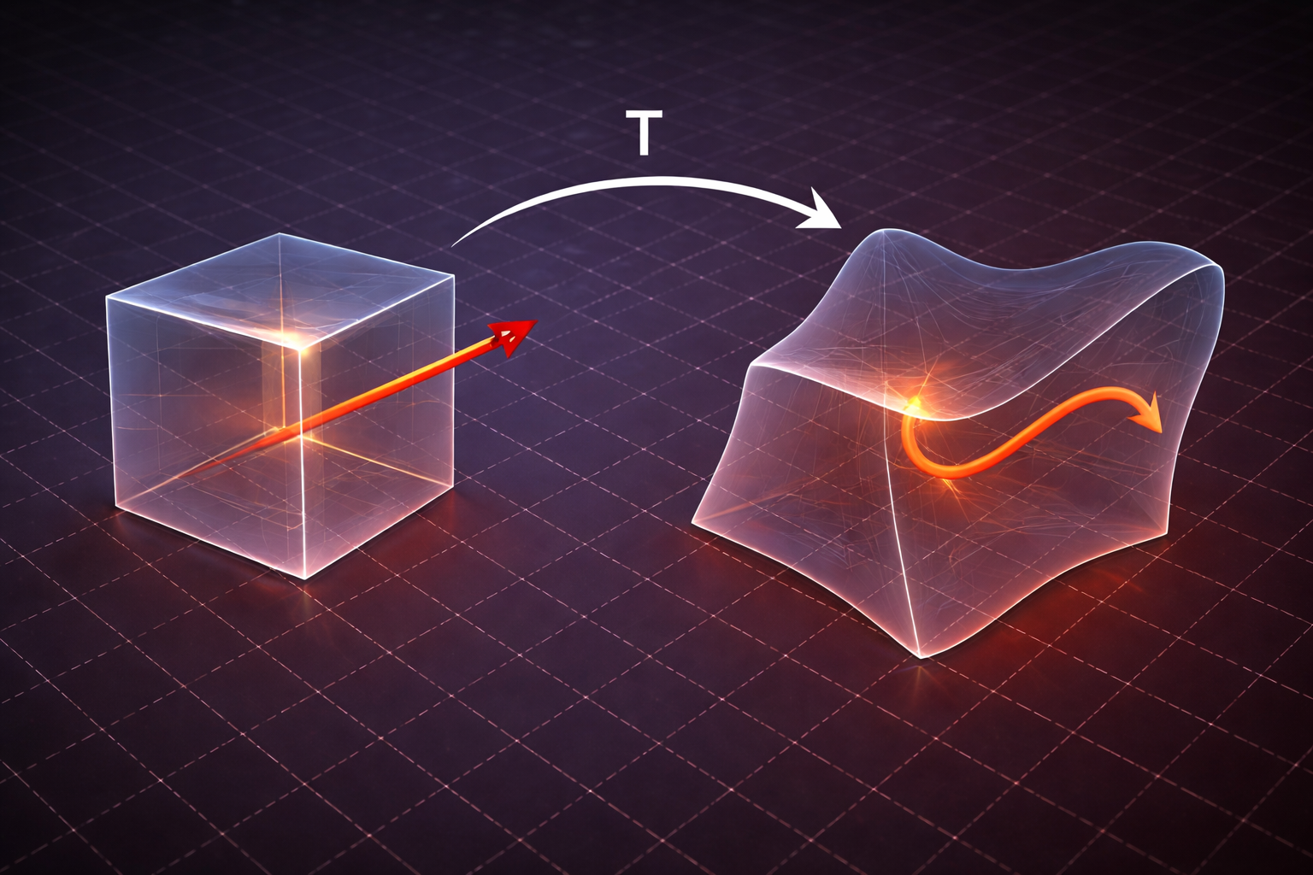
Not a Tensor
This concept art shows a nonlinear transformation.
Straight lines bend, so the mapping is not linear and cannot be represented by a tensor (matrix).
(However, nonlinear transformations can often be approximated locally by linear maps.
In calculus, we approximate a curved transformation with many infinitesimal linear pieces. This is the idea behind derivatives and integrals. We won’t care about that in this course.)

Slide 51
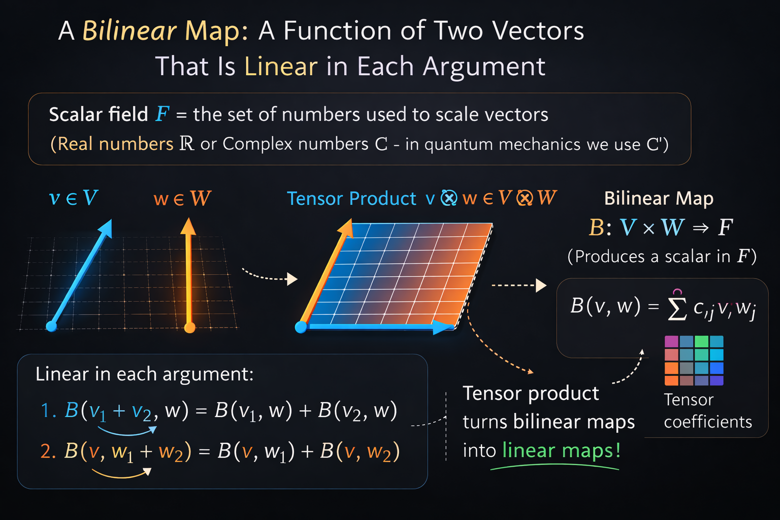

Slide 52

Tensor Products
Let V and W be vector spaces over a scalar field $𝔽.$
The tensor product space
$$V ⊗W$$
is a vector space together with a map
$$⊗: V ×W →V ⊗W$$
such that
$$\left(v,w\right)↦v⊗w$$
and the map is bilinear.
The tensor product of matrices is not ordinary matrix multiplication.
The tensor product combines transformations acting on different spaces.
The product operator takes operators are its arguments.

Slide 53

Tensor products are higher-order functions
The tensor product can combine vector spaces and operators.
Combining vector spaces
If $V,W \text{are} \text{vector} \text{spaces}$ then the tensor product constructs a new space
$$V ⊗W$$
whose dimension satisfies
$$\dim\left(V⊗W\right)=\dim\left(V\right)\dim\left(W\right)$$
Combining operators
If $A : V →V, B : W →W$
then the tensor product produces a new operator
$$A ⊗B : V ⊗W →V ⊗W$$
defined by
$$\left(A⊗B\right)\left(v⊗w\right)=\left(Av\right)⊗\left(Bw\right)$$

Slide 54

Programming analogy
In computer science we often write higher-order functions:
def pair_map(f, g):
def combined(x, y):
return (f(x), g(y))
return combined # return a function
def square(x):
return x * x
def double(x):
return 2 * x
h = pair_map(square, double)
print(h(3.0, 4.0))
(9.0, 8.0)
The tensor product constructs a new operator
defined by
$$\left(A⊗B\right)\left(v⊗w\right)=\left(Av\right)⊗\left(Bw\right)$$

Slide 55


Tensor products are higher-order functions
Example:
Let
$$A=\left(\begin{matrix}1 & 2 \\ 3 & 4\end{matrix}\right)=\left(\begin{matrix}a_{11} & a_{12} \\ a_{21} & 22\end{matrix}\right) B=\left(\begin{matrix}0 & 5 \\ 6 & 7\end{matrix}\right)$$
Both represent linear operators on $ℝ^{2}$
The tensor product operator
$$A ⊗B$$
is defined by
$$A⊗B=\left(\begin{matrix}a_{11}B & a_{12}B \\ a_{21}B & a_{22}B\end{matrix}\right)=\left(\begin{matrix}1B & 2B \\ 3B & 4B\end{matrix}\right)=\left(\begin{matrix}1\left(\begin{matrix}5 & 5 \\ 6 & 7\end{matrix}\right) & 2\left(\begin{matrix}5 & 5 \\ 6 & 7\end{matrix}\right) \\ 3\left(\begin{matrix}5 & 5 \\ 6 & 7\end{matrix}\right) & 4\left(\begin{matrix}5 & 5 \\ 6 & 7\end{matrix}\right)\end{matrix}\right)=\left(\begin{matrix}0 & 5 & 0 & 10 \\ 6 & 7 & 12 & 14 \\ 0 & 15 & 0 & 20 \\ 18 & 21 & 24 & 28\end{matrix}\right)$$
Dimension Rule
$$A∈ℝ^{𝟚×𝟚}, B∈ℝ^{𝟚×𝟚}$$
$$A⊗B∈ℝ^{𝟜×𝟜}$$

Slide 56


We are ready to learn about quantum computing!
A single qubit lives in the Hilbert space
$$ℂ^{𝟚}$$
with basis
$$\left|0\right\rangle =\left(\begin{matrix}10\end{matrix}\right) \left|1\right\rangle =\left(\begin{matrix}01\end{matrix}\right)$$
A general state is
$$\left|ψ\right\rangle =α\left|0\right\rangle +β\left|1\right\rangle$$
Two Qubits
If we combine two qubits, the state space must represent all combinations of their amplitudes.
The correct construction is the tensor product space
$$ℂ^{𝟚}⊗ℂ^{𝟚}$$
which has dimension
$$2 ×2 = 4$$

