Slide 1

Basis products and norms
Lecture 5

Slide 2
Recap
We have built the mathematical setting for quantum computation:
• Complex vector spaces → allow superposition
• Inner products → give length, angle, probability
• Conjugation → fixes geometry in complex space
• Completeness → ensures limits stay inside the space

Slide 3
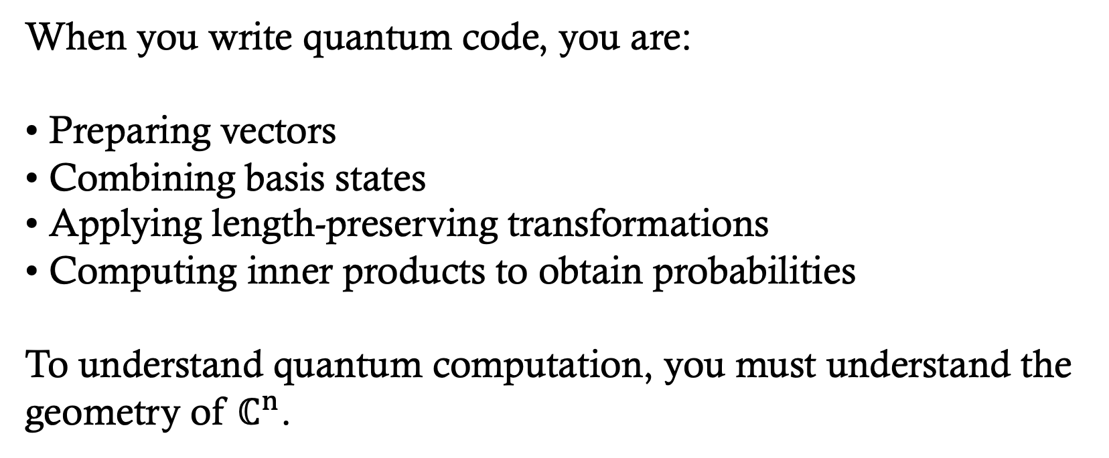
Recap
When you write quantum code, you are:
• Preparing vectors
• Combining basis states
• Applying length-preserving transformations
• Computing inner products to obtain probabilities
To understand quantum computation, you must understand the geometry of $ℂ^{n}$.

Slide 4
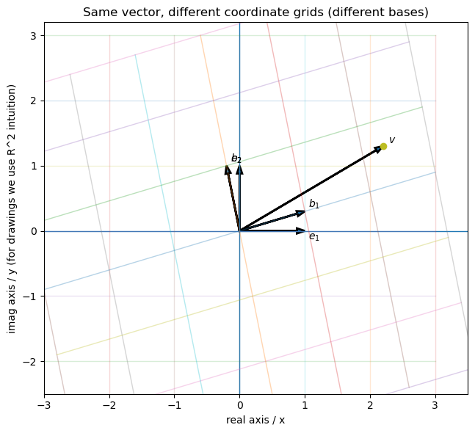
From Hilbert Spaces to Coordinates making Hilbert space computational
MATH 314 and 321 : Linear Algebra
A vector is a geometric object, independent of any coordinate system.
Coordinates are the numbers you get after choosing a basis.
Same vector, different basis, different coordinates.
Goal today: move between geometry (vectors) and computation (coordinates and matrices).

Slide 5
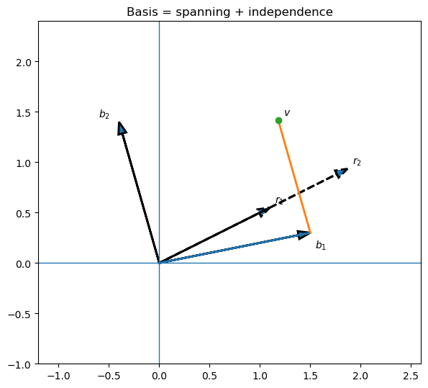
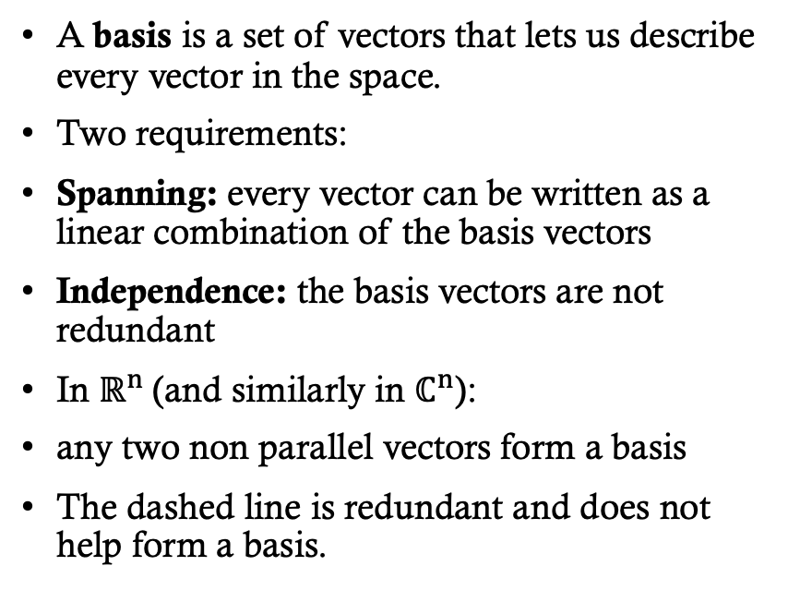
What Is a Basis?
Definition of basis in a complex vector space.
Linear independence and spanning.
MATH 314 and 321 : Linear Algebra
A basis is a set of vectors that lets us describe every vector in the space.
Two requirements:
Spanning: every vector can be written as a linear combination of the basis vectors
Independence: the basis vectors are not redundant
In $ℝ^{n}$(and similarly in $ℂ^{n}$):
any two non parallel vectors form a basis
The dashed line is redundant and does not help form a basis.

Slide 6
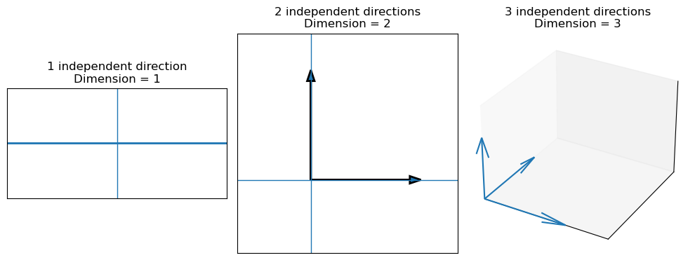
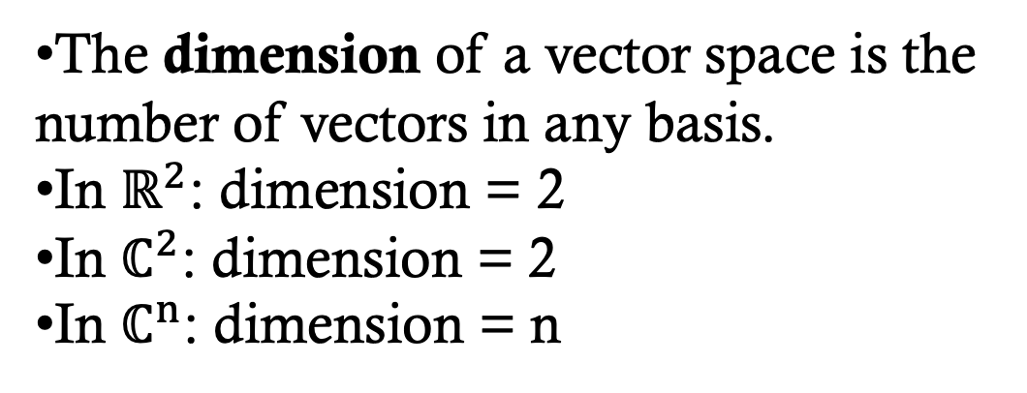

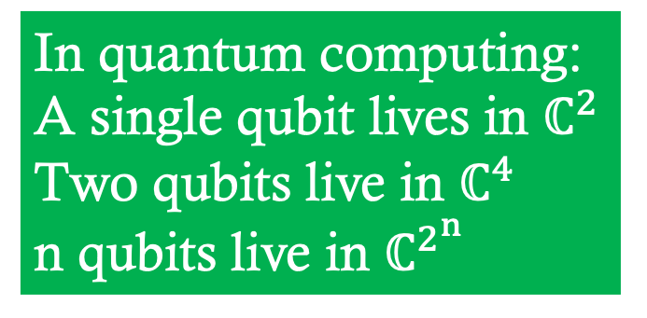
Dimension and Degrees of Freedom
Finite-dimensional Hilbert spaces.
Connection to qubits$:ℂ^{2^{n}}.$
MATH 314 and 321 : Linear Algebra
In quantum computing:
A single qubit lives in $ℂ^{2}$
Two qubits live in $ℂ^{4}$
n qubits live in $ℂ^{2^{n}}$
The dimension of a vector space is the number of vectors in any basis.
In $ℝ^{2}$: dimension = 2
In $ℂ^{2}$: dimension = 2
In $ℂ^{n}$: dimension = n

Slide 7
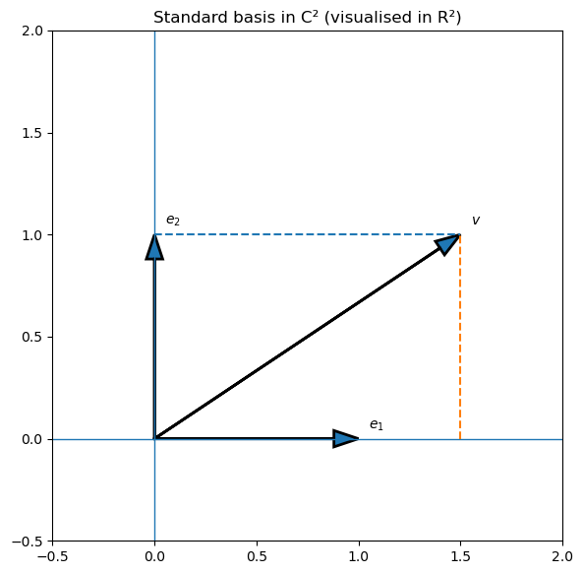
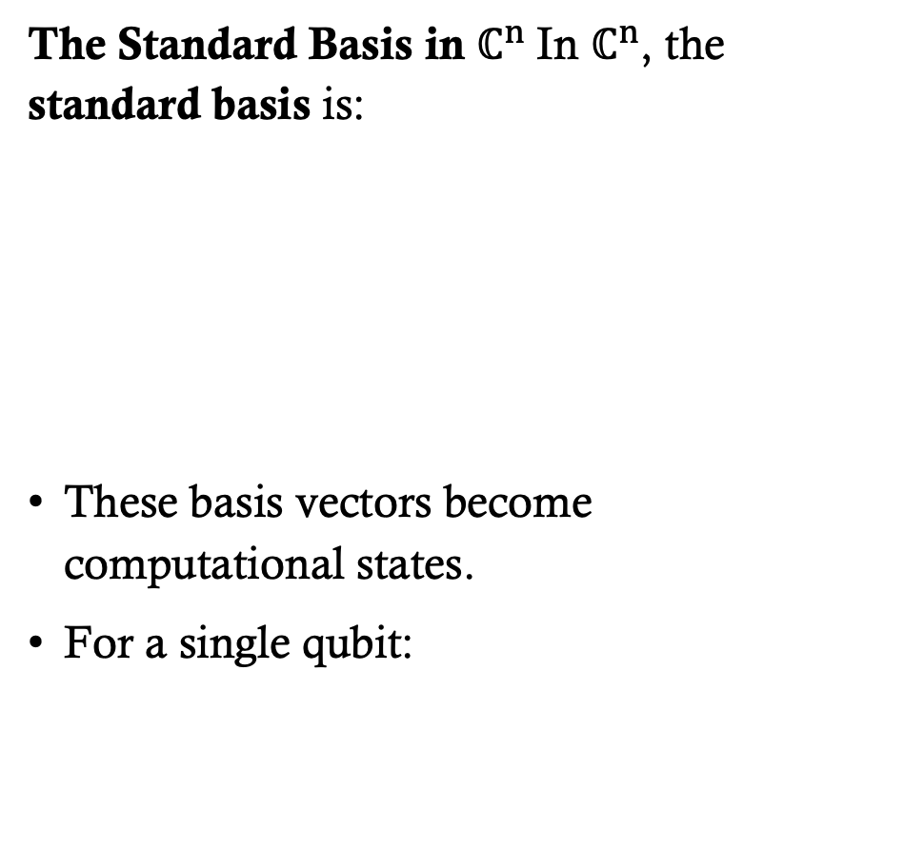
Coordinates Relative to a Basis
Expressing vectors as coordinate lists. Column vector representation.
The Standard Basis in $ℂ^{n} \text{In} ℂ^{n}\text{, }\text{the} \text{standard} \text{basis} \text{is}\text{:}$
$\text{These} \text{basis} \text{vectors} \text{become} \text{computational} \text{states}\text{.}$
$\text{For} \text{a} \text{single} \text{qubit}\text{:}$

Slide 8
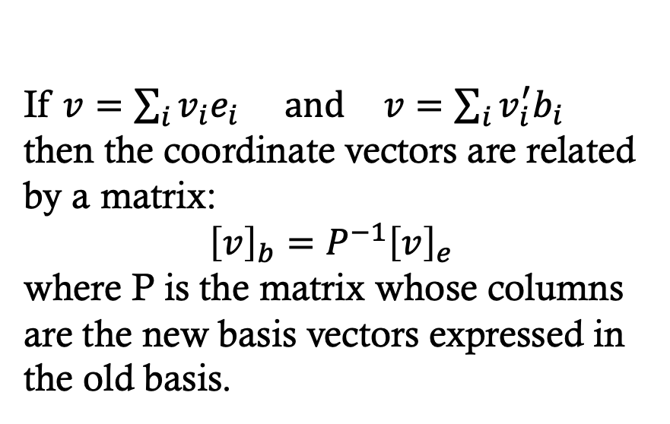
Change of Basis a vector exists independent of the coordinate system, the choice of coordinate system determines the numbers we use to represent a vector
MATH 314 and 321 : Linear Algebra
If $v=\sum_{i}{v_{i}e_{i}} \text{and} v=\sum_{i}{v_{i}^{′}b_{i}}$
then the coordinate vectors are related by a matrix:
$${\left[v\right]}_{b}=P^{−1}{\left[v\right]}_{e}$$
where P is the matrix whose columns are the new basis vectors expressed in the old basis.
Changing basis = multiplying by a matrix.
This is why matrices represent transformations.
In quantum computing:
Changing measurement basis
Rotating state representations
Switching between computational and eigenbases
are all change-of-basis operations.

Slide 9
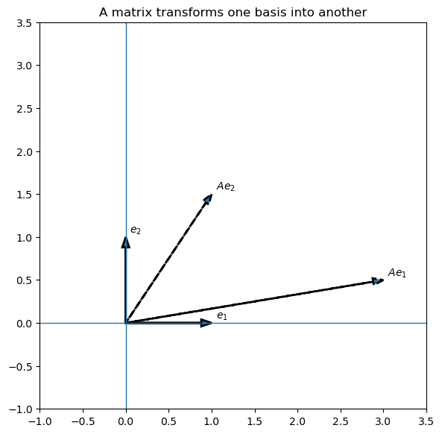
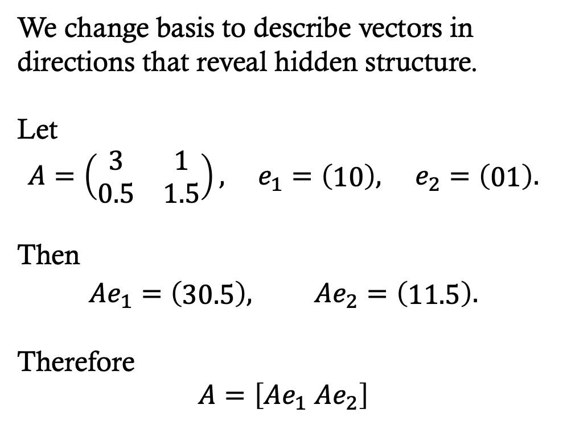
Change of Basis
We change basis to describe vectors in directions that reveal hidden structure.
Let
$$A=\left(\begin{matrix}3 & 1 \\ 0.5 & 1.5\end{matrix}\right), e_{1}=\left(\begin{matrix}10\end{matrix}\right), e_{2}=\left(\begin{matrix}01\end{matrix}\right).$$
Then
$$Ae_{1}=\left(\begin{matrix}30.5\end{matrix}\right), Ae_{2}=\left(\begin{matrix}11.5\end{matrix}\right).$$
Therefore
$$A=\left[Ae_{1} Ae_{2}\right]$$

Slide 10
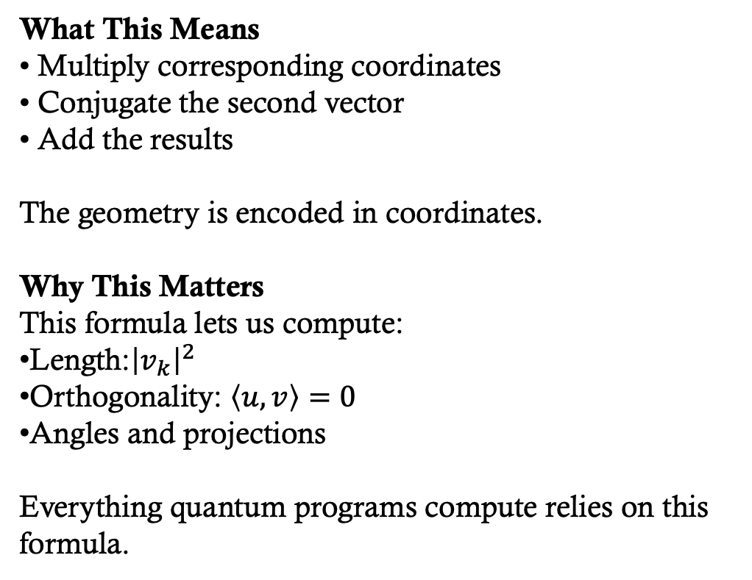
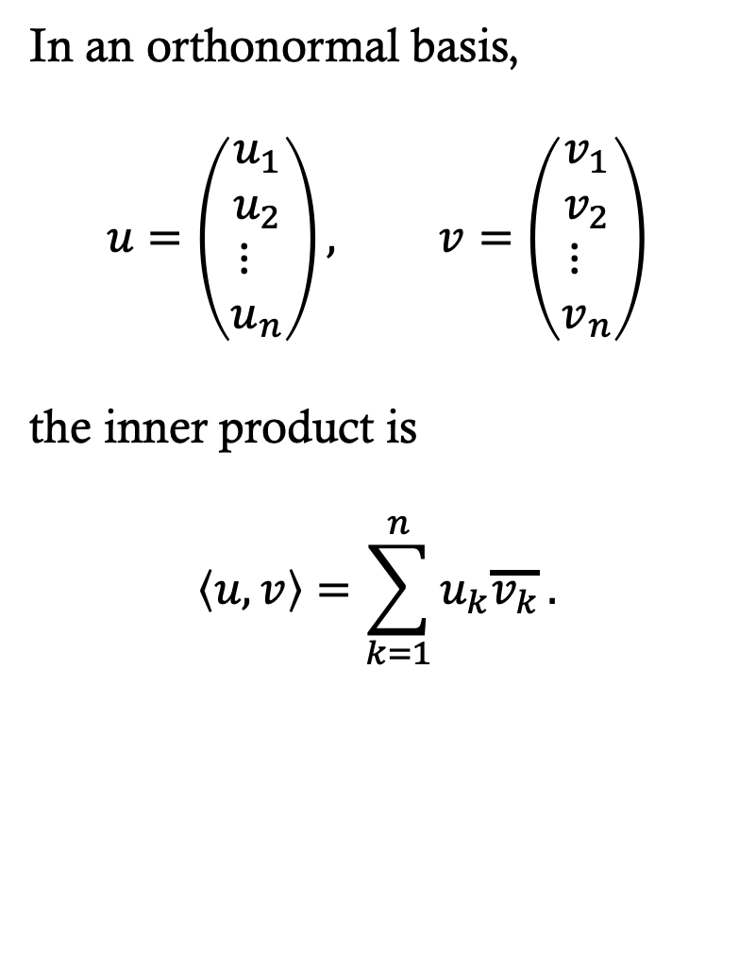
Inner Products in Coordinates
How basis choice affects inner product.
What This Means
• Multiply corresponding coordinates
• Conjugate the second vector
• Add the results
The geometry is encoded in coordinates.
Why This Matters
This formula lets us compute:
Length:${\left|v_{k}\right|}^{2}$
Orthogonality: $\left\langle u,v\right\rangle =0$
Angles and projections
Everything quantum programs compute relies on this formula.
In an orthonormal basis,
$$u=\left(\begin{matrix}u_{1} \\ u_{2} \\ {\begin{aligned}⋮ \\ u\end{aligned}}_{n}\end{matrix}\right), v=\left(\begin{matrix}v_{1} \\ v_{2} \\ {\begin{aligned}⋮ \\ v\end{aligned}}_{n}\end{matrix}\right)$$
the inner product is
$$\left\langle u,v\right\rangle =\sum_{k=1}^{n}{u_{k}\overline{v_{k}}}.$$

Slide 11
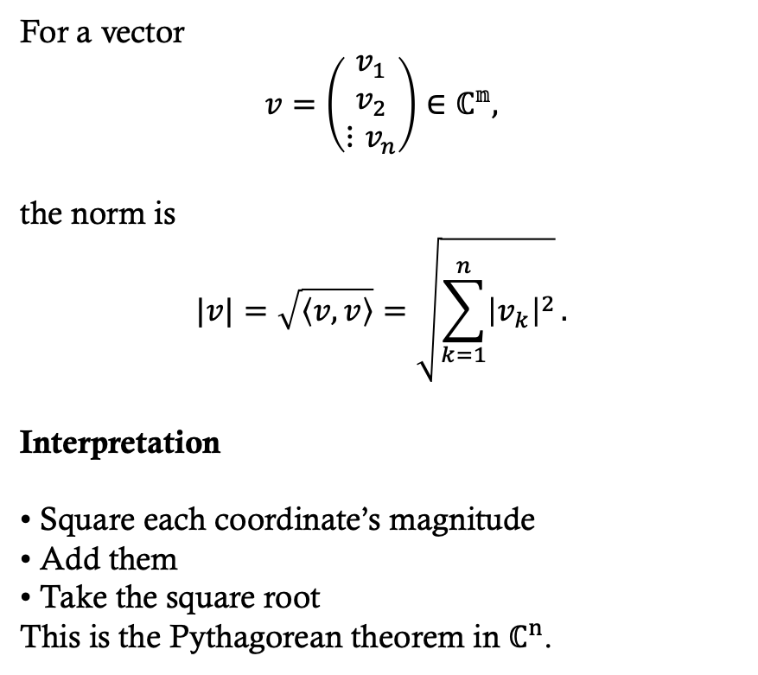
Norms and Length in Coordinates
Normalization of quantum states.
For a vector
$$v=\left(\begin{matrix}v_{1} \\ v_{2} \\ ⋮v_{n}\end{matrix}\right)∈ℂ^{𝕟},$$
the norm is
$$|v|=\sqrt{\left\langle v,v\right\rangle }=\sqrt{\sum_{k=1}^{n}{{\left|v_{k}\right|}^{2}}}.$$
Interpretation
• Square each coordinate’s magnitude
• Add them
• Take the square root
This is the Pythagorean theorem in $ℂ^{n}$.

Slide 12
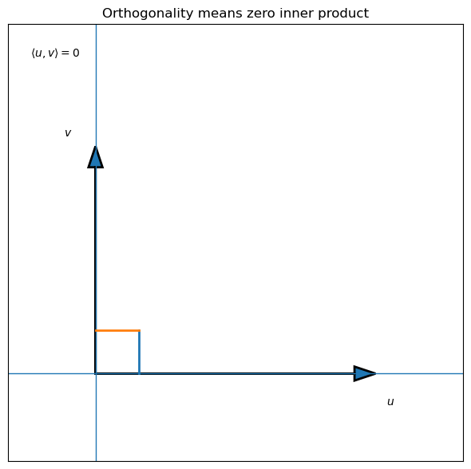
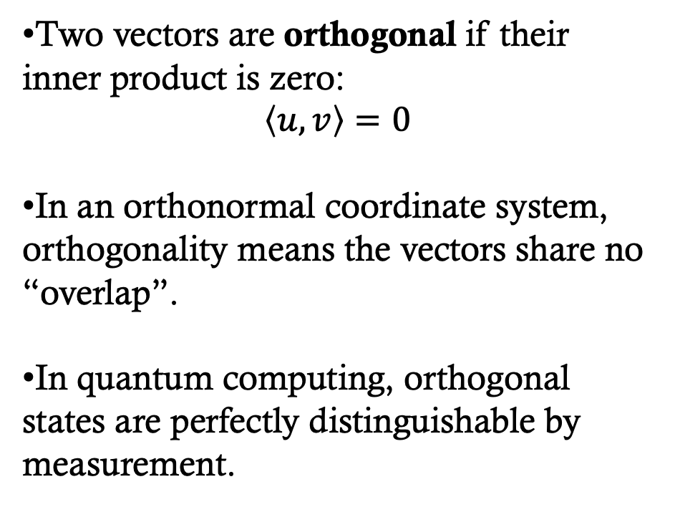
Orthogonality
Quantum meaning: distinguishable states.
Two vectors are orthogonal if their inner product is zero:
$$\left\langle u,v\right\rangle =0$$
In an orthonormal coordinate system, orthogonality means the vectors share no “overlap”.
In quantum computing, orthogonal states are perfectly distinguishable by measurement.

Slide 13
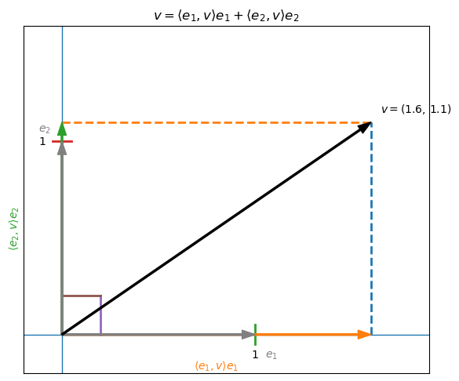
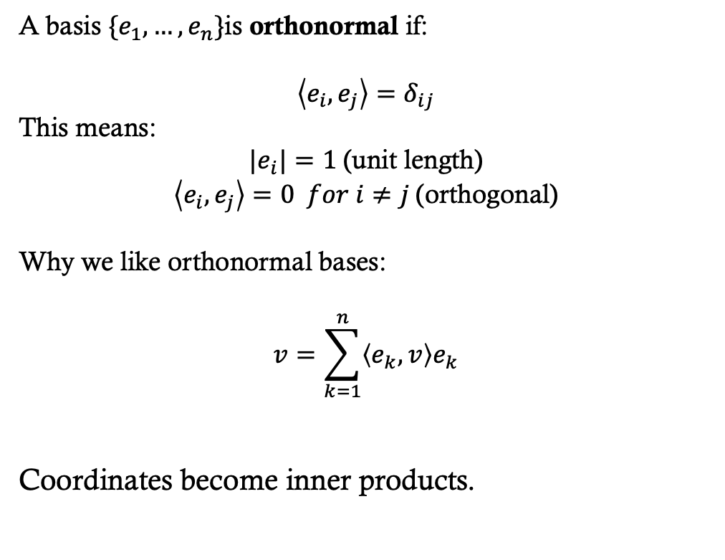
Orthonormal Bases
Definition and properties. Why they simplify inner products.
A basis $\{e_{1},…,e_{n}\}$is orthonormal if:
This means:
$|e_{i}|=1$(unit length)
$\left\langle e_{i},e_{j}\right\rangle =0 for i≠j$(orthogonal)
Why we like orthonormal bases:
$$v=\sum_{k=1}^{n}{\left\langle e_{k},v\right\rangle e_{k}}$$
Coordinates become inner products.

Slide 14
Orthonormal Bases
Definition and properties. Why they simplify inner products.
You might think I am just showing you the same old axis you have been using since high-school. I.e. x, y, z
But you learned that coordinates come first. Then vectors live inside coordinates.
What I am showing you is that the vectors define the coordinate system, not the other way around.
The inner product defines geometry.
Coordinates are the result of that geometry.
In quantum computing the coordinates are defined by inner products and the coordinates are amplitudes.
A basis $\{e_{1},…,e_{n}\}$is orthonormal if:
This means:
$|e_{i}|=1$(unit length)
$\left\langle e_{i},e_{j}\right\rangle =0 for i≠j$(orthogonal)
Why we like orthonormal bases:
$$v=\sum_{k=1}^{n}{\left\langle e_{k},v\right\rangle e_{k}}$$
Coordinates become inner products.

Slide 15
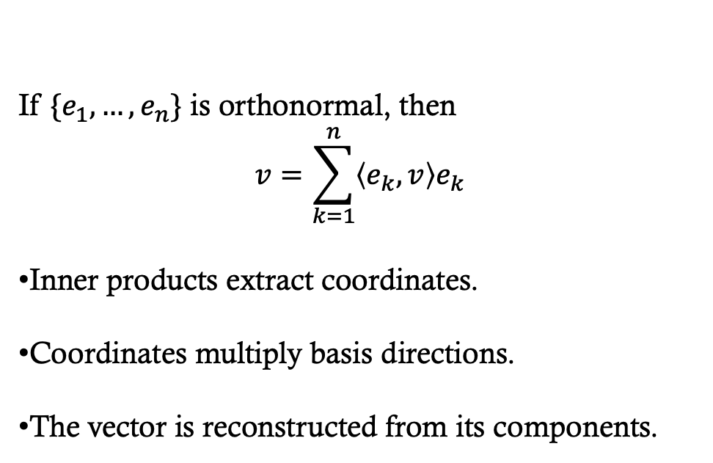
Expanding Vectors in an Orthonormal Basis
This is crucial for measurement and spectral decomposition.
MATH 314 and 321 : Linear Algebra
If $\{e_{1},…,e_{n}\}$ is orthonormal, then
$$v=\sum_{k=1}^{n}{\left\langle e_{k},v\right\rangle e_{k}}$$
Inner products extract coordinates.
Coordinates multiply basis directions.
The vector is reconstructed from its components.
later, we will reinterpret the same expansion physically
The inner product extracts the coordinate of $v$ in direction $e_{k}$.

Slide 16
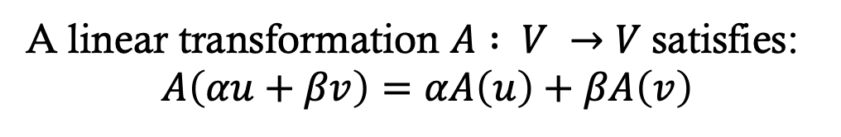
Linear Transformations in a Basis
Introduce operators. Matrix representation relative to a basis.
MATH 314 and 321 : Linear Algebra
A linear transformation $A : V →V$satisfies:
$$A\left(αu+βv\right)=αA\left(u\right)+βA\left(v\right)$$
Geometric properties
A linear transformation can:
Rotate
Stretch
Reflect
Shear
But it always sends lines through the origin to lines through the origin.
Algebraic properties
Linear maps preserve addition.
Linear maps preserve scalar multiplication.
They move vectors while preserving structure.
Determined entirely by its action on a basis.

Slide 17
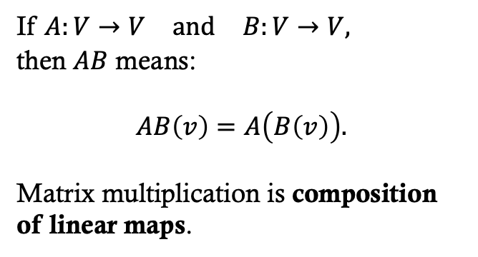
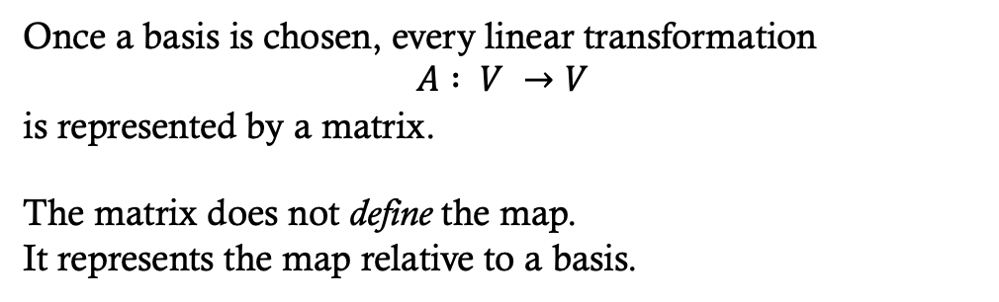
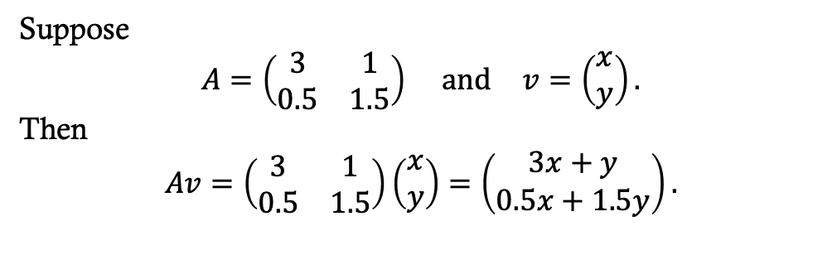
Matrices as Linear Maps
Multiplication as composition of maps.
A linear map is a function that takes vectors in and produces new vectors out, in a way that respects addition and scaling.
If $A:V→V \text{and} B:V→V,$
then $AB$ means:
$$AB\left(v\right)=A\left(B\left(v\right)\right).$$
Matrix multiplication is composition of linear maps.
Once a basis is chosen, every linear transformation
$$A : V →V$$
is represented by a matrix.
The matrix does not define the map.
It represents the map relative to a basis.
Suppose
$$A=\left(\begin{matrix}3 & 1 \\ 0.5 & 1.5\end{matrix}\right) \text{and} v=\left(\begin{matrix}\begin{aligned}x \\ y\end{aligned}\end{matrix}\right).$$
Then
$$Av=\left(\begin{matrix}3 & 1 \\ 0.5 & 1.5\end{matrix}\right)\left(\begin{matrix}\begin{aligned}x \\ y\end{aligned}\end{matrix}\right)=\left(\begin{matrix}\begin{aligned}3x+y \\ 0.5x+1.5y\end{aligned}\end{matrix}\right).$$
A linear map cannot: Shift the origin, bend space, warp curves. It can only: Rotate, Stretch, Reflect, Shear

Slide 18
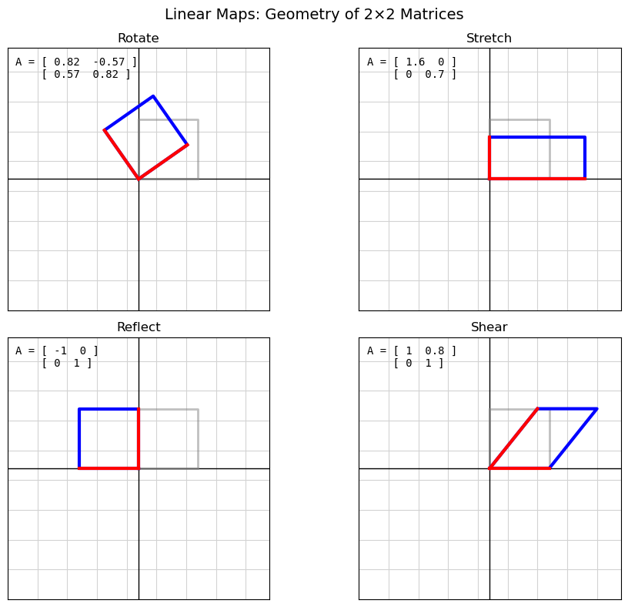
Matrices as Linear Maps
Multiplication as composition of maps.
A linear map can Rotate, Stretch, Reflect, Shear
It will turn out that quantum computing depends on linear maps. Non-linear transformations break quantum computing.

Slide 19
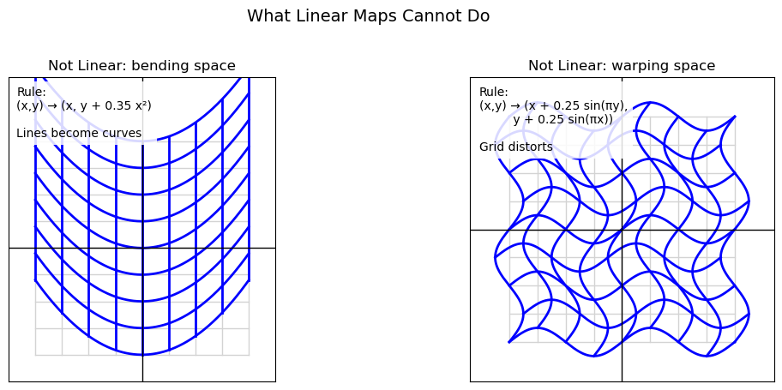
Matrices as Linear Maps
Multiplication as composition of maps.

Slide 20
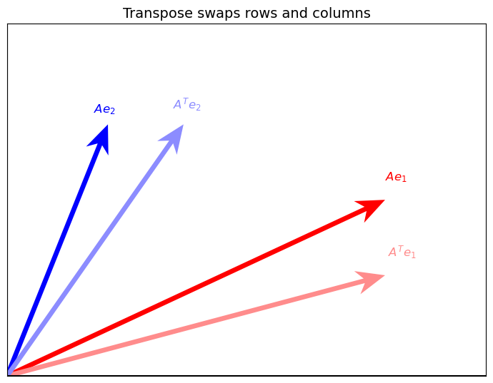
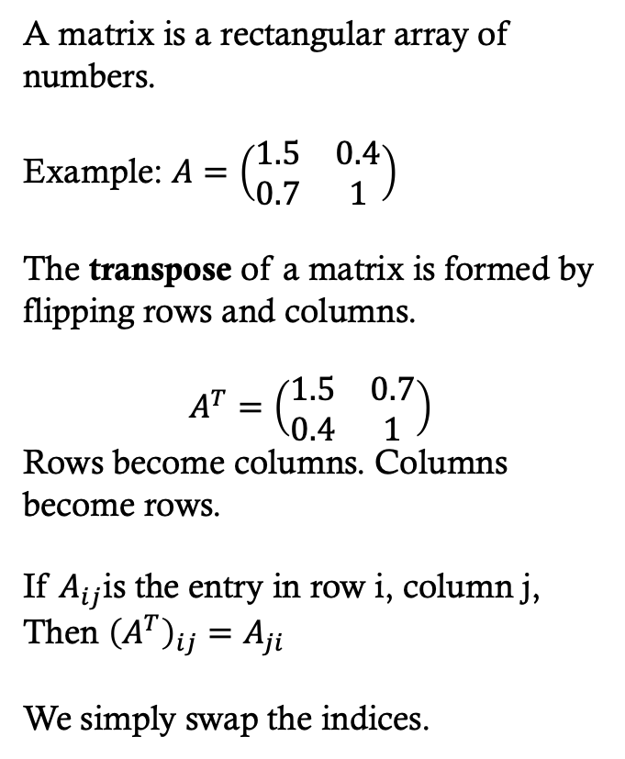

Matrix transpose: $A^{T}$
MATH 314 and 321 : Linear Algebra
A matrix is a rectangular array of numbers.
Example: $A=\left(\begin{matrix}1.5 & 0.4 \\ 0.7 & 1\end{matrix}\right)$
The transpose of a matrix is formed by flipping rows and columns.
$$A^{T}=\left(\begin{matrix}1.5 & 0.7 \\ 0.4 & 1\end{matrix}\right)$$
Rows become columns. Columns become rows.
If $A_{ij}$is the entry in row i, column j,
Then ${\left(A^{T}\right)}_{ij}=A_{ji}$
We simply swap the indices.

Slide 21
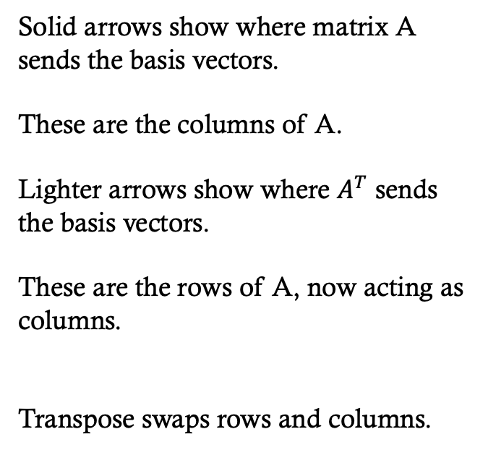
Matrix transpose: $A^{T}$
MATH 314 and 321 : Linear Algebra
Solid arrows show where matrix A sends the basis vectors.
These are the columns of A.
Lighter arrows show where $A^{T}$ sends the basis vectors.
These are the rows of A, now acting as columns.
Transpose swaps rows and columns.

Slide 22
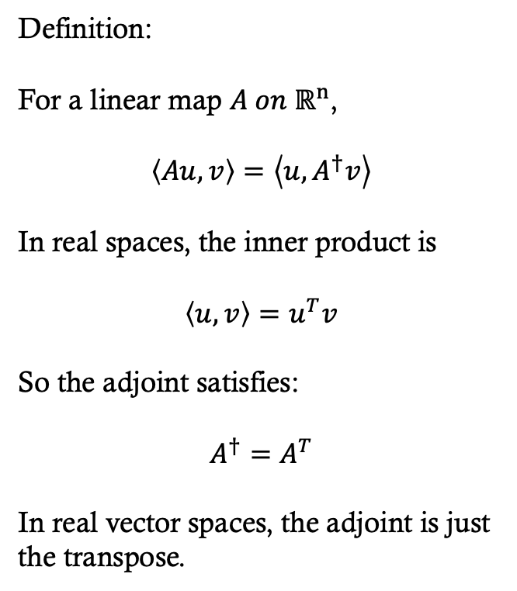
Adjoint of a Matrix in Real vector space
Definition:
For a linear map $A on ℝ^{n}$,
$$\left\langle Au,v\right\rangle =\left\langle u,A^{†}v\right\rangle$$
In real spaces, the inner product is
$$\left\langle u,v\right\rangle =u^{T}v$$
So the adjoint satisfies:
$$A^{†}=A^{T}$$
In real vector spaces, the adjoint is just the transpose.
The adjoint is not defined as the transpose.
It is defined by the inner product symmetry.
In real spaces, that symmetry forces the adjoint to be the transpose.

Slide 23
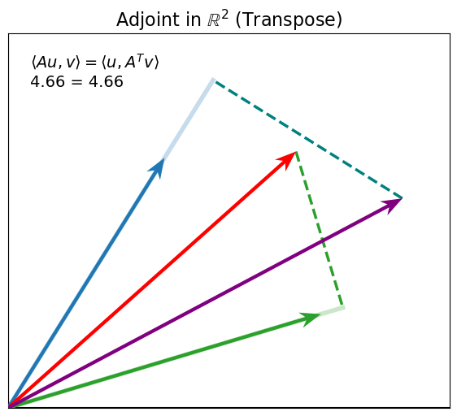
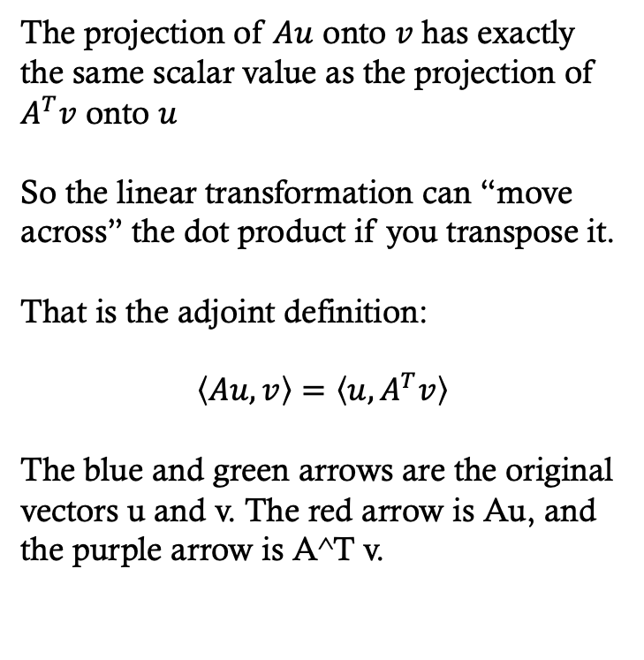
Adjoint of a Matrix in Real vector space
The projection of $Au$ onto $v$has exactly the same scalar value as the projection of $A^{T}v$ onto $u$
So the linear transformation can “move across” the dot product if you transpose it.
That is the adjoint definition:
$$\left\langle Au,v\right\rangle =\left\langle u,A^{T}v\right\rangle$$
The blue and green arrows are the original vectors u and v. The red arrow is Au, and the purple arrow is A^T v.

Slide 24
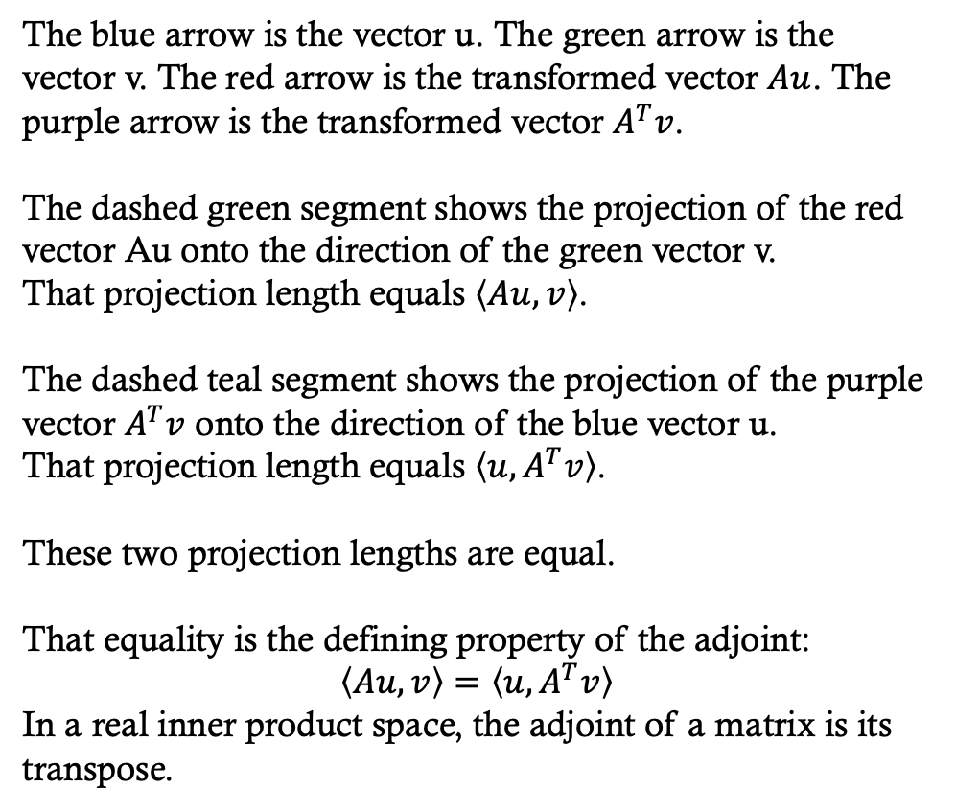
Adjoint of a Matrix in Real vector space
The blue arrow is the vector u. The green arrow is the vector v. The red arrow is the transformed vector $Au$. The purple arrow is the transformed vector $A^{T}v$.
The dashed green segment shows the projection of the red vector Au onto the direction of the green vector v.
That projection length equals $\left\langle Au,v\right\rangle$.
The dashed teal segment shows the projection of the purple vector $A^{T}v$ onto the direction of the blue vector u.
That projection length equals $\left\langle u,A^{T}v\right\rangle$.
These two projection lengths are equal.
That equality is the defining property of the adjoint:
$$\left\langle Au,v\right\rangle =\left\langle u,A^{T}v\right\rangle$$
In a real inner product space, the adjoint of a matrix is its transpose.

Slide 25
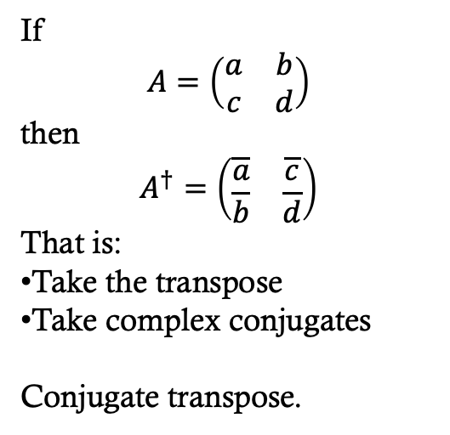
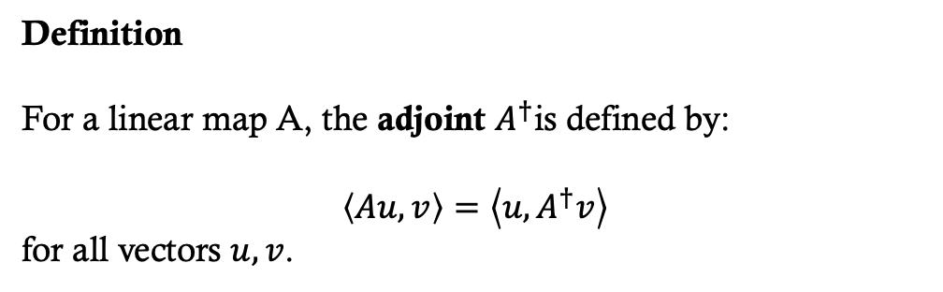
Adjoint of a Matrix in complex vector space
Definition
For a linear map A, the adjoint $A^{†}$is defined by:
$$\left\langle Au,v\right\rangle =\left\langle u,A^{†}v\right\rangle$$
for all vectors $u, v$.
If
$$A=\left(\begin{matrix}a & b \\ c & d\end{matrix}\right)$$
then
$$A^{†}=\left(\begin{matrix}\overline{a} & \overline{c} \\ \overline{b} & \overline{d}\end{matrix}\right)$$
That is:
Take the transpose
Take complex conjugates
Conjugate transpose.
The adjoint is the operator that:
“moves A from one side of the inner product to the other.”
It is defined relative to the inner product.

Slide 26
Adjoint of a Matrix in complex vector space
This is not just matrix manipulation.
The adjoint is defined by the geometry of the inner product.
It exists because we are in a Hilbert space.
The adjoint lets us define:
Hermitian matrices
Unitary matrices
Length-preserving maps
Which are the operators allowed in quantum mechanics.

Slide 27
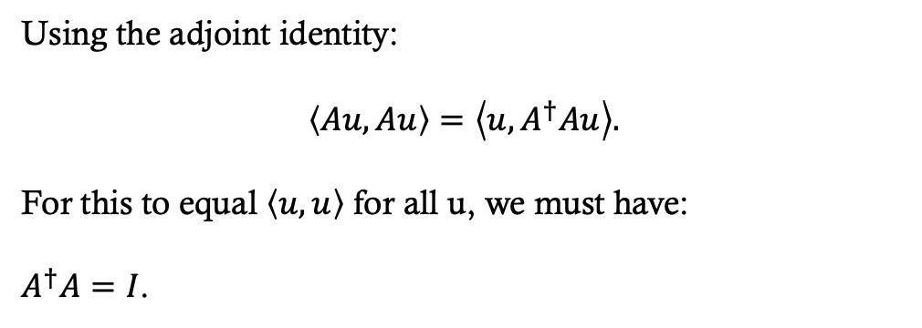
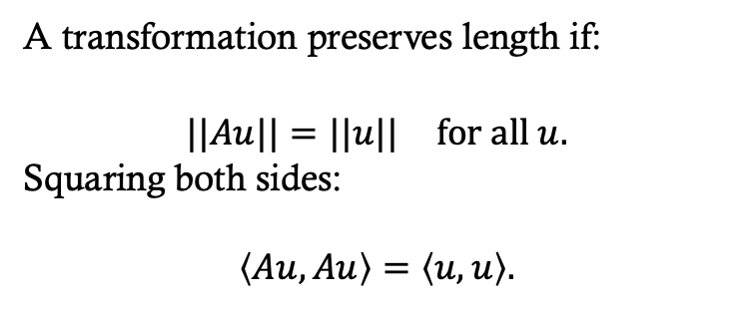
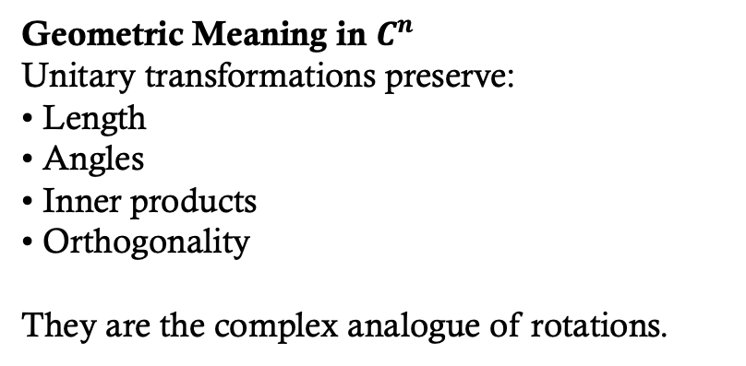
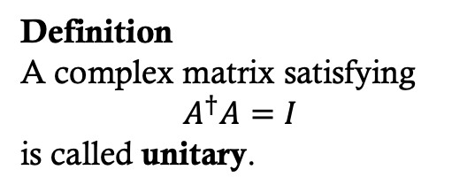
Length-Preserving Transformations
A transformation preserves length if:
$$||Au||=||u|| \text{for} \text{all} u.$$
Squaring both sides:
$$\left\langle Au,Au\right\rangle =\left\langle u,u\right\rangle .$$
Using the adjoint identity:
$$\left\langle Au,Au\right\rangle =\left\langle u,A^{†}Au\right\rangle .$$
For this to equal $\left\langle u,u\right\rangle$ for all u, we must have:
$A^{†}A=I$.
Definition
A complex matrix satisfying
$$A^{†}A=I$$
is called unitary.
Geometric Meaning in $C^{n}$
Unitary transformations preserve:
• Length
• Angles
• Inner products
• Orthogonality
They are the complex analogue of rotations.

Slide 28
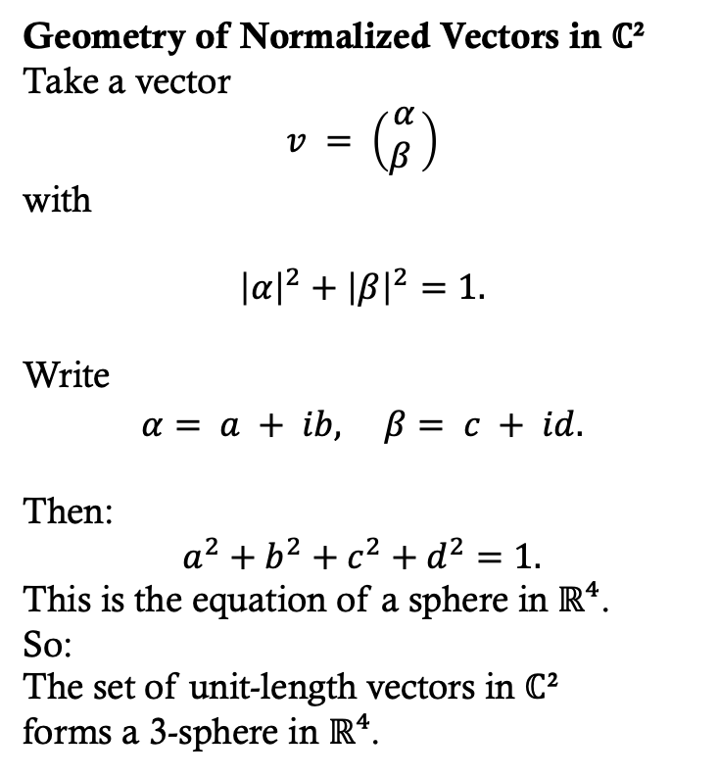
Length-Preserving Transformations
Geometry of Normalized Vectors in ℂ²
Take a vector
$$v = \left(\begin{matrix}α \\ β \end{matrix}\right)$$
with
$${\left|α\right|}^{2}+{\left|β\right|}^{2}=1.$$
Write
$$α= a + ib, β= c + id.$$
Then:
$$a^{2}+b^{2}+c^{2}+d^{2}=1.$$
This is the equation of a sphere in ℝ⁴.
So:
The set of unit-length vectors in ℂ²
forms a 3-sphere in ℝ⁴.

Slide 29
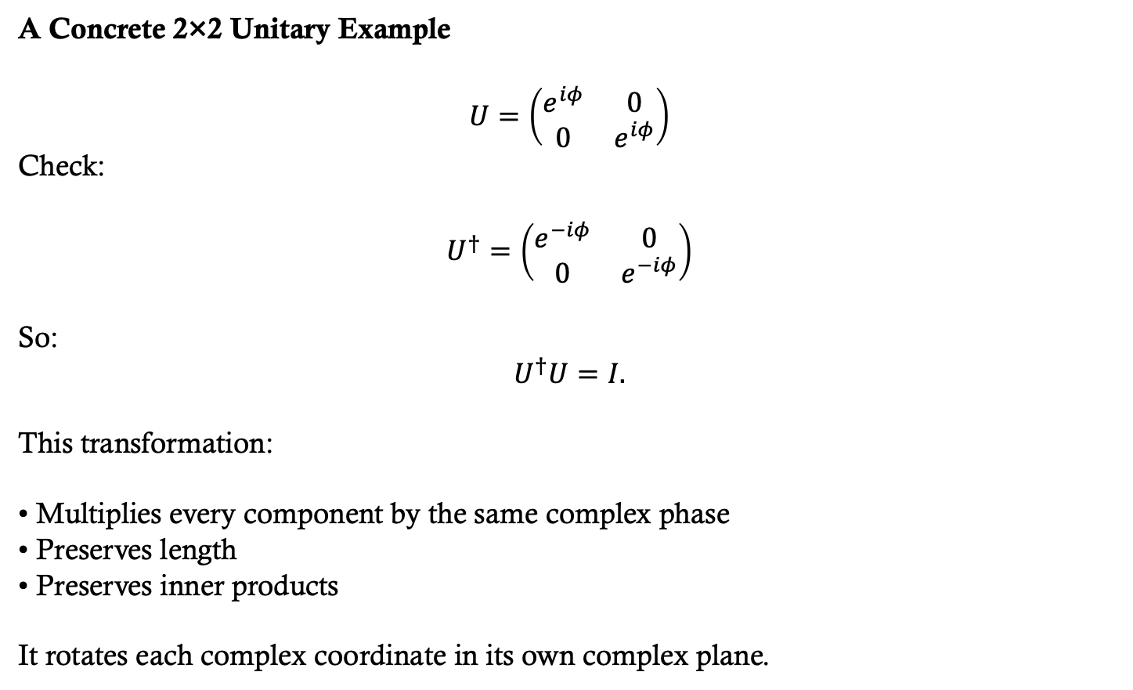
Length-Preserving Transformations
A Concrete 2×2 Unitary Example
$$U=\left(\begin{matrix}e^{iφ} & 0 \\ 0 & e^{iφ}\end{matrix}\right)$$
Check:
$$U^{†}=\left(\begin{matrix}e^{−iφ} & 0 \\ 0 & e^{−iφ}\end{matrix}\right)$$
So:
$$U^{†}U=I.$$
This transformation:
• Multiplies every component by the same complex phase
• Preserves length
• Preserves inner products
It rotates each complex coordinate in its own complex plane.
Need to revisit this slide.
Trying to introduce unitary maps…

Slide 30
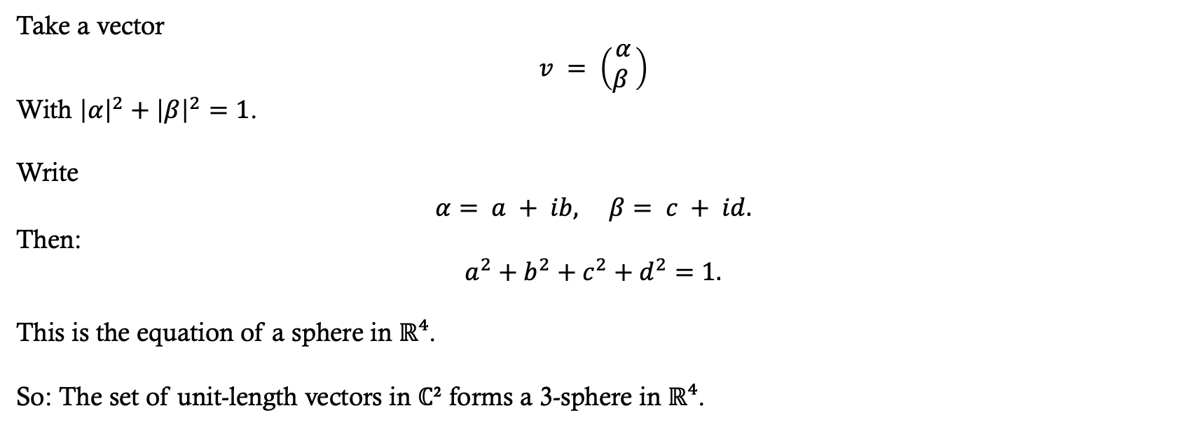
Geometry of Normalized Vectors in ℂ²
Take a vector
$$v = \left(\begin{matrix}α \\ β \end{matrix}\right)$$
With ${\left|α\right|}^{2}+{\left|β\right|}^{2}=1$.
Write
$$α= a + ib, β= c + id.$$
Then:
$$a^{2}+b^{2}+c^{2}+d^{2}=1.$$
This is the equation of a sphere in ℝ⁴.
So: The set of unit-length vectors in ℂ² forms a 3-sphere in ℝ⁴.

Slide 31
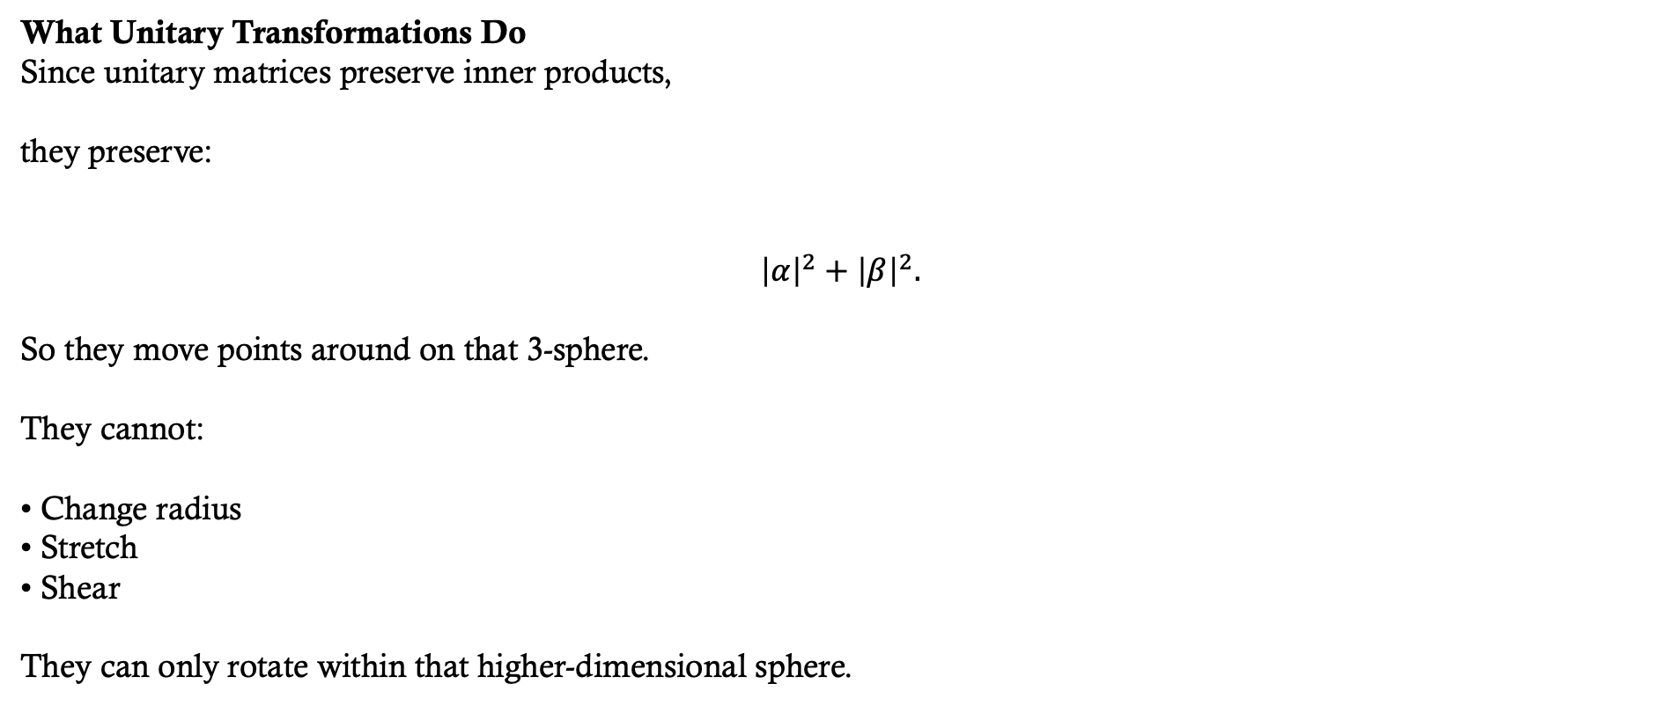
Geometry of Normalized Vectors in ℂ²
What Unitary Transformations Do
Since unitary matrices preserve inner products,
they preserve:
$${\left|α\right|}^{2}+{\left|β\right|}^{2}.$$
So they move points around on that 3-sphere.
They cannot:
• Change radius
• Stretch
• Shear
They can only rotate within that higher-dimensional sphere.
“In ℝ², orthogonal matrices rotate the circle.
In ℂ², unitary matrices rotate a 3-sphere.”

Slide 32
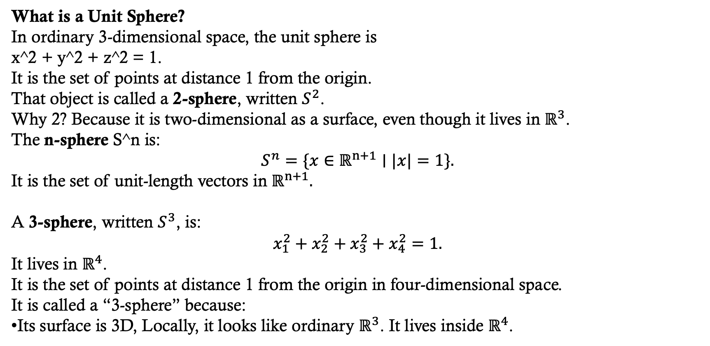
Higher dimensional spheres
MATH 439 - Differential Geometry
What is a Unit Sphere?
In ordinary 3-dimensional space, the unit sphere is
x^2 + y^2 + z^2 = 1.
It is the set of points at distance 1 from the origin.
That object is called a 2-sphere, written $S^{2}$.
Why 2? Because it is two-dimensional as a surface, even though it lives in $ℝ^{3}$.
The n-sphere S^n is:
$$S^{n}=\{x∈ℝ^{n+1}∣|x|=1\}.$$
It is the set of unit-length vectors in $ℝ^{n+1}.$
A 3-sphere, written $S^{3}$, is:
$$x_{1}^{2}+x_{2}^{2}+x_{3}^{2}+x_{4}^{2}=1.$$
It lives in $ℝ^{4}$.
It is the set of points at distance 1 from the origin in four-dimensional space.
It is called a “3-sphere” because:
Its surface is 3D, Locally, it looks like ordinary $ℝ^{3}$. It lives inside $ℝ^{4}$.

Slide 33
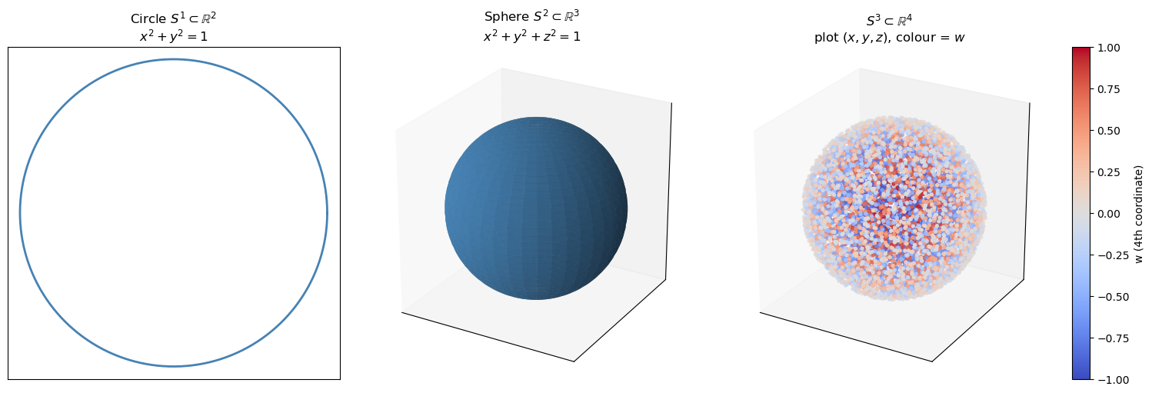
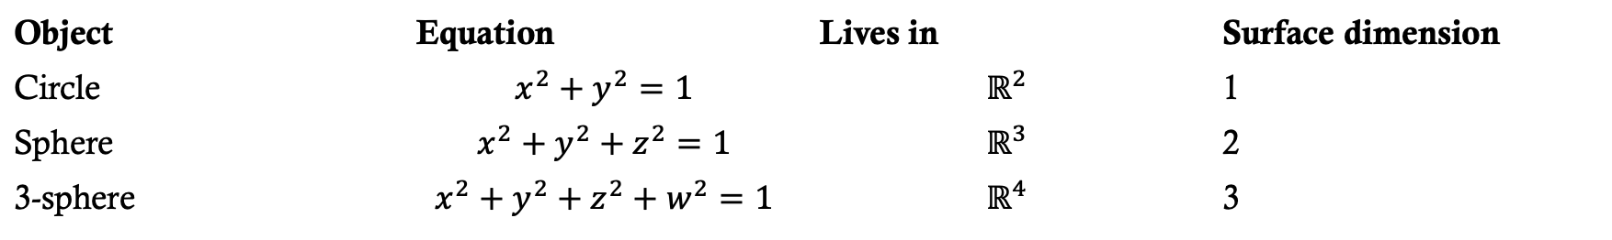
Higher dimensional spheres
MATH 439 - Differential Geometry
Object | Equation | Lives in | Surface dimension
Circle | $$x^{2}+y^{2}=1$$ | $$ℝ^{2}$$ | 1
Sphere | $$x^{2}+y^{2}+z^{2}=1$$ | $$ℝ^{3}$$ | 2
3-sphere | $$x^{2}+y^{2}+z^{2}+w^{2}=1$$ | $$ℝ^{4}$$ | 3
UNM MATH 439 - Differential Geometry
A circle is a 1-sphere (S¹) whose slices, obtained by fixing one coordinate in the equation above, are two points (can you see why its 2 points algebraically?); a 2-sphere (S²) is a sphere whose slices are circles; and a 3-sphere (S³) is a sphere whose slices are 2-spheres.

Slide 34
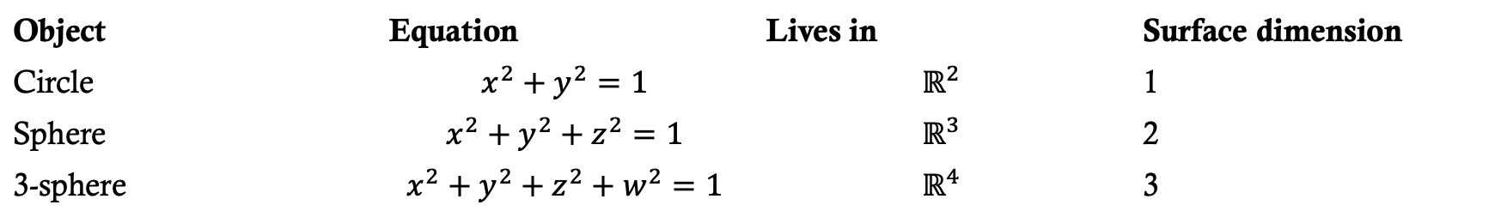
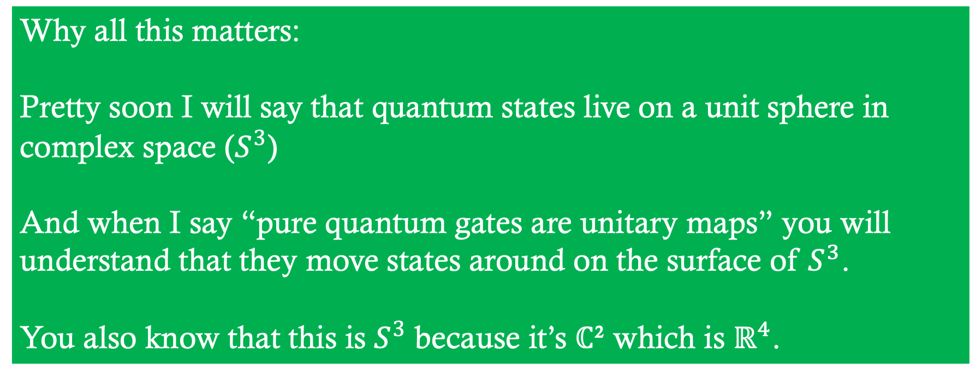
Higher dimensional spheres
MATH 439 - Differential Geometry
Object | Equation | Lives in | Surface dimension
Circle | $$x^{2}+y^{2}=1$$ | $$ℝ^{2}$$ | 1
Sphere | $$x^{2}+y^{2}+z^{2}=1$$ | $$ℝ^{3}$$ | 2
3-sphere | $$x^{2}+y^{2}+z^{2}+w^{2}=1$$ | $$ℝ^{4}$$ | 3
Why all this matters:
Pretty soon I will say that quantum states live on a unit sphere in complex space ($S^{3}$)
And when I say “pure quantum gates are unitary maps” you will understand that they move states around on the surface of $S^{3}$.
You also know that this is $S^{3}$ because it’s ℂ² which is $ℝ^{4}$.
UNM MATH 439 - Differential Geometry
A circle is a 1-sphere (S¹) whose slices, obtained by fixing one coordinate in the equation above, are two points (can you see why its 2 points algebraically?); a 2-sphere (S²) is a sphere whose slices are circles; and a 3-sphere (S³) is a sphere whose slices are 2-spheres.

Slide 35
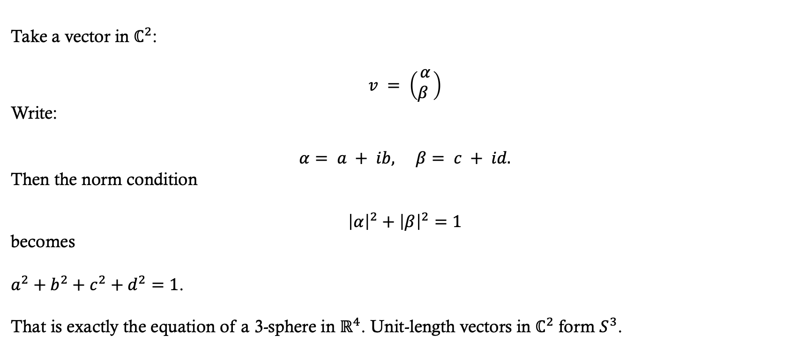
Geometry of Normalized Vectors in ℂ²
Take a vector in $ℂ^{2}$:
$$v = \left(\begin{matrix}α \\ β \end{matrix}\right)$$
Write:
$$α= a + ib, β= c + id.$$
Then the norm condition
$${\left|α\right|}^{2}+{\left|β\right|}^{2}=1$$
becomes
$a^{2}+b^{2}+c^{2}+d^{2}=1$.
That is exactly the equation of a 3-sphere in $ℝ^{4}$. Unit-length vectors in $ℂ^{2}$ form $S^{3}$.

Slide 36
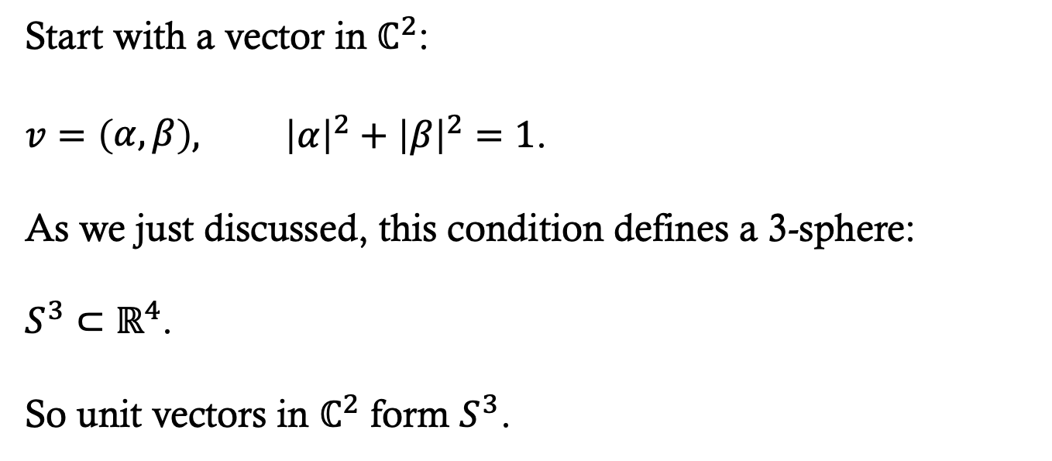
Geometry of Normalized Vectors in ℂ²
Start with a vector in $ℂ^{2}$:
$v=\left(\begin{matrix}α,β\end{matrix}\right), {\left|α\right|}^{2}+{\left|β\right|}^{2}=1$.
As we just discussed, this condition defines a 3-sphere:
$S^{3}⊂ℝ^{4}$.
So unit vectors in $ℂ^{2}$ form $S^{3}$.

Slide 37

Geometry of Normalized Vectors in ℂ²
Now here is the key step.
If we multiply the vector by a complex number of unit magnitude,
$$v↦e^{iφ}v,$$
its length does not change:
$$|e^{iφ}v|=|v|$$
Geometrically, this operation moves us along a circle inside $S^{3}$.
Each point in $S^{3}$lies on such a circle.

Slide 38

Geometry of Normalized Vectors in ℂ²
MATH 531 – Algebraic Topology I
If we now identify all vectors that differ only by this phase factor,
$v∼e^{iφ}v$,
we are collapsing each of those circles to a single point.
Mathematically, this quotient space is
$S^{3}/S^{1}$.
And a theorem from geometry says:
$S^{3}/S^{1}≅S^{2}$.
So when you remove the redundant phase degree of freedom from unit vectors in $ℂ^{𝟚}$, what remains is a 2-sphere.

Slide 39



QUbits
That 2-sphere is what later gets called the Bloch sphere.
So the reduction is:
$\text{unit} \text{vectors} \text{in} ℂ^{𝟚}⟶S^{3}⟶\frac{S^{3}}{S^{1}}≅S^{2}$.
In quantum computing instead of having bits that can be 0 or 1 like we do in classical computing, we have qubits whose state is a point on this 2-sphere.
Unitary maps are rotations of this sphere and define the operations we can perform on qubits.

