Slide 1

Complex vectors and inner products
Lecture 4

Slide 2
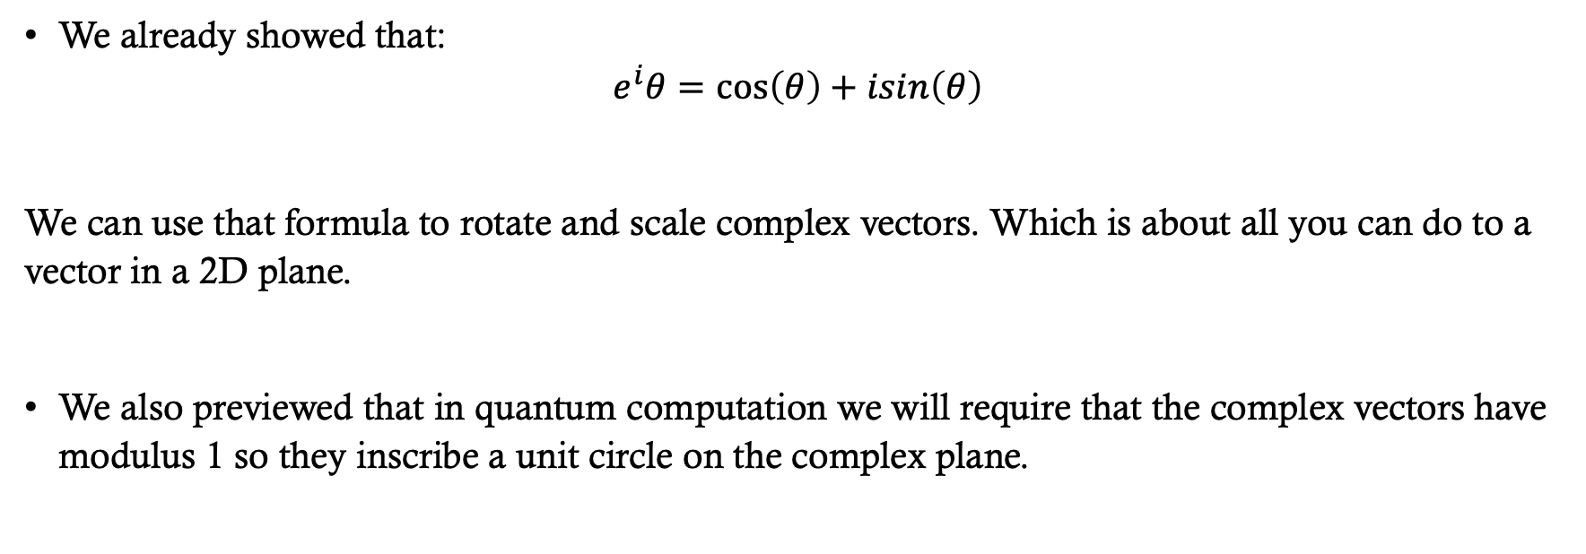
Last time: Euler’s equation
We already showed that:
$$e^{i}θ=\cos\left(θ\right)+isin\left(θ\right)$$
We can use that formula to rotate and scale complex vectors. Which is about all you can do to a vector in a 2D plane.
We also previewed that in quantum computation we will require that the complex vectors have modulus 1 so they inscribe a unit circle on the complex plane.

Slide 3
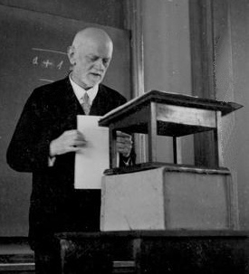
This time: complex VectorS and Hilbert spaces
Quantum computing is built on a mathematical structure called a Hilbert space.
In this lecture, we begin developing the geometry of complex vector spaces that will allow us to understand what a Hilbert space is and why quantum states live there.
Hilbert’s program sought a complete and consistent formal foundation for mathematics.
As you will see in your CS theory courses Kurt Godel and Alan Turing showed Hilbert’s dream was impossible.
David Hilbert in 1932
Grundlagen der Geometrie (Foundations of Geometry), 1899
University of Göttingen
“We must know. We will know.”
(Wir müssen wissen. Wir werden wissen.)
“Mathematics in Göttingen? There is none anymore.” reaction to the Nasi expulsion of Jewish faculty in 1933.

Slide 4
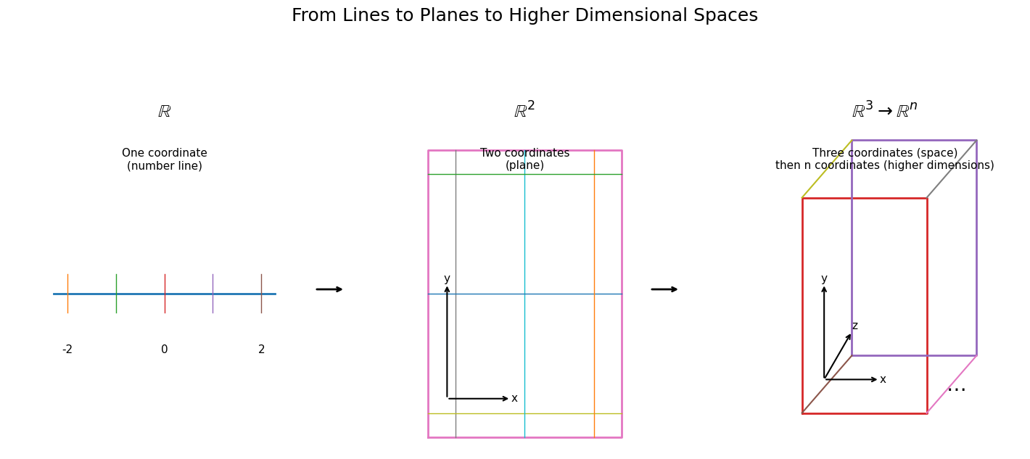
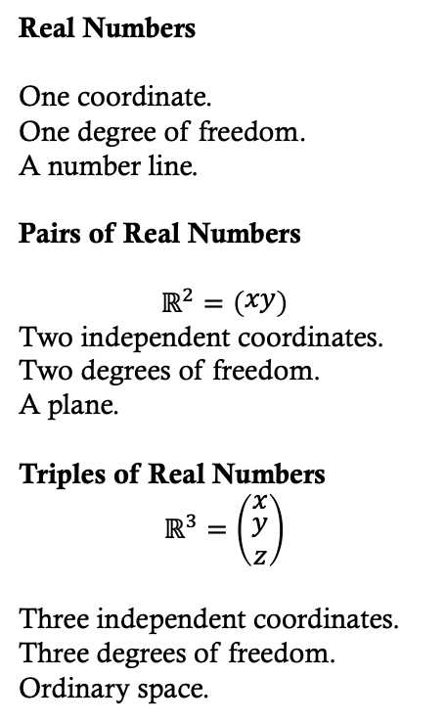
Vector space geometry
Real Numbers
One coordinate.
One degree of freedom.
A number line.
Pairs of Real Numbers
$$ℝ^{2}=\left(\begin{matrix}xy\end{matrix}\right)$$
Two independent coordinates.
Two degrees of freedom.
A plane.
Triples of Real Numbers
$$ℝ^{3}=\left(\begin{matrix}x \\ \begin{aligned}y \\ z\end{aligned}\end{matrix}\right)$$
Three independent coordinates.
Three degrees of freedom.
Ordinary space.

Slide 5
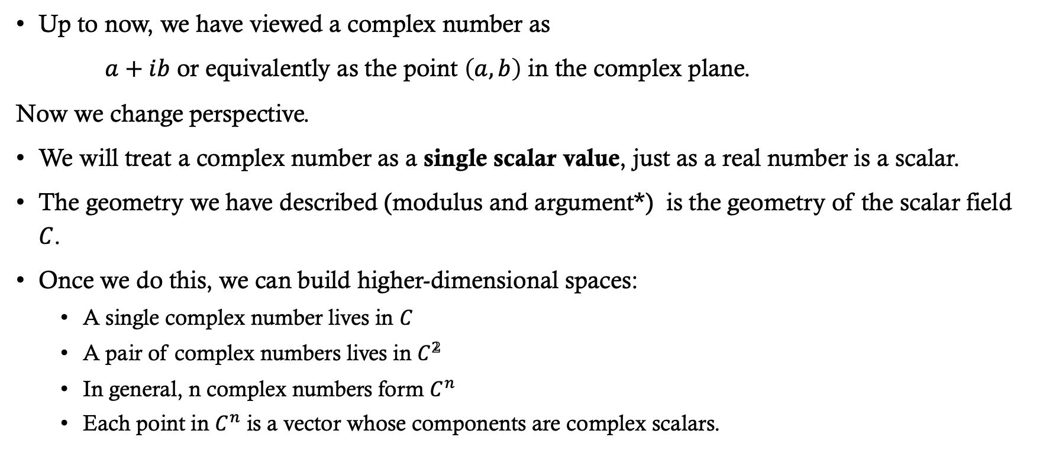
Complex number are a single value
Up to now, we have viewed a complex number as
$a+ib$ or equivalently as the point $\left(a,b\right)$ in the complex plane.
Now we change perspective.
We will treat a complex number as a single scalar value, just as a real number is a scalar.
The geometry we have described (modulus and argument*) is the geometry of the scalar field $C$.
Once we do this, we can build higher-dimensional spaces:
  A single complex number lives in $C$
  A pair of complex numbers lives in $C^{𝟚}$
  In general, n complex numbers form $C^{n}$
  Each point in $C^{n}$ is a vector whose components are complex scalars.
*As with the rest of language there are many words for the same thing: Modulus: magnitude, length, size; Argument: angle, phase, rotation (rotation is an operation though not a property.)

Slide 6
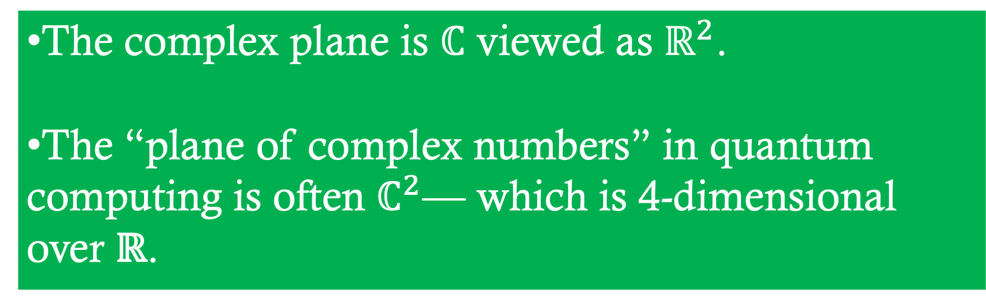
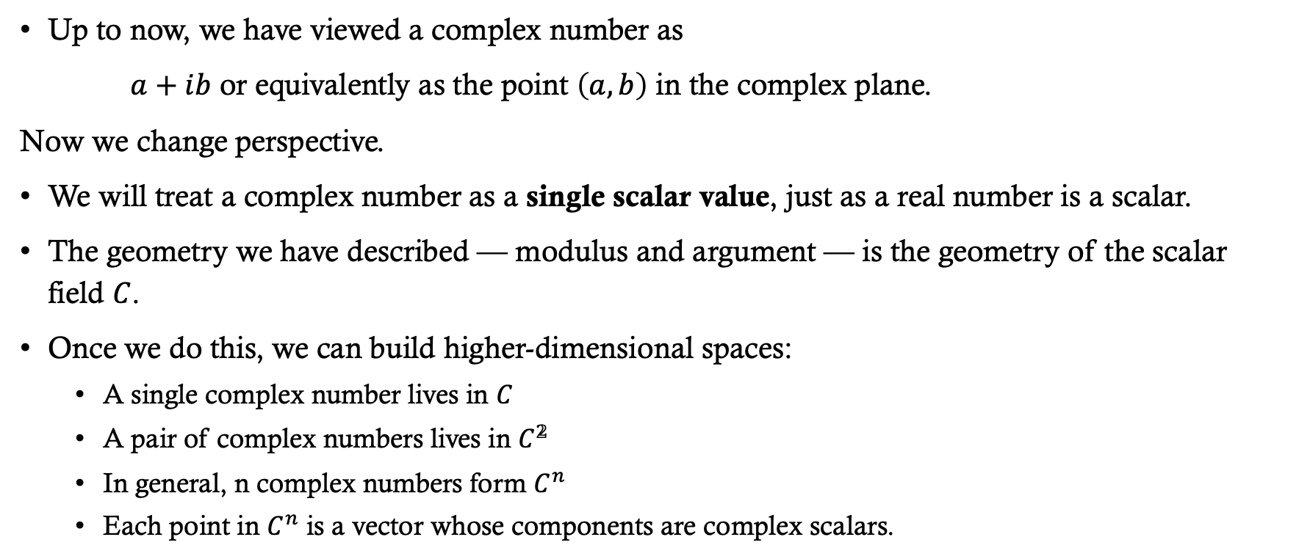
Complex number are a single value
The complex plane is ℂ viewed as ${\text{ℝ}}^{2}$.
The “plane of complex numbers” in quantum computing is often ${\text{ℂ}}^{2}$— which is 4-dimensional over $\text{ℝ}$.
Up to now, we have viewed a complex number as
$a+ib$ or equivalently as the point $\left(a,b\right)$ in the complex plane.
Now we change perspective.
We will treat a complex number as a single scalar value, just as a real number is a scalar.
The geometry we have described — modulus and argument — is the geometry of the scalar field $C$.
Once we do this, we can build higher-dimensional spaces:
  A single complex number lives in $C$
  A pair of complex numbers lives in $C^{𝟚}$
  In general, n complex numbers form $C^{n}$
  Each point in $C^{n}$ is a vector whose components are complex scalars.

Slide 7
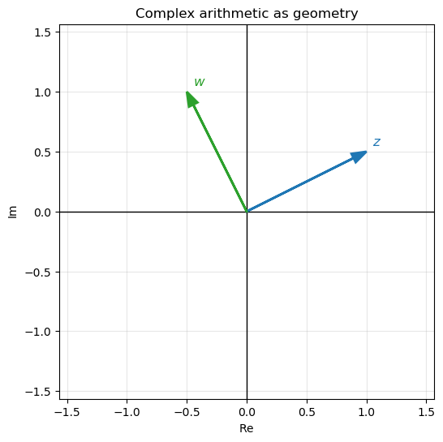
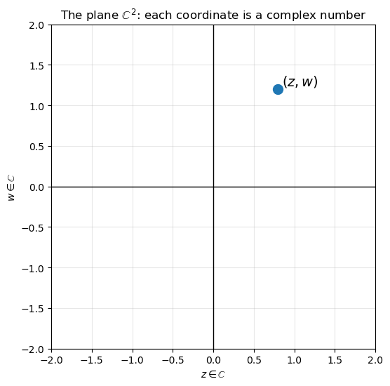

$${\text{The}\text{ 2}\text{D} \text{Complex} \text{vector} \text{space}\text{: }\text{ℂ}}^{2}$$
Complex Plane

Slide 8

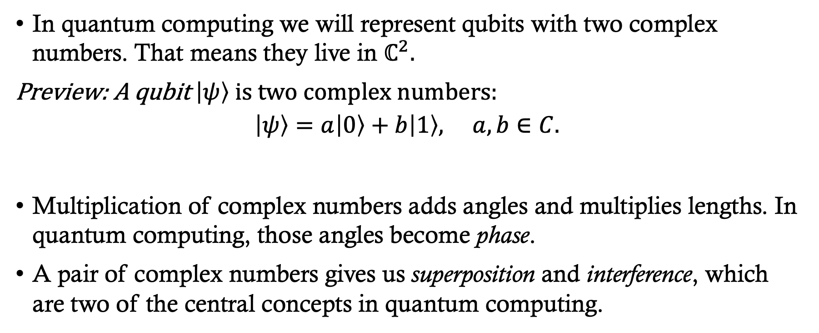
Why we care…
In quantum computing we will represent qubits with two complex numbers. That means they live in ${\text{ℂ}}^{2}.$
Preview: A qubit $\left|ψ\right\rangle is two complex numbers:$
$$\left|ψ\right\rangle =a\left|0\right\rangle +b\left|1\right\rangle , a,b∈C.$$
Multiplication of complex numbers adds angles and multiplies lengths. In quantum computing, those angles become phase.
A pair of complex numbers gives us superposition and interference, which are two of the central concepts in quantum computing.

Slide 9
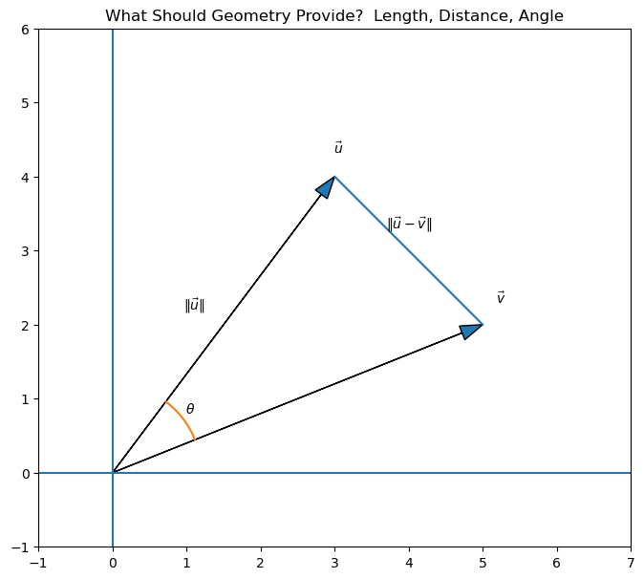
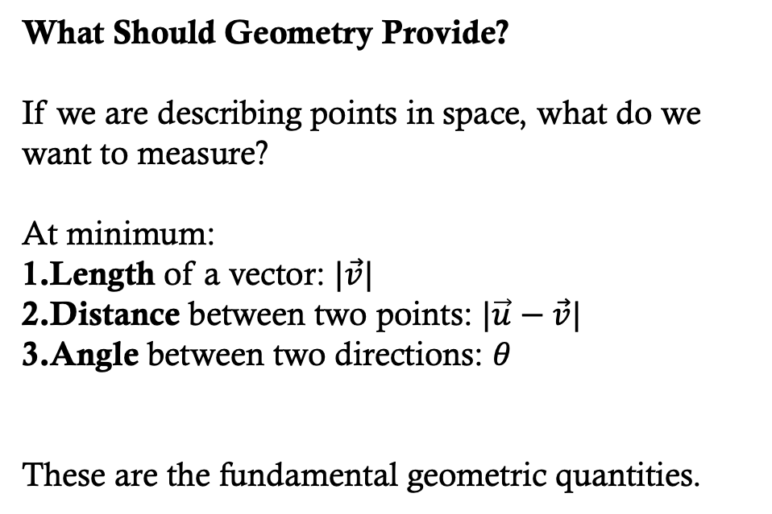

Measurement in ${\text{ℝ}}^{2}$geometry
MATH 215: Calc III, MATH 316: Vector Analysis
What Should Geometry Provide?
If we are describing points in space, what do we want to measure?
At minimum:
Length of a vector: $|\vec{v}|$
Distance between two points: $|\vec{u}−\vec{v}|$
Angle between two directions: $θ$
These are the fundamental geometric quantities.

Slide 10
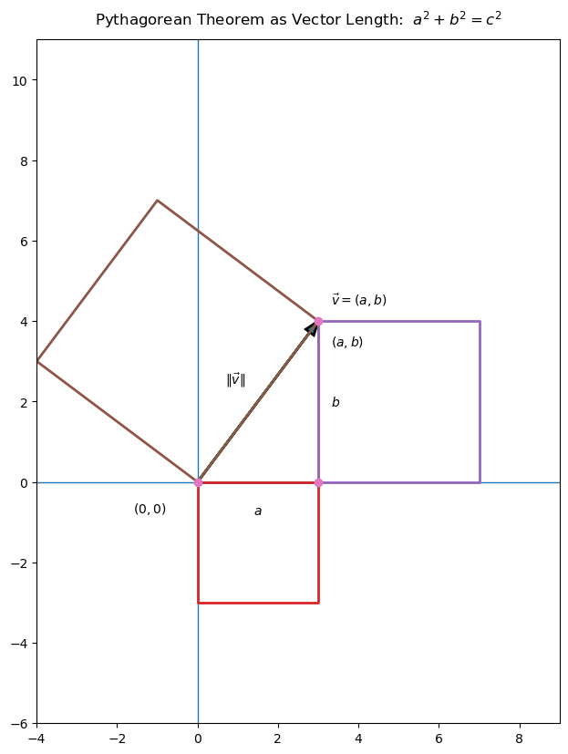
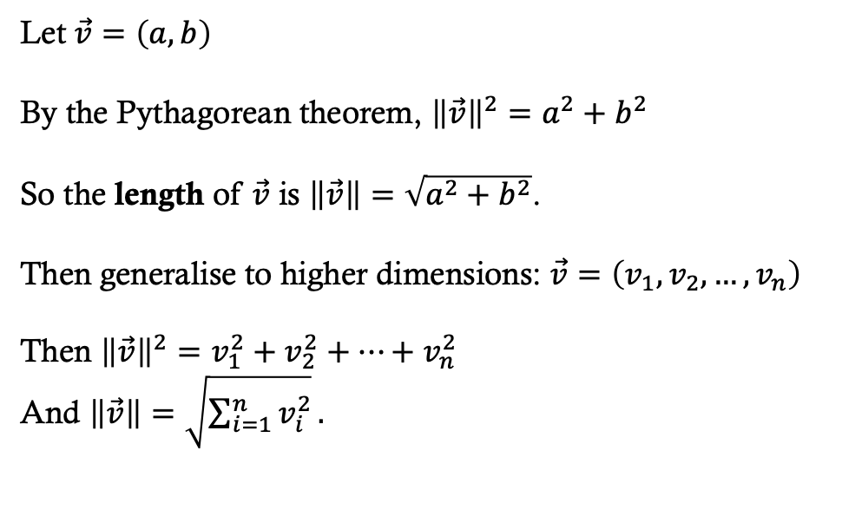

Length of a Vector in ${\text{ℝ}}^{2}$
MATH 215: Calc III, MATH 316: Vector Analysis
Let $\vec{v}=\left(a,b\right)$
By the Pythagorean theorem, ${\left\|\vec{v}\right\|}^{2}=a^{2}+b^{2}$
So the length of $\vec{v}$ is $\left\|\vec{v}\right\|=\sqrt{a^{2}+b^{2}}$.
Then generalise to higher dimensions: $\vec{v}=\left(v_{1},v_{2},…,v_{n}\right)$
Then ${\left\|\vec{v}\right\|}^{2}=v_{1}^{2}+v_{2}^{2}+…+v_{n}^{2}$
And $\left\|\vec{v}\right\|=\sqrt{\sum_{i=1}^{n}{v_{i}^{2}}}.$

Slide 11
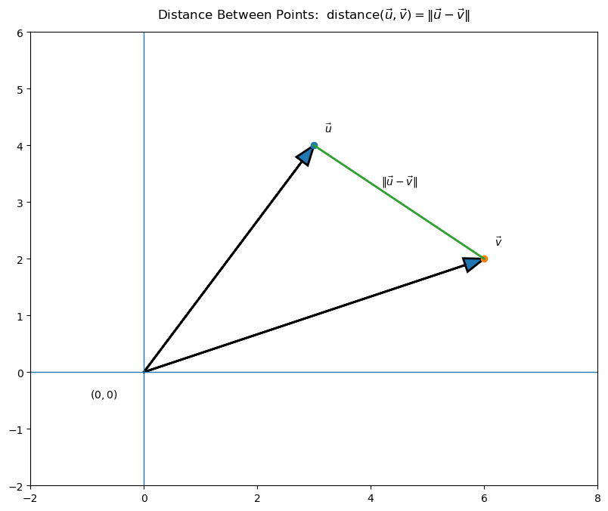
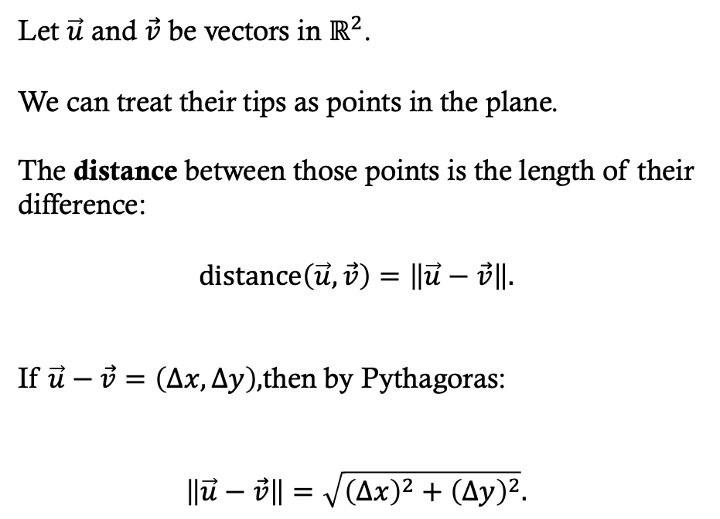

Distance between two points in ${\text{ℝ}}^{2}$
MATH 215: Calc III, MATH 316: Vector Analysis
Let $\vec{u}$ and $\vec{v}$ be vectors in ${\text{ℝ}}^{2}$.
We can treat their tips as points in the plane.
The distance between those points is the length of their difference:
$$\text{distance}\left(\vec{u},\vec{v}\right)=\left\|\vec{u}−\vec{v}\right\|.$$
If $\vec{u}−\vec{v}=\left(Δx,Δy\right),$then by Pythagoras:
$$\left\|\vec{u}−\vec{v}\right\|=\sqrt{{\left(Δx\right)}^{2}+{\left(Δy\right)}^{2}}.$$

Slide 12
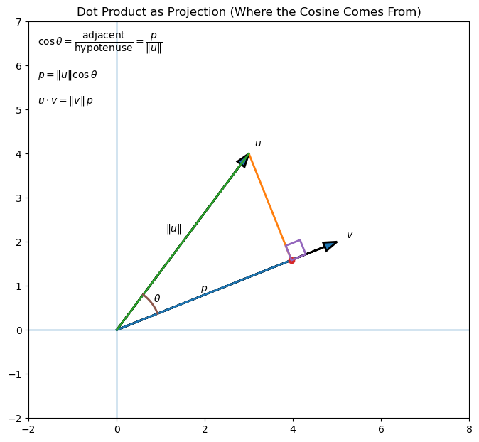
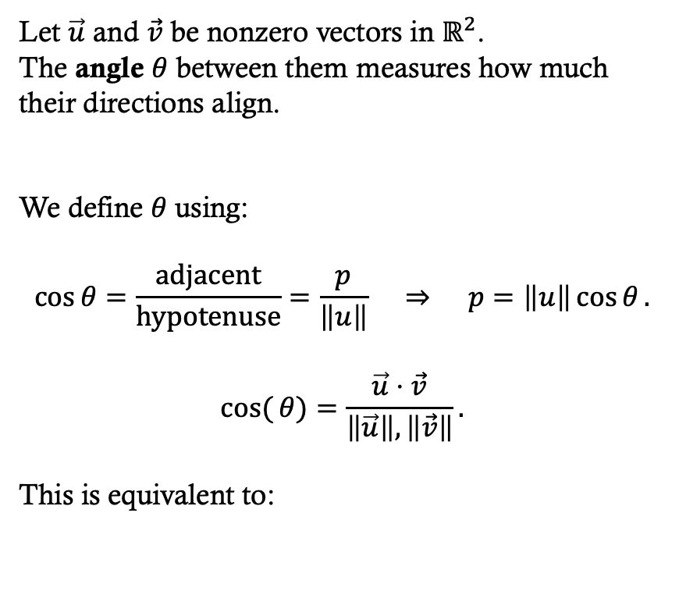

Angles between ${\text{ℝ}}^{2}$vectors
MATH 215: Calc III, MATH 316: Vector Analysis
Let $\vec{u}$ and $\vec{v}$ be nonzero vectors in ${\text{ℝ}}^{2}$.
The angle $θ$ between them measures how much their directions align.
We define $θ$using:
$$\cos{θ}=\frac{\text{adjacent}}{\text{hypotenuse}}=\frac{p}{\left\|u\right\|} ⇒ p=\left\|u\right\|\cos{θ}.$$
$$cos({θ)}=\frac{\vec{u}⋅\vec{v}}{\left\|\vec{u}\right\|,\left\|\vec{v}\right\|}.$$
This is equivalent to:

Slide 13
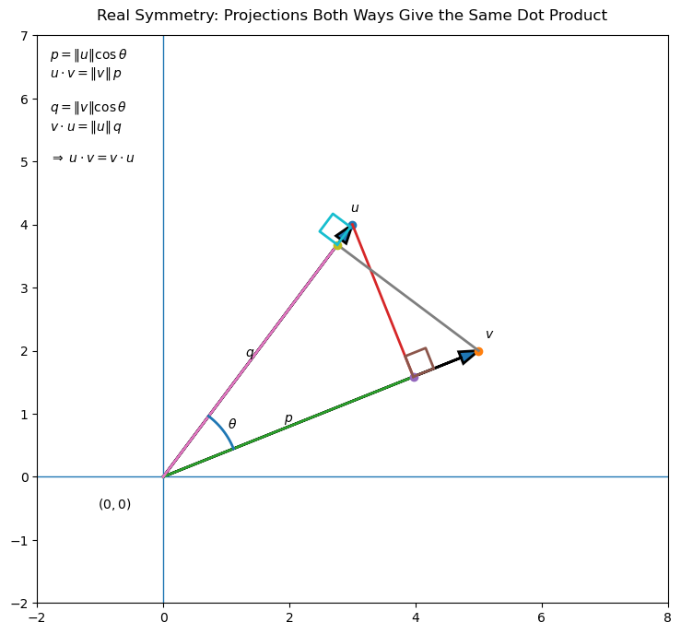
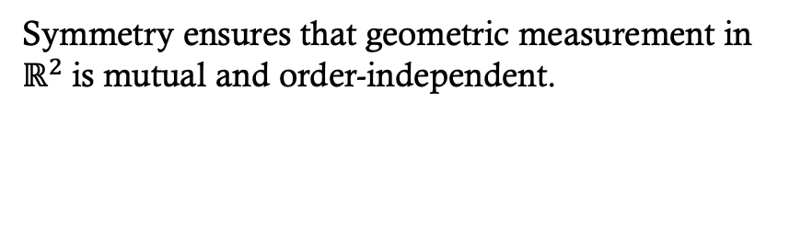
Symmetry of angles
MATH 215: Calc III, MATH 316: Vector Analysis
Symmetry ensures that geometric measurement in ${\text{ℝ}}^{2}$is mutual and order-independent.

Slide 14

Measurement in ${\text{ℂ}}^{2}$geometry
We want all those in our complex space so we can reason about how complex vectors relate to each other.

Slide 15
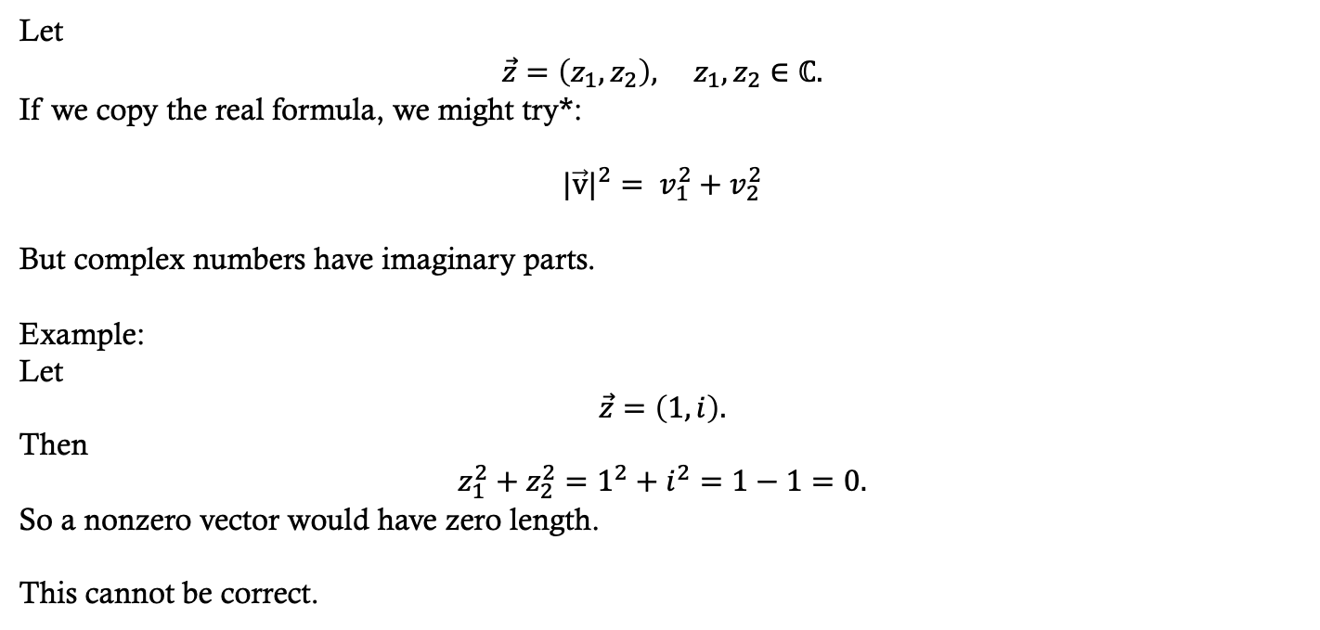

Length of a Vector in${ \text{ℂ}}^{2}$ (wrong)
Let
$\vec{z}=\left(z_{1},z_{2}\right), z_{1},z_{2}∈ℂ.$
If we copy the real formula, we might try*:
$${|\vec{v}|}^{2}= v_{1}^{2}+v_{2}^{2}$$
But complex numbers have imaginary parts.
Example:
Let
$\vec{z}=\left(1,i\right).$
Then
$z_{1}^{2}+z_{2}^{2}=1^{2}+i^{2}=1−1=0.$
So a nonzero vector would have zero length.
This cannot be correct.

Slide 16
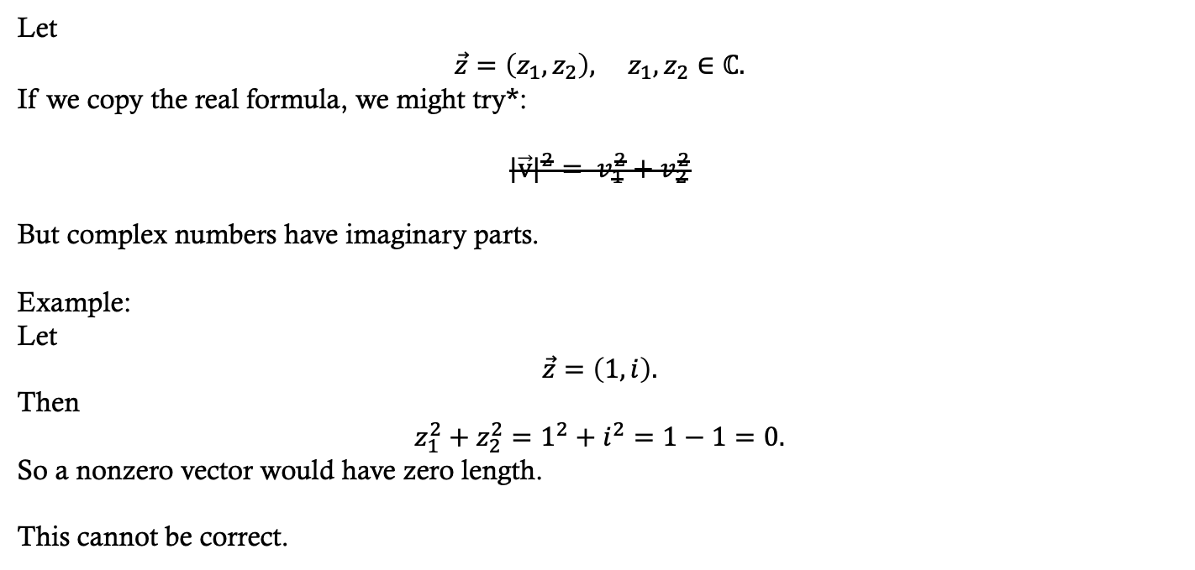
Length of a Vector in${ \text{ℂ}}^{2}$ (wrong)
Let
$$\vec{z}=\left(z_{1},z_{2}\right), z_{1},z_{2}∈ℂ.$$
If we copy the real formula, we might try*:
$${|\vec{v}|}^{2}= v_{1}^{2}+v_{2}^{2}$$
But complex numbers have imaginary parts.
Example:
Let
$$\vec{z}=\left(1,i\right).$$
Then
$$z_{1}^{2}+z_{2}^{2}=1^{2}+i^{2}=1−1=0.$$
So a nonzero vector would have zero length.
This cannot be correct.

Slide 17
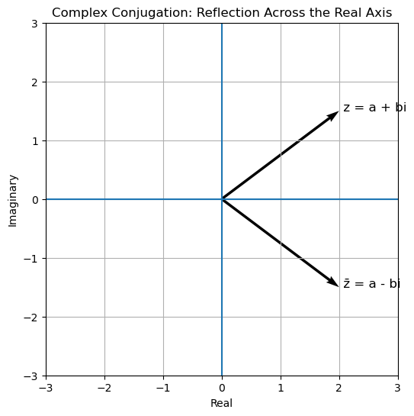
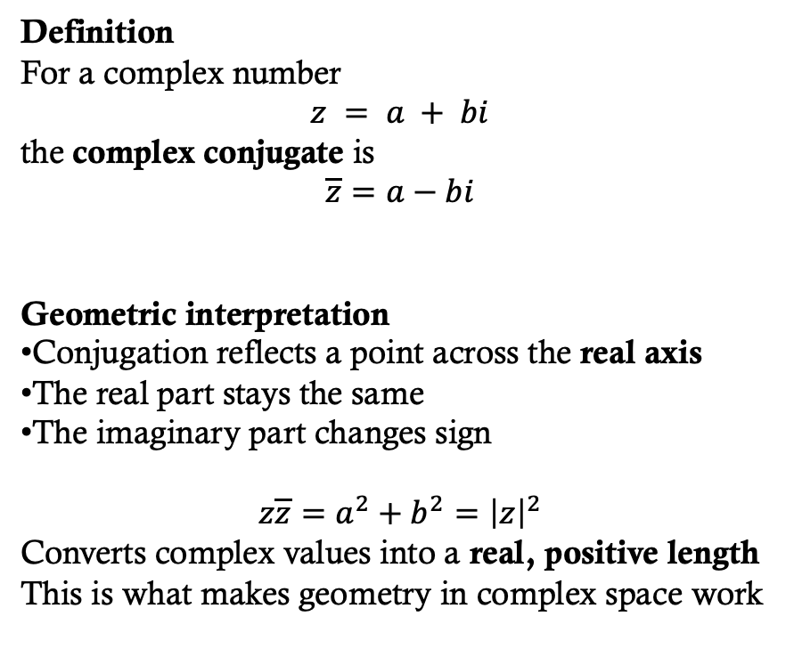
Complex conjugation
Definition
For a complex number
$z = a + bi$
the complex conjugate is
$$\overline{z}=a−bi$$
Geometric interpretation
Conjugation reflects a point across the real axis
The real part stays the same
The imaginary part changes sign
$z\overline{z}=a^{2}+b^{2}={\left|z\right|}^{2}$
Converts complex values into a real, positive length
This is what makes geometry in complex space work

Slide 18
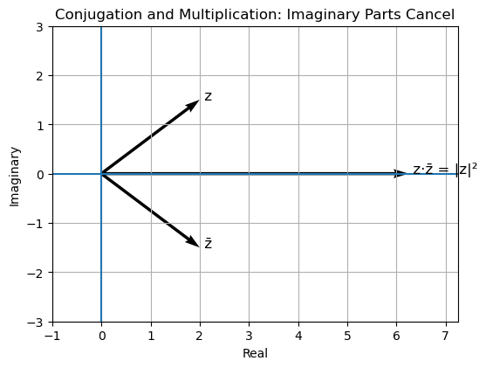
Complex conjugation
These two vectors are mirror images.
When we multiply them, the imaginary parts cancel, and the result lands entirely on the real axis, giving us the squared length.

Slide 19
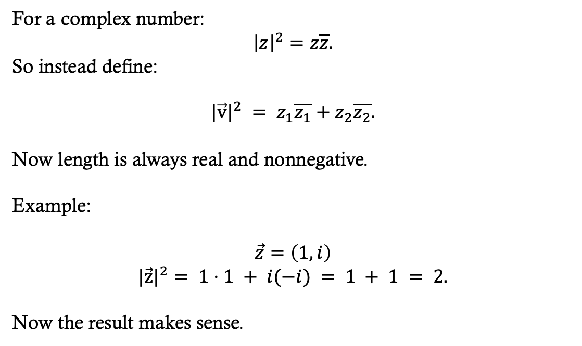

Length of a Vector in${ \text{ℂ}}^{2}$ (fixed)
For a complex number:
$${\left|z\right|}^{2}=z\overline{z}.$$
So instead define:
$${|\vec{v}|}^{2} = z_{1}\overline{z_{1}}+z_{2}\overline{z_{2}}.$$
Now length is always real and nonnegative.
Example:
$$\vec{z}=\left(1,i\right)$$
$${|\vec{z}|}^{2}= 1⋅1 + i(−i) = 1 + 1 = 2.$$
Now the result makes sense.
This fix is going to propagate to the
Distance and angle functions since they also contain information about length.

Slide 20

Angles between${ \text{ℂ}}^{2}$ vectors
MATH 215: Calc III, MATH 316: Vector Analysis
Real case:
u \cdot v = a_1 a_2 + b_1 b_2.
Complex case must preserve length.
So define:
\langle u, v \rangle = u_1 \overline{v_1} + u_2 \overline{v_2}.
Then
\langle v, v \rangle = |v_1|^2 + |v_2|^2 = \Vert v \Vert^2.

Slide 21
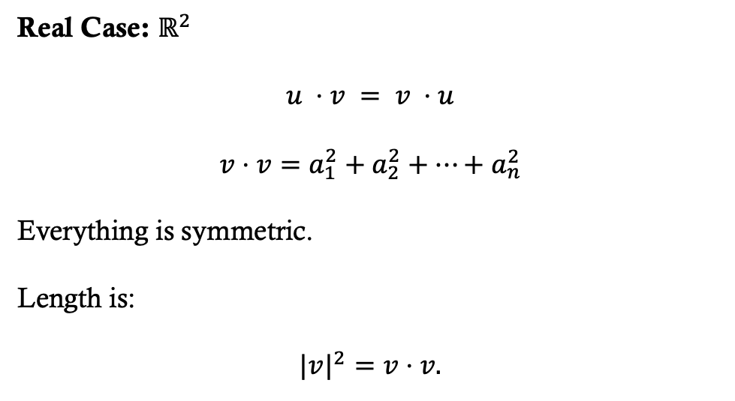
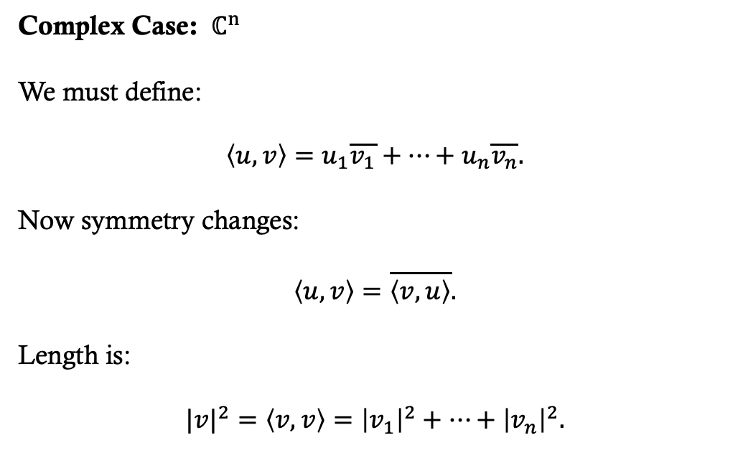
Angles between${ \text{ℂ}}^{2}$ vectors
MATH 215: Calc III, MATH 316: Vector Analysis
Complex Case: ${ \text{ℂ}}^{n}$
We must define:
$$\left\langle u,v\right\rangle =u_{1}\overline{v_{1}}+…+u_{n}\overline{v_{n}}.$$
Now symmetry changes:
$$\left\langle u,v\right\rangle =\overline{\left\langle v,u\right\rangle }.$$
Length is:
$$|v|^{2}=\left\langle v,v\right\rangle ={\left|v_{1}\right|}^{2}+…+{\left|v_{n}\right|}^{2}.$$
Real Case: ${\text{ℝ}}^{2}$
$$u ⋅v = v ⋅u$$
$$v⋅v=a_{1}^{2}+a_{2}^{2}+…+a_{n}^{2}$$
Everything is symmetric.
Length is:
$$|v|^{2}=v⋅v.$$
In real space: symmetry.
In complex space: conjugate symmetry.

Slide 22
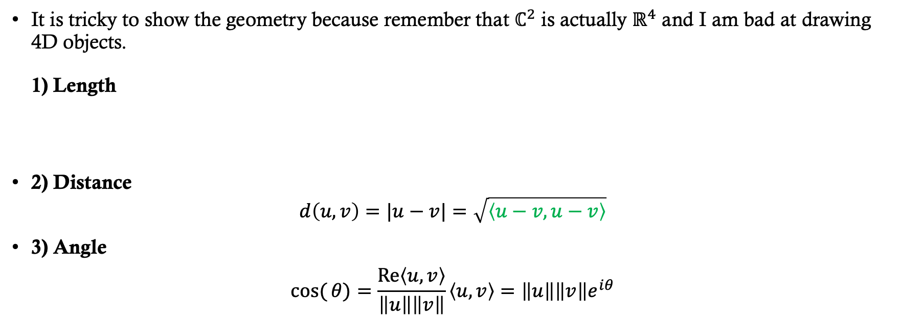

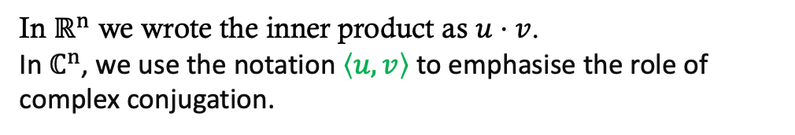
Measurements in${ \text{ℂ}}^{2}$
It is tricky to show the geometry because remember that $ℂ^{2}$ is actually $ℝ^{4}$ and I am bad at drawing 4D objects.
1) Length
2) Distance
$$d\left(u,v\right)=|u−v|=\sqrt{\left\langle u−v,u−v\right\rangle }$$
3) Angle
$$cos({θ)}=\frac{\text{Re}\left\langle u,v\right\rangle }{\left\|u\right\|\left\|v\right\|}\left\langle u,v\right\rangle =\left\|u\right\|\left\|v\right\|e^{iθ}$$
In $ℝ^{n}$ we wrote the inner product as $u⋅v$.
In $ℂ^{n}$, we use the notation $\left\langle u,v\right\rangle$ to emphasise the role of complex conjugation.

Slide 23
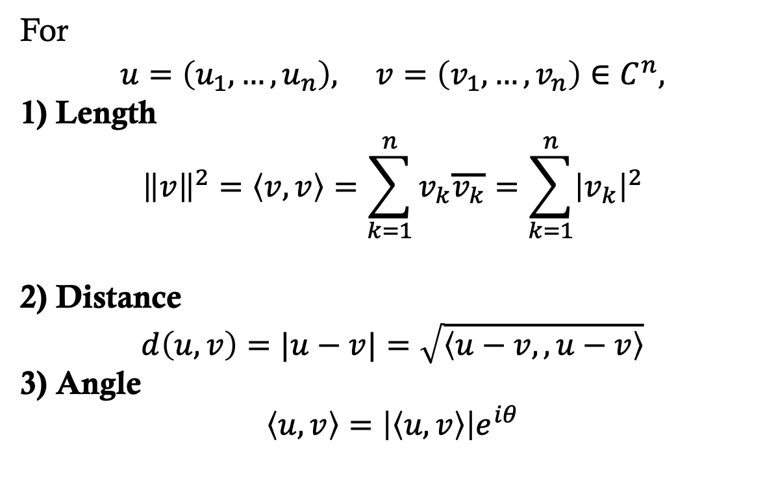

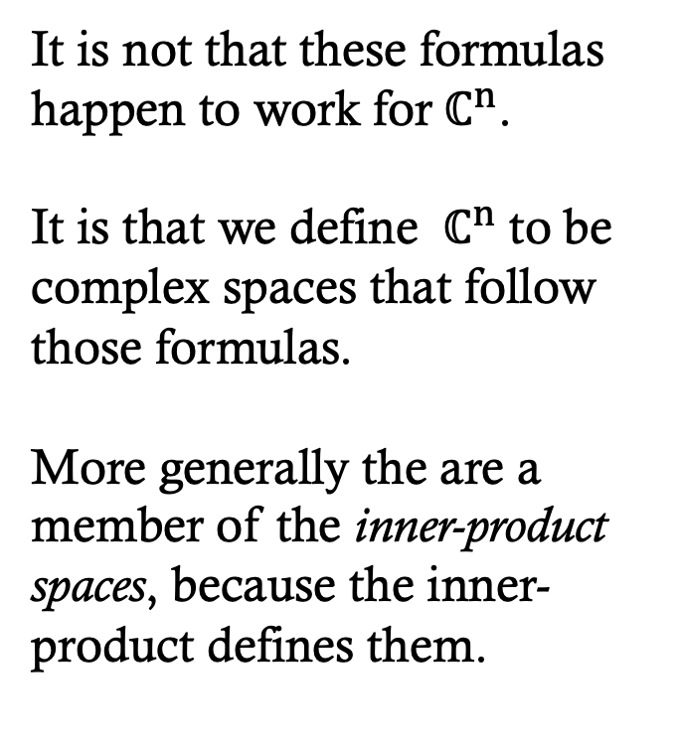
Measurements in ${ \text{ℂ}}^{n}$
It is not that these formulas happen to work for${ \text{ℂ}}^{n}$.
It is that we define ${ \text{ℂ}}^{n}$ to be complex spaces that follow those formulas.
More generally the are a member of the inner-product spaces, because the inner-product defines them.
For
$$u=\left(u_{1},…,u_{n}\right), v=\left(v_{1},…,v_{n}\right)∈C^{n},$$
1) Length
$${\left\|v\right\|}^{2}=\left\langle v,v\right\rangle =\sum_{k=1}^{n}{v_{k}\overline{v_{k}}}=\sum_{k=1}^{n}{{\left|v_{k}\right|}^{2}}$$
2) Distance
$$d\left(u,v\right)=|u−v|=\sqrt{\left\langle u−v,,u−v\right\rangle }$$
3) Angle
$$\left\langle u,v\right\rangle =\left|\left\langle u,v\right\rangle \right|e^{iθ}$$

Slide 24
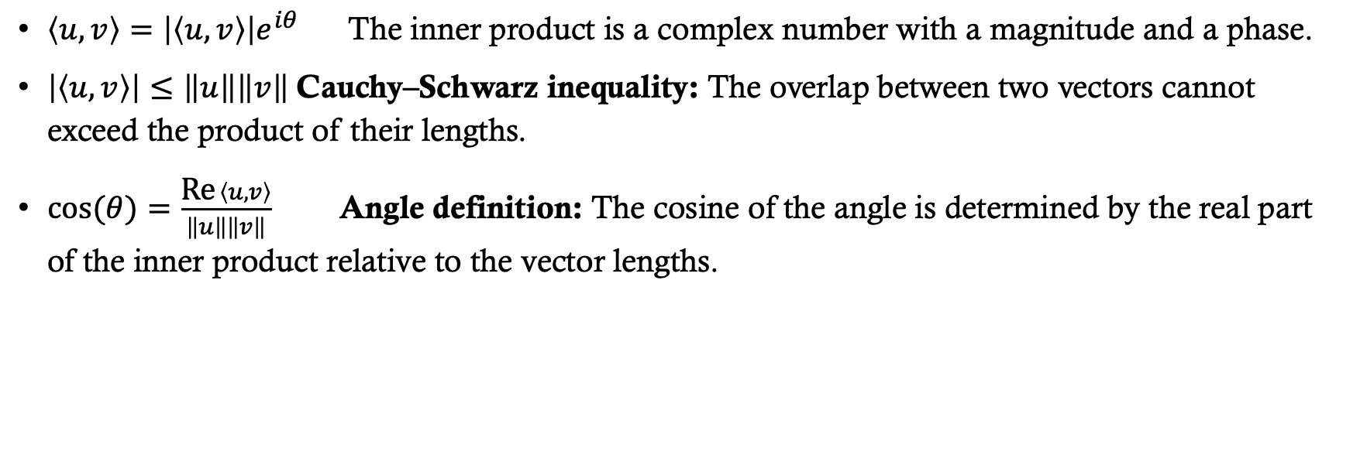
Complex vector spaces
$\left\langle u,v\right\rangle =\left|\left\langle u,v\right\rangle \right|e^{iθ} \text{The} \text{inner} \text{product} \text{is} \text{a} \text{complex} \text{number} \text{with} \text{a} \text{magnitude} \text{and} \text{a} \text{phase}\text{.}$
$\left|\left\langle u,v\right\rangle \right|≤\left\|u\right\|\left\|v\right\|$ Cauchy–Schwarz inequality: The overlap between two vectors cannot exceed the product of their lengths.
$\cos{(θ)}=\frac{\text{Re} \left\langle u,v\right\rangle }{\left\|u\right\|\left\|v\right\|} \text{Angle} \text{definition}\text{:} \text{The} \text{cosine} \text{of} \text{the} \text{angle} \text{is} \text{determined} \text{by} \text{the} \text{real} \text{part} \text{of} \text{the} \text{inner} \text{product} \text{relative} \text{to} \text{the} \text{vector} \text{lengths}\text{.}$

Slide 25
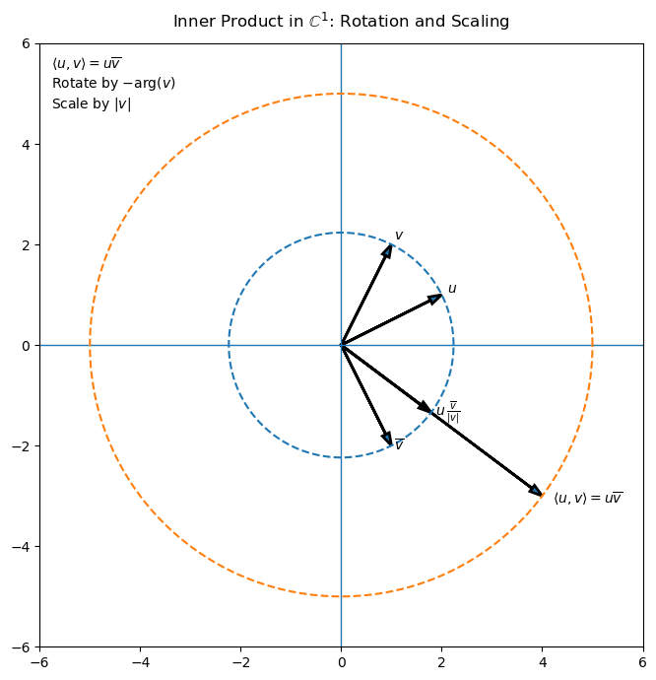
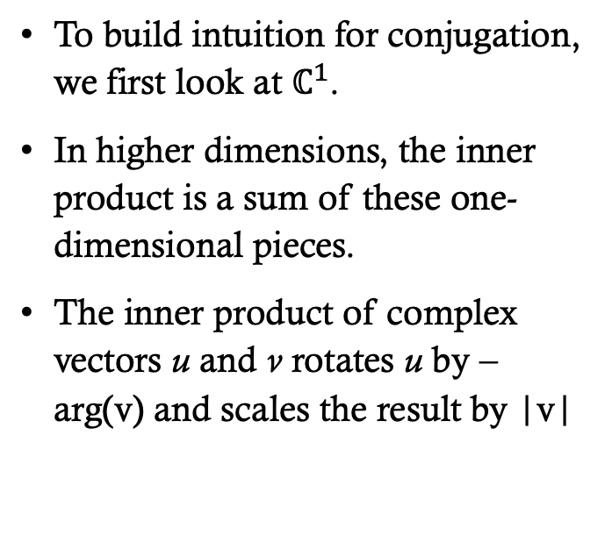
Complex inner product
To build intuition for conjugation, we first look at $ℂ^{1}$.
In higher dimensions, the inner product is a sum of these one-dimensional pieces.
The inner product of complex vectors u and v rotates u by –arg(v) and scales the result by |v|

Slide 26
Hilbert spaces
A Hilbert space is a complex vector space equipped with an inner product and complete with respect to the induced norm.
Quantum states live in complex Hilbert spaces.
ℂⁿ with this inner product is already complete.
Therefore ℂⁿ is a Hilbert space.

Slide 27
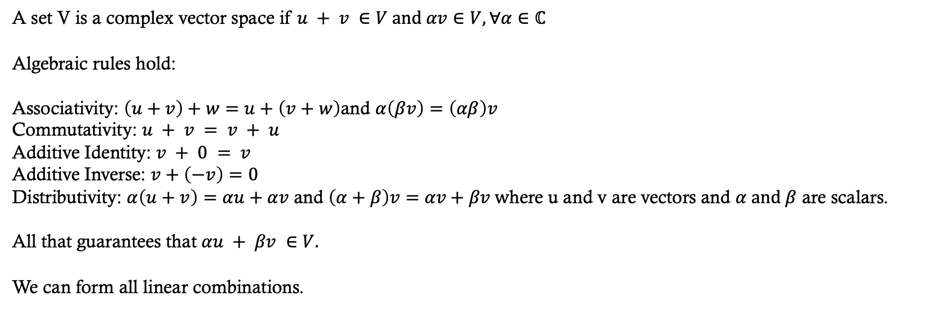
Complex Hilbert spaces are vector spaces
MATH 314 and 321 : Linear Algebra
Vector spaces do NOT automatically give us:
• A notion of length
• A notion of angle
• A notion of distance
• Convergence of infinite sequences
A vector space provides algebra.
Geometry and limits require more.
A set V is a complex vector space if $u + v ∈V and αv∈V, ∀α∈ℂ$
Algebraic rules hold:
Associativity: $\left(u+v\right)+w=u+\left(v+w\right)$and $α\left(βv\right)=\left(αβ\right)v$
Commutativity: $u + v = v + u$
Additive Identity: $v + 0 = v$
Additive Inverse: $v+\left(−v\right)=0$
Distributivity: $α\left(u+v\right)=αu+αv$ and $\left(α+β\right)v=αv+βv w$here u and v are vectors and $α and β$ are scalars.
All that guarantees that $αu + βv ∈V.$
We can form all linear combinations.

Slide 28

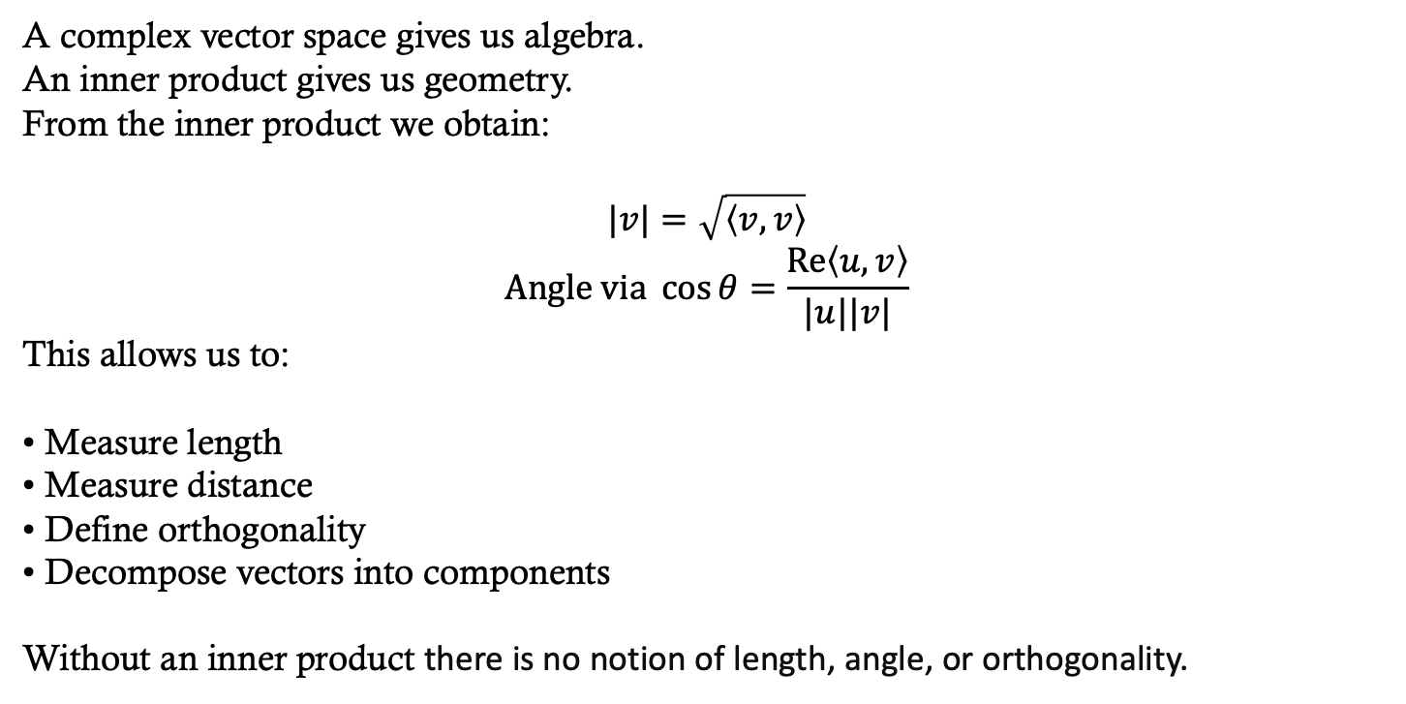
Complex Hilbert spaces: inner products
A complex vector space gives us algebra.
An inner product gives us geometry.
From the inner product we obtain:
$$|v|=\sqrt{\left\langle v,v\right\rangle }$$
$$\text{Angle} \text{via} \cos{θ}=\frac{\operatorname{Re}\left\langle u,v\right\rangle }{|u||v|}$$
This allows us to:
• Measure length
• Measure distance
• Define orthogonality
• Decompose vectors into components
Without an inner product there is no notion of length, angle, or orthogonality.
$$Re(z) means return just the real part$$

Slide 29
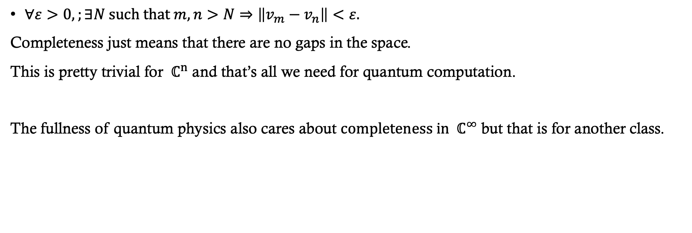
Hilbert spaces: complete
$∀ε>0,;∃N \text{such} \text{that} m,n>N⇒\left\|v_{m}−v_{n}\right\|<ε.$
Completeness just means that there are no gaps in the space.
This is pretty trivial for ${ \text{ℂ}}^{n}$ and that’s all we need for quantum computation.
The fullness of quantum physics also cares about ${\text{completeness} \text{in} \text{ℂ}}^{∞}$ but that is for another class.

Slide 30
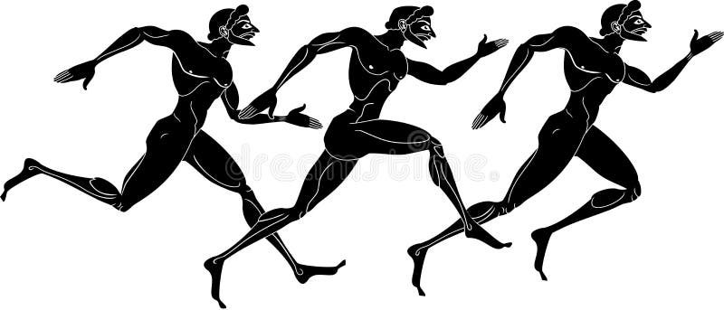
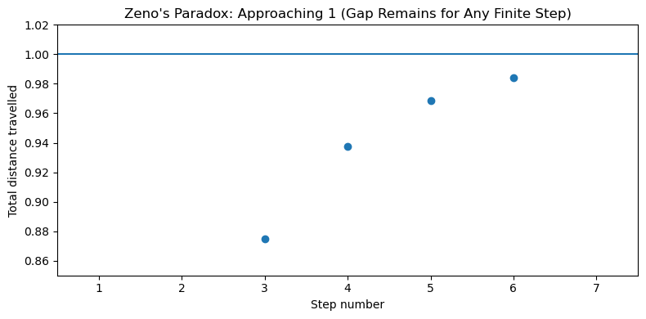
Xeno’s paradox
Zeno of Elea
Date: circa 450 BCE
Source: The paradoxes are known primarily from Aristotle’s Physics (Book VI), where Aristotle discusses and critiques them.
Zeno’s Paradox (Achilles)
Zeno argues:
To reach the finish line, you must first go halfway.
Then half of the remaining distance.
Then half again.
And so on forever.
So how can motion ever finish?
Because there are infinitely many steps.

Slide 31
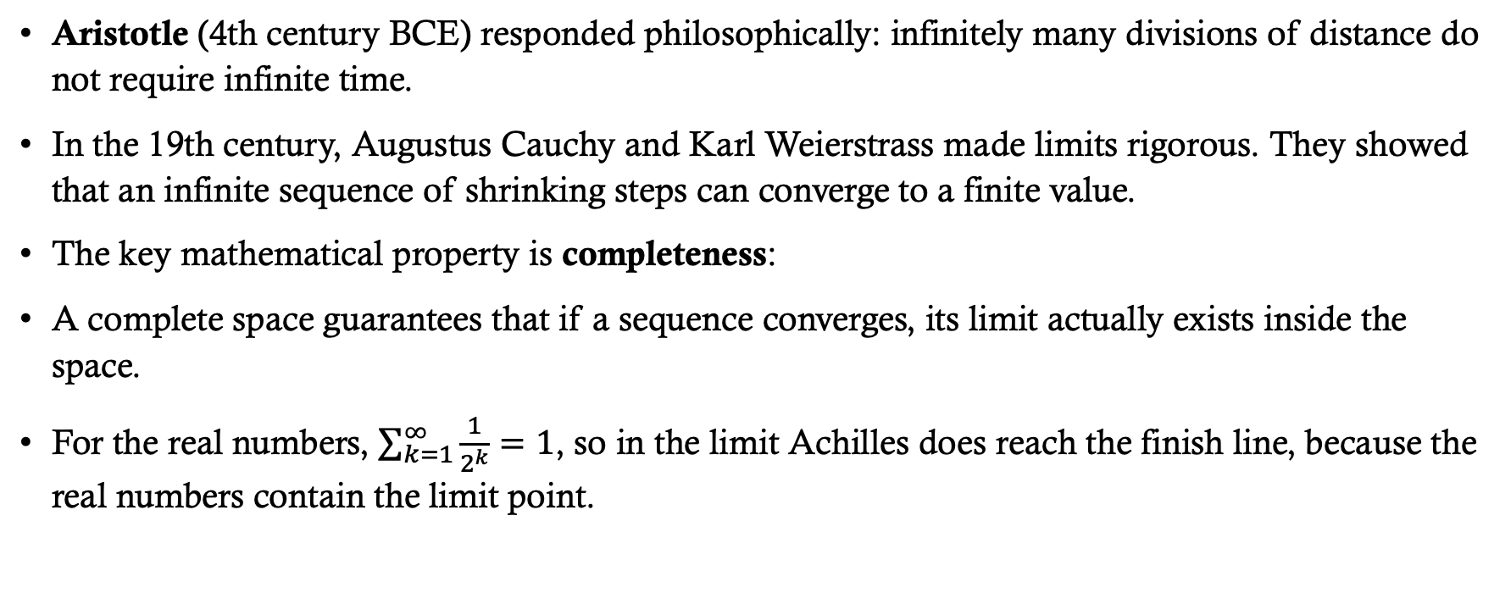
Xeno’s paradox and compete spaces
UNM MATH 401 — Advanced Calculus I (Real Analysis)
Aristotle (4th century BCE) responded philosophically: infinitely many divisions of distance do not require infinite time.
In the 19th century, Augustus Cauchy and Karl Weierstrass made limits rigorous. They showed that an infinite sequence of shrinking steps can converge to a finite value.
The key mathematical property is completeness:
A complete space guarantees that if a sequence converges, its limit actually exists inside the space.
For the real numbers, $\sum_{k=1}^{∞}{\frac{1}{2^{k}}}=1$, so in the limit Achilles does reach the finish line, because the real numbers contain the limit point.

Slide 32
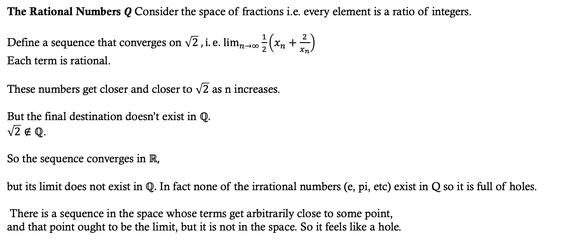
Not every space is complete
The Rational Numbers $Q$Consider the space of fractions i.e. every element is a ratio of integers.
Define a sequence that converges on $\sqrt{2} , i.e.$ $\lim_{n→∞}{\frac{1}{2}\left(x_{n}+\frac{2}{x_{n}}\right)}$
Each term is rational.
These numbers get closer and closer to $\sqrt{2}$ as n increases.
But the final destination doesn’t exist in $ℚ.$
$\sqrt{2}∉ℚ$.
So the sequence converges in $ℝ,$
but its limit does not exist in $ℚ.$ In fact none of the irrational numbers (e, pi, etc) exist in Q so it is full of holes.
There is a sequence in the space whose terms get arbitrarily close to some point,
and that point ought to be the limit, but it is not in the space. So it feels like a hole.

Slide 33
Complex Hilbert spaces: complete
A Hilbert space is:
A complex vector space with an inner product that has no missing limit points.
Completeness guarantees:
Infinite sums of vectors converge to a vector in the space.
  Cauchy sequences of states have limits inside the space.
Approximations converge to actual physical states.
If a sequence of quantum states converges, its limit is also a valid state.
You are guaranteed to reach the missing finish line if you converge on it.

Slide 34
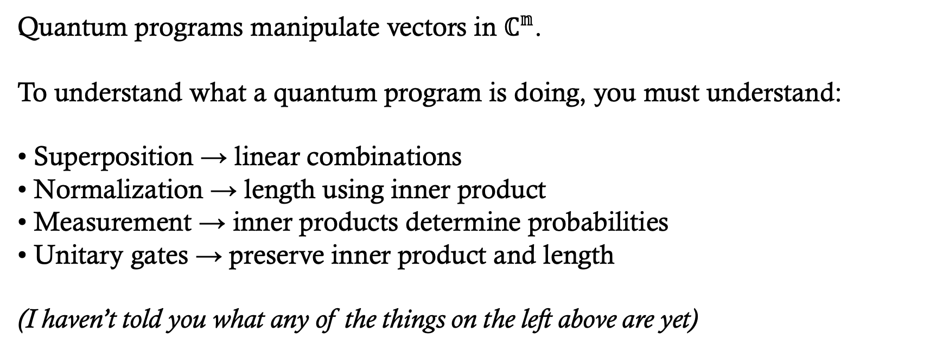
Quantum computation is linear algebra in a complex Hilbert space.
Quantum programs manipulate vectors in $ℂ^{𝕟}$.
To understand what a quantum program is doing, you must understand:
• Superposition → linear combinations
• Normalization → length using inner product
• Measurement → inner products determine probabilities
• Unitary gates → preserve inner product and length
(I haven’t told you what any of the things on the left above are yet)

