Slide 1

Complex Geometry
Lecture 3

Slide 2
Goals
By the end of this lecture, you should be able to:
Treat complex numbers as vectors in the plane and reason geometrically about addition and multiplication.
Use polar form to compute powers and roots, and explain why roots form regular polygons.
Apply De Moivre’s formula and connect it to the complex exponential form.
Write Python in a Jupyter notebook to visualise complex transformations and the nth roots of unity.
Understand Möbius transformations as “fractional linear” maps that send lines and circles to lines and circles.
Code to generate figures is available online at: …

Slide 3


Vectors in the complex Plane
Complex numbers as 2D vectors
Last lecture we defined complex numbers and showed how they exist in a 2d plane formed by the combination of the real and imaginary number lines.
Vectors are mathematical objects that let us describe relationships in the plane easily
Instead of always writing , we will shorten things to this is not just for convenience. That notation is general and allows us to apply all sorts of powerful mechanisms.
means vector “v” with components or elements a and b
Vectors are ubiquitous in math and physics and so have developed a lot of different notation over the years. Physicists often put an arrow over the variable to indicate a vector while mathematicians lean towards bold face: vs. .
J. Willard Gibbs formalised vector calculus in Vector Analysis, 1901

Slide 4
Complex numbers as geometry
In Lecture 2 you saw how we defined an algebra of complex numbers.
An algebra is a set of objects and rules for combining those objects.
  We defined the set of objects to be all combinations of a real number plus an imaginary number.
  We defined the rules to be addition, multiplication, exponentiation.
The objects and rules are represented by discrete symbols. Arithmetic is an algebra where the objects are real numbers, and the rules are things like + and ⨉. The algebra gives us ways to produce new sets of legal symbol combinations.
Geometry on the other hand describes the relationships between objects in space. Euclid’s geometry writing had no symbols.
Rene Descartes was the first to show that the same mathematical objects could be described geometrically (drawings) and algebraically (applying symbol rules).
We will find it useful in this course to switch back and forth between the two representations.

Slide 5
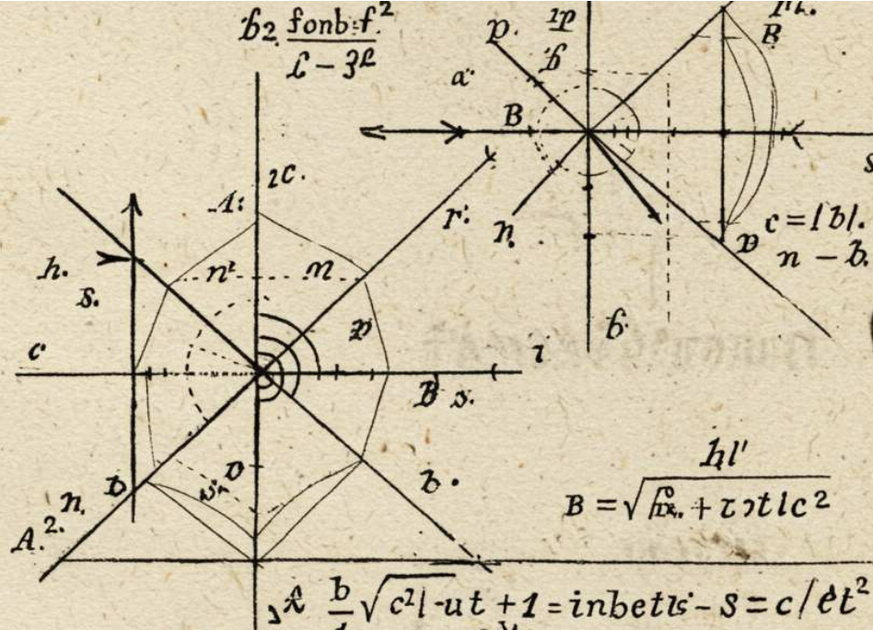
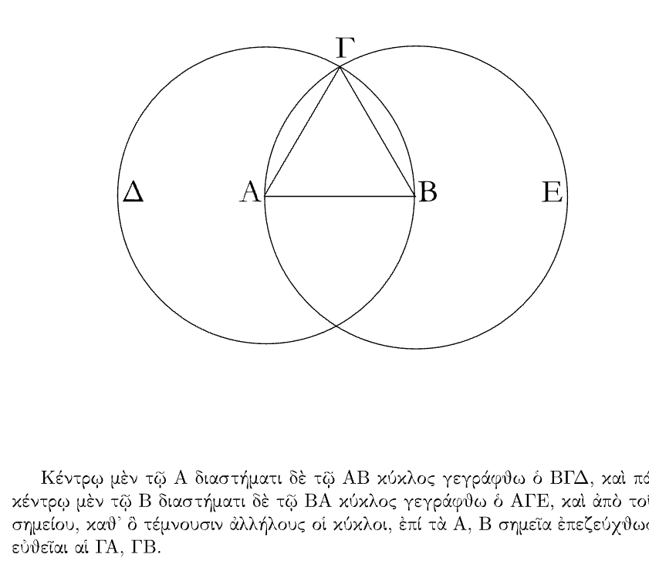
Geometry is algebra
A) Geometry. Spatial reasoning only. Symbols are named points, not variables. Euclid (Elements, ca. 300 BCE
B) Analytic Geometry. Spatial objects are mapped to algebraic objects. René Descartes (La Géométrie, 1637)
Notes:
This brief historical detour is not about Euclid or Descartes for their own sake. It is about understanding how algebra and geometry become the same mathematics. Quantum computing is built on that unification. We will describe quantum states algebraically using complex numbers, vectors, and matrices, but the behaviour of those states — superposition, interference, and evolution — is fundamentally geometric.

Slide 6


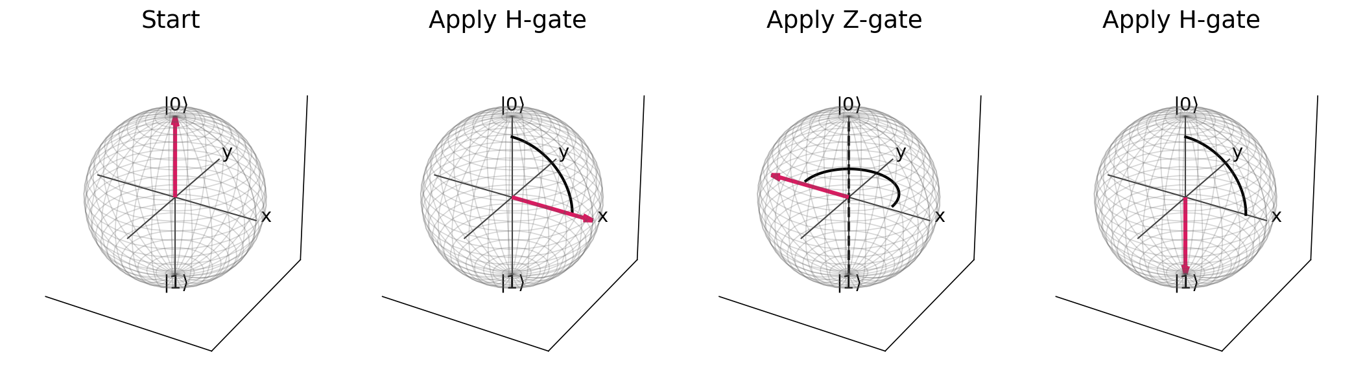
Why it matters for quantum computing
We will apply algebraic operations (gates) to a quantum state and describe what is happening geometrically with Bloch spheres.
Algebraically:
Geometrically:
Code to generate figures is available online at: https://github.com/gmfricke/Quantum_Computing/Complex_Geometry

Slide 7
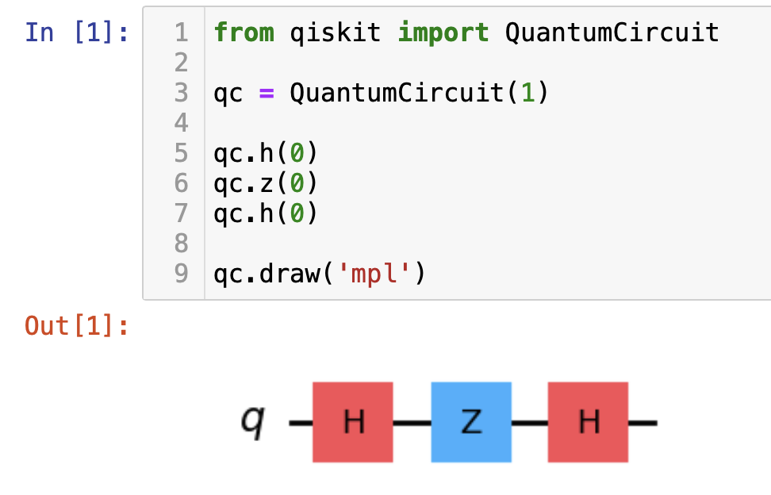
Why it matters for quantum computing
We will apply algebraic operations (gates) to a quantum state and describe what is happening geometrically with Bloch spheres.
And eventually in code:
(Aside: Programming languages are generally not algebras, but the quantum part of quantum computing is an algebra.)
Code to generate figures is available online at: https://github.com/gmfricke/Quantum_Computing/Complex_Geometry

Slide 8
The complex plane
a complex number z = a + bi is a point or vector in the plane
this plane is the simplest possible state space where algebra already is geometry
This mirrors the Bloch sphere idea, but in 2D instead of 3D
Let’s work out how how numbers can be manipulated in the complex plane

Slide 9
Multiplication
Multiplication in the complex algebra corresponds geometrically to rotation and scaling of vectors in the complex plane.
In a quantum computer, the state of the system is described by complex numbers.
Programming a quantum computer means applying operations that multiply and combine those complex numbers in precise ways.

Slide 10


Multiplication
A complex number multiplied by complex number is,
Is a vector in the complex plane, with:
horizontal component a
vertical component b
So every complex number has:
a length (its modulus)
a direction (its argument)
Code to generate figures is available online at: https://github.com/gmfricke/Quantum_Computing/Complex_Geometry

Slide 11
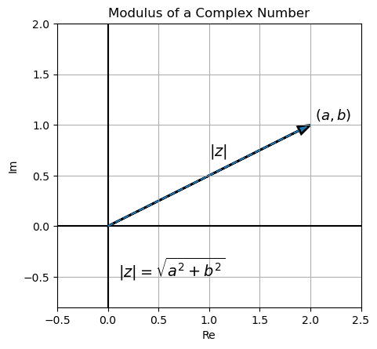
Modulus
A complex number
Modulus in vector calculus is just the
length of the vector:
Modulus is a very overloaded term, especially in computer science. It is just Latin for measure.
Code to generate figures is available online at: https://github.com/gmfricke/Quantum_Computing/Complex_Geometry

Slide 12
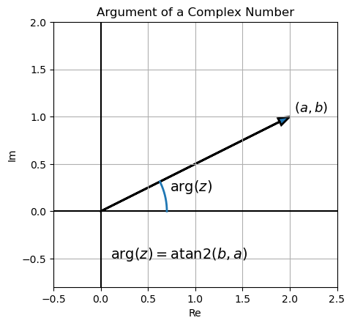

Argument
A complex number
Argument in vector calculus is just angle between the
vector and the positive real number line (pos. x-axis).
It’s called the argument because the standard function for manipulate complex vectors takes as an argument.
Code to generate figures is available online at: https://github.com/gmfricke/Quantum_Computing/Complex_Geometry

Slide 13
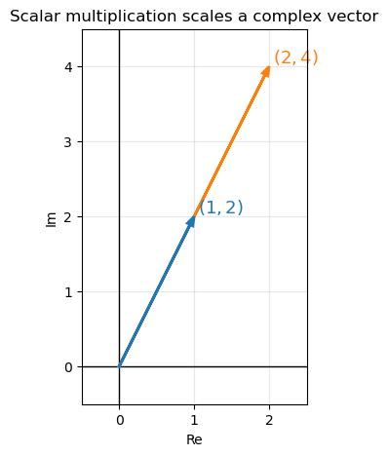
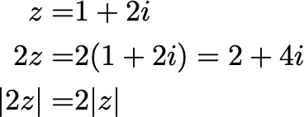

Real
Scalar multiplication
Algebra
Geometry
Multiplication of a complex number by a real scalar lengthens the complex vector
Code to generate figures is available online at: https://github.com/gmfricke/Quantum_Computing/Complex_Geometry

Slide 14
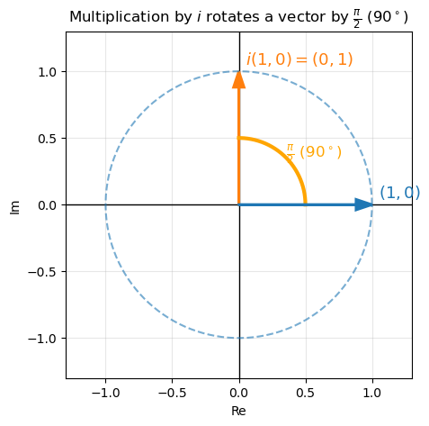


Multiplication
Rotation only
Algebra
Geometry
Multiplication of the real number 1 by the imaginary number i rotates the complex vector by 90 degrees
Code to generate figures is available online at: https://github.com/gmfricke/Quantum_Computing/Complex_Geometry

Slide 15
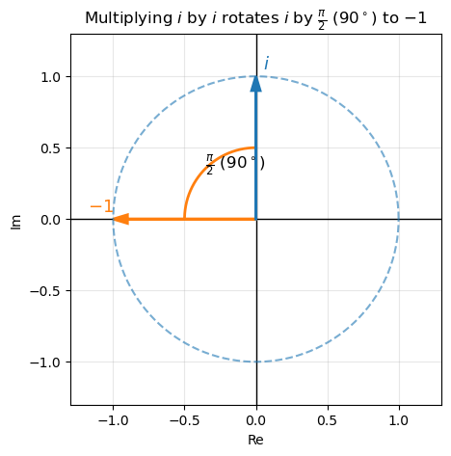


Multiplication
Rotation only
Algebra
Geometry
Multiplication of the imaginary number i by itself rotates the complex vector by 90 degrees
Code to generate figures is available online at: https://github.com/gmfricke/Quantum_Computing/Complex_Geometry

Slide 16
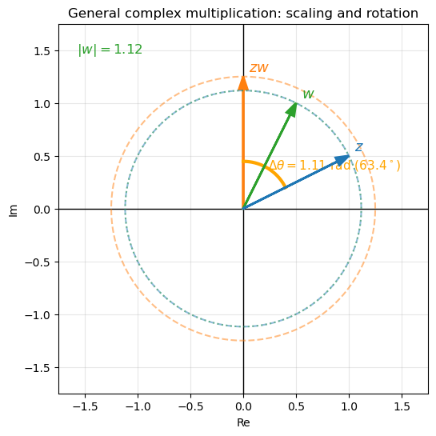
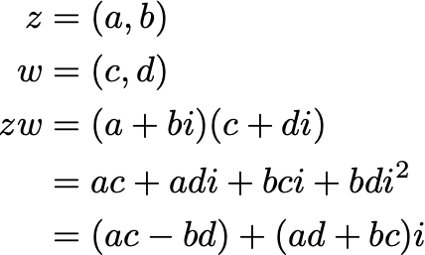

Algebra
Geometry
In general multiplying complex vectors together results in a stretched and rotated output vector.
Code to generate figures is available online at: https://github.com/gmfricke/Quantum_Computing/Complex_Geometry

Slide 17
Algebra
Geometry
We have two simple rules:
When you multiply two complex numbers, the length of the result is the product of their lengths.
The argument of the product is the sum of their arguments.
Code to generate figures is available online at: https://github.com/gmfricke/Quantum_Computing/Complex_Geometry

Slide 18



Algebraic derivation of the modulus product rule

Slide 19



Algebraic derivation of the modulus product rule

Slide 20

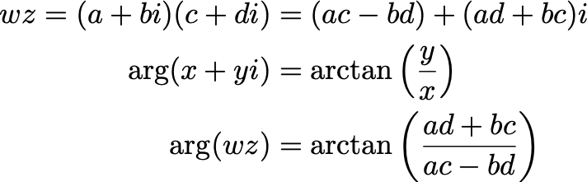
Algebraic derivation of the ARGUMENT product rule

Slide 21



Algebraic derivation of the ARGUMENT product rule
Trig identity

Slide 22



Algebraic derivation of the ARGUMENT product rule

Slide 23

Algebraic derivation of the ARGUMENT product rule
AND

Slide 24


Complex multiplication
Now we have a way to relate any two vectors in the complex plane:
tells you the difference in length
tells you the difference in rotation
We are thinking of an algebraic and geometric objects.

Slide 25

Powers
Yes, these are both modulus: Mathematicians are bad at inventing new names
Exponentiation is repeated multiplication.
We already know a couple of things from properties of multiplication:
Each multiplication by z scales by |z|
Each rotation by z adds arg(z)
We don’t have a general formula for exponentiation yet, we will move to polar coordinate for that later
Notes:
k

Slide 26
Powers
Sanity checks:
Quantum evolution preserves length, so only rotations are allowed.

Slide 27



Inverse of powers
Real numbers have two senses of inverse:
Fixed exponent, solve for the base
This is taking the nth root.
Fixed base, solve for the exponent:
These are functions:

Slide 28

Inverse of powers
Roots and logarithms of complex numbers have more than one possible value.
The multi-valued nature of roots is fundamentally because complex numbers live in a plane, not a line like the real numbers do.
On the real number line there is a strict ordering and no angles between values.
Values on the complex plane have an argument (angle) and modulus (length).
Since we have angles between numbers and angles wrap (mod 2π) then we can have several output values
Logs and roots of complex numbers are therefore not single-valued functions; they are set-valued mappings, where the output is a subset (an element of the powerset of inverses) of complex numbers consisting of all possible inverses.

Slide 29
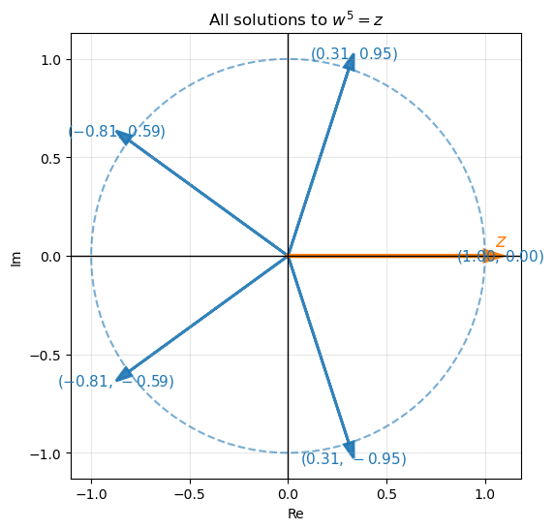
Inverse of powers
There are 5 solution vectors to the problem of finding the fifth root of z (4 blue and one under the orange vector.)
We have been using cartesian algebraic representations for the geometry of the complex plane.
Since length and rotation (modulus and argument) are how we are thinking of complex numbers there is another way of mapping geometry to algebra: polar coordinates.

Slide 30
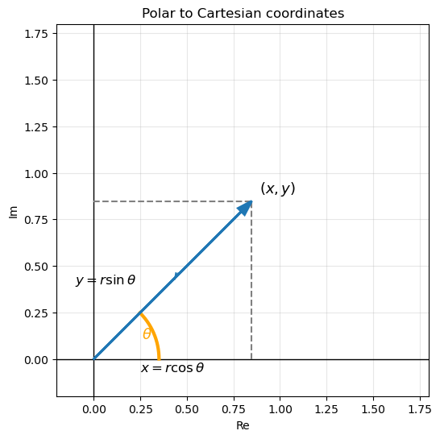

Inverse of powers
The mapping between polar and cartesian coordinates is:

Slide 31
Multiplication in
Cartesian form:
Polar form:
In Cartesian form, multiplication produces terms like ac and ad, whose geometric meaning is not immediately clear.
In polar form, multiplication corresponds directly to multiplying lengths and adding angles, which gives a clear geometric interpretation.

Slide 32
Powers in
Since complex multiplication in polar form is
Exponentiation is just:
Exponentiation scales the length by r^{n} and multiplies the angle by n.

Slide 33
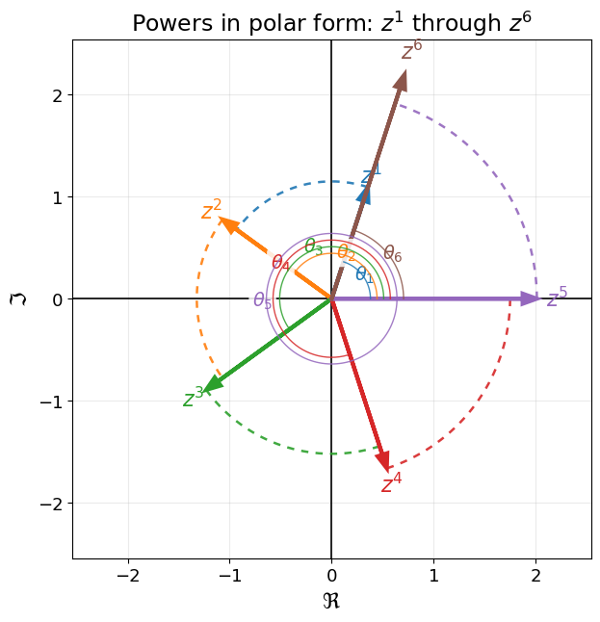
Powers in
Exponentiation is just:
Exponentiation scales the length by r^{n} and multiplies the angle by n.
The modulus and argument of the vector result of each successive power increases.
This is De Moivre’s formula

Slide 34
Powers in
De Moivre’s formula
Exponentiation is just:
In Quantum Mechanics we restrict the vectors to have modulus 1. I.e they define a unit circle.
In which case the formular can drop the modulus

Slide 35
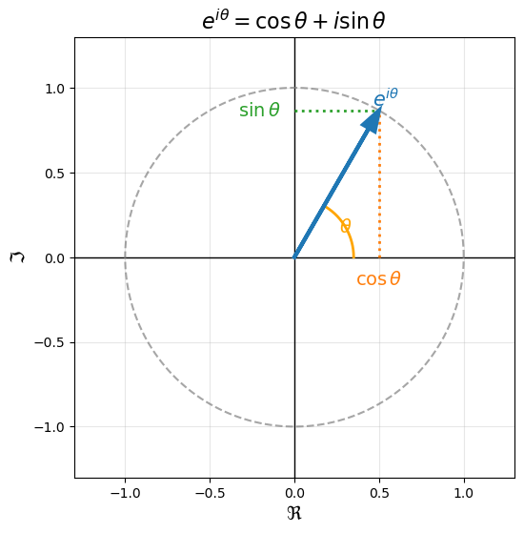
Powers in
Euler’s formula
De Moivre tells us what happens when we raise a rotation to an integer power.
Euler’s formula tells us how to describe rotation itself.
The following is how Euler proved it. But proofs are just an argument that convinces your reader.
The following proof is no longer considered rigorous.

Slide 36

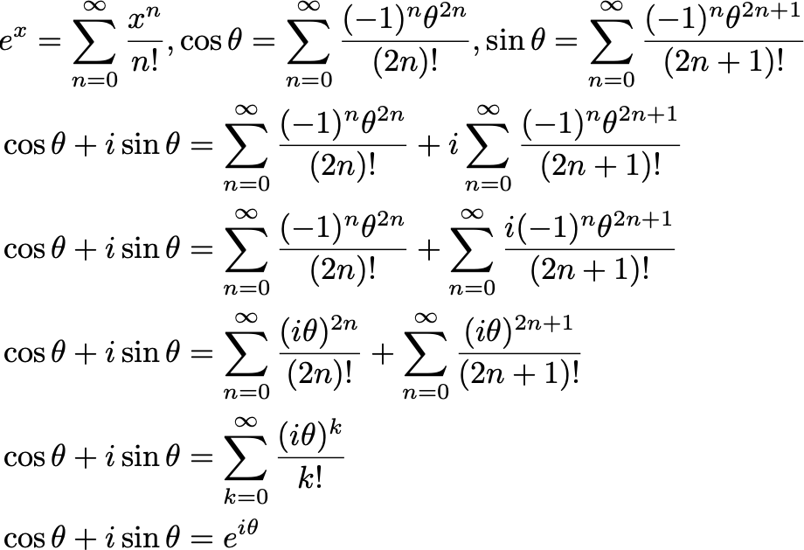
Powers in
Euler’s Proof* (1740s)
Series definitions
Substitute series
Distribute i into second sum
Use i^{2n}=(-1)^{n}
Combine even and odd terms
Well, that’s interesting!
*Euler predates Karl Weierstrass, whose development of real analysis established modern standards of rigor for proofs involving infinite processes.

Slide 37


Phase (preview)
In quantum computing, the angle (argument) of a complex number is called its phase.
Some of the properties of quantum computing that are most powerful depend on the relative phase of a qubit:
The relative phase of the qubit’s components a and b is given by:

